Slide 1

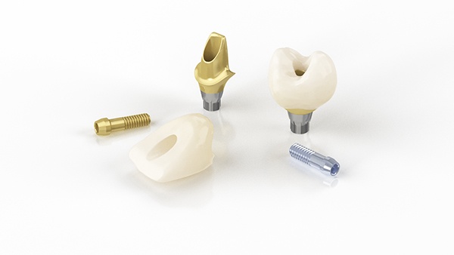
Accurate, convenient control
Atlantis® CustomBase solution for screw-retained restorations
32671212-USX-1701 © Dentsply Sirona 2017
Notes:
Accurate, convenient control
Atlantis CustomBase solution for screw-retained restorations
from Dentsply Sirona

Slide 2

Atlantis® CustomBase solution
First true patient-specific, two-piece screw-retained solution
Patient-specific solution
  Customized emergence profile for enhanced soft-tissue management
  Placement of material junction considering biological principles
  Optimized retention and design
  Patient-specific design of core height
Flexibility of materials
  gold-shaded titanium and titanium abutments
For your choice of implant systems¹
1. Refer to the Atlantis abutments implant compatibility chart.
Notes:
Something unique is happening with screw-retained solutions. Innovations are changing the landscape. For the first time, a patient-specific screw-retained solution has been developed. The Atlantis CustomBase solution features an Atlantis Abutment and Atlantis Crown with a customized emergence profile,
available in titanium or gold-shaded titanium and compatible with your choice of implant systems¹. Are you ready to take control?
Atlantis CustomBase solution - First true patient-specific, two-piece screw-retained solution
Patient-specific solution
Customized emergence profile for enhanced soft-tissue management
Placement of material junction considering biological principles
Optimized retention and design
Patient-specific design of core height
Flexibility of materials
Gold-shaded titanium and titanium abutments
For your choice of implant systems¹
1. Refer to the Atlantis abutments implant compatibility chart.

Slide 3
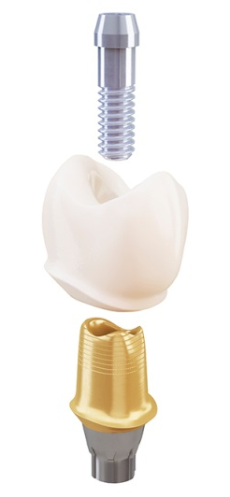
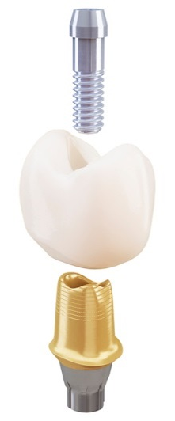
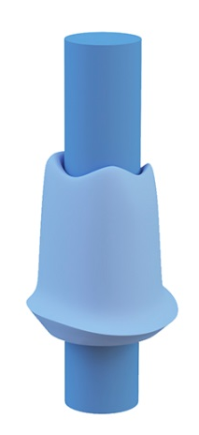
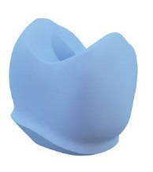
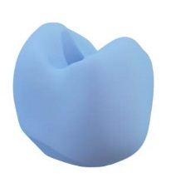
All together now
– Atlantis® CustomBase solution for screw-retained restorations
Atlantis® Crown,
Cut-back and Full-contour
Atlantis® Abutment
Atlantis® Crown File
Atlantis® Core File
Notes:
All together now – Atlantis® CustomBase solution for screw-retained restorations
Atlantis CustomBase solution is available for single-tooth, screw-retained restorations on all major implant systems¹.
CustomBase solution combines an Atlantis Abutment together with
an Atlantis Crown with a screw access hole.
The crown is cemented to the abutment extraorally and screw-retained to
the implant to avoid potential complications caused by excess cement.
Atlantis Abutment is FDA-compliant and supported by a comprehensive warranty.
The Atlantis Crown with screw access hole is ordered from Dentsply Sirona
at the same time as the Atlantis Abutment.
The crown can be ordered in a cut-back version for porcelain veneering or
as a full-contour version for staining and glazing of the crown.
The crown is available in 13 different translucent shades of zirconia or
as a “ready-to-mill” digital file.
As an alternative, a core file with a screw access hole indicated can be ordered together with the Atlantis Abutment, for crown production by the dental laboratory. Atlantis Core File (a digital file of the total case, including the outer surface of the Atlantis Abutment) is easy to import into the design software.

Slide 4
Atlantis® Abutment
Unique, patient-specific abutment
  Customized emergence profile for soft-tissue esthetics
  Built-in anti-rotational features created
  by Virtual Atlantis® Design (VAD) software
  Patient-specific design of core height
  Optimal placement of material junction
Available in biocompatible materials,
including titanium and gold-shaded titanium
Notes:
Atlantis® Abutment
A uniquely designed, patient-specific abutment for single tooth, screw-retained restorations. Built-in anti-rotational features created by the patented Virtual Atlantis Design (VAD) software and a retentive abutment surface. Available in biocompatible materials, including titanium and gold-shaded titanium.

Slide 5
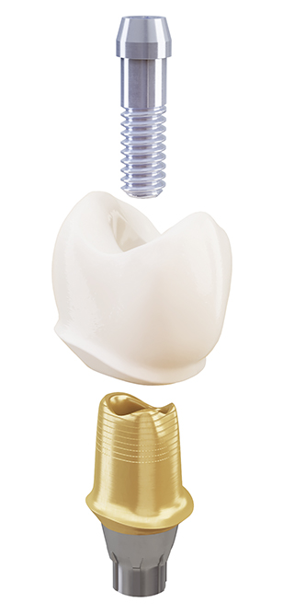
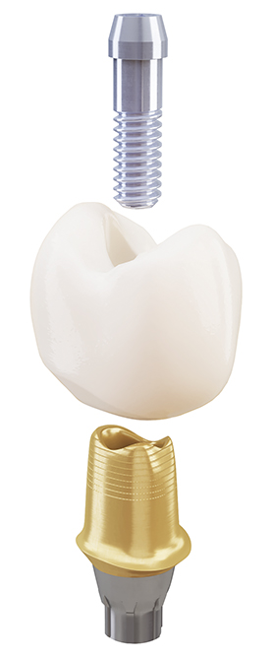
Atlantis® Crown,
Cut-back and Full-contour
Atlantis Crown with a screw access hole
can be ordered at the same time as
the Atlantis Abutment
Available in cut-back version for porcelain
veneering or as a full-contour for staining
and glazing the crown
Fixed cement space of 40μm
Crown is cemented extraorally
Available in 12 different shades of zirconia
and one white zirconia
Notes:
Atlantis® Crown, Cut-Back and Full-contour
The Atlantis Crown with a screw access hole can be ordered at
the same time as the Atlantis Abutment. The crown is available in a
cut-back version for porcelain veneering or as a full-contour version
for staining and glazing the crown. With a fixed cement space of
40 μm, the crown is cemented extraorally to the Atlantis Abutment to
avoid potential complications caused by excess cement. Available in
12 different translucent shades of zirconia and one white zirconia to
resemble the shades on the Vita shade guide.

Slide 6
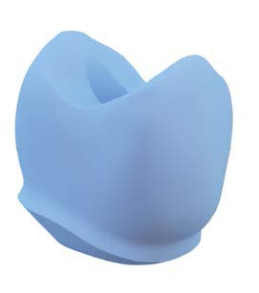

Atlantis® Crown File
Ready-to-mill digital file of the cut-back
or the full-contour crown design
Patient-specific design
Designed in Virtual Atlantis Design (VAD) software
Easily downloaded to customer’s software
Crown is milled in the dental laboratory
Notes:
Atlantis® Crown File
The Atlantis Crown File is a patient-specific, “ready-to-mill” digital file of
the cut-back or the full-contour crown design. Designed in the patented
Virtual Atlantis Design (VAD) software, the crown file is downloaded to
the customer’s software, and the crown is milled in the dental laboratory.

Slide 7

Atlantis® Core File
A digital file of the total case including
the outer surface of the Atlantis Abutment
Screw access hole indicated
Easy to import into the design software
– more effective laboratory workflow
Crown is milled in the dental laboratory
Notes:
Atlantis® Core File
The Atlantis Core File with a screw access hole indicated can be ordered together with the Atlantis Abutment for crown production in the dental laboratory. Atlantis Core File (a digital file of the total case, including the outer surface of the Atlantis Abutment) is easy to import in the design software.

Slide 8
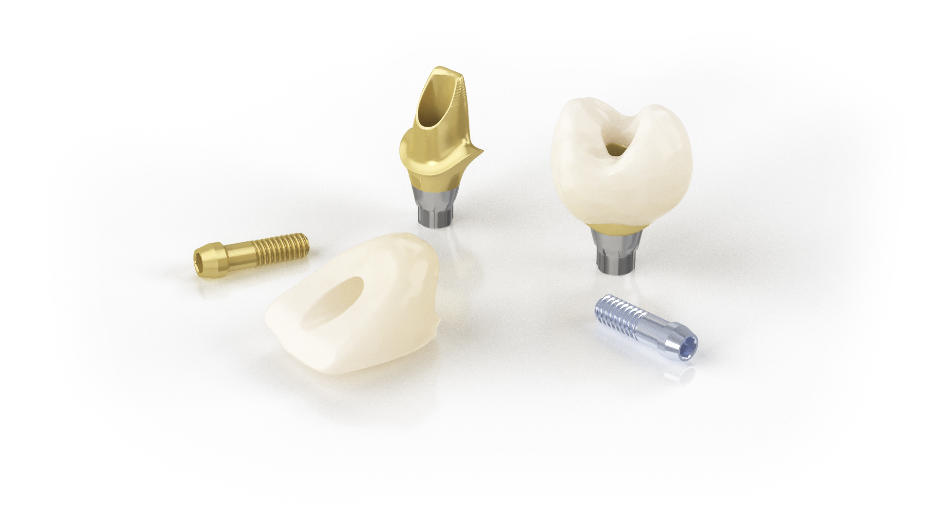
Outstanding flexibility in your workflow
A choice of using your own crown design
and crown milling capacity by utilizing
Atlantis Core File or Atlantis Crown File
Free up skilled dental technician’s time
for other tasks
A business model that is less vulnerable
in peak seasons
Notes:
Outstanding flexibility in your workflow
No investment in or maintenance of additional equipment and software
A choice of using your own crown design and crown milling capacity by utilizing Atlantis Core File or Atlantis Crown File
Free up skilled dental technician’s time for other tasks
A business model that is less vulnerable in peak seasons

Slide 9
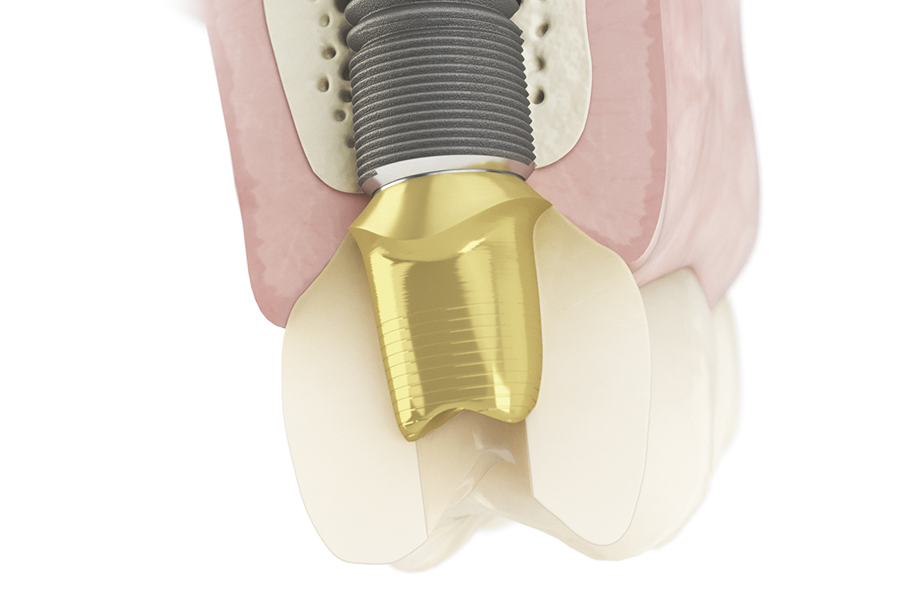
Unique, comprehensive solution
Customized emergence
profile for enhanced
soft-tissue management
Placement of material junction
considering biological principles
Optimized retention and design
Patient-specific design of core height
Notes:
Unique selling points that differentiate an Atlantis CustomBase solution from a stock titanium-base component;
Read from upper left to upper right;
Customized emergence profile for enhanced soft-tissue management
Placement of material junction considering biological principles
Read from bottom left to bottom right;
Optimized retention and design
Patient-specific design of core height
Each unique selling point will be presented on the next coming slides.

Slide 10
Customized emergence profile for enhanced soft-tissue management
  Customized emergence profile
  for enhanced soft-tissue management
  A patient-specific transmucosal emergence profile from implant level to up to the marginal gingiva, is specifically important
  for cases with limited space and when esthetics is in focus¹.
1. Lops D, Bressan E, Parpaiola A, et al. Soft tissues stability of cad-cam and stock abutments in anterior regions: 2-year prospective multicentric cohort study.
Clin Oral Implants Res 2015;26(12):1436-42
Notes:
Customized emergence profile for enhanced soft-tissue management
A patient-specific transmucosal emergence profile from implant level to up to the marginal gingiva, is specifically important
for cases with limited space and when esthetics is in focus¹.
1. Lops D, Bressan E, Parpaiola A, et al. Soft tissues stability of cad-cam and stock abutments in anterior regions: 2-year prospective multicentric cohort study. Clin Oral Implants Res 2015;26(12):1436-42

Slide 11
Placement of material junction considering biological principles
  Placement of material junction
  considering biological principles
  Ensures healthy soft tissue conditions – optimized position of the material junction
  to guarantee adequate peri-implant biological width and maintained
  bone levels¹.
1. Berglundh T, Lindhe J. Dimension of the periimplant mucosa. Biological width revisited. J Clin Periodontol 1996;23(10):971-3
Notes:
Placement of material junction considering biological principles
Ensures healthy soft tissue conditions – optimized position of the material junction to guarantee adequate peri-implant biological width and maintained bone levels¹.
1. Berglundh T, Lindhe J. Dimension of the periimplant mucosa. Biological width revisited. J Clin Periodontol 1996;23(10):971-3

Slide 12
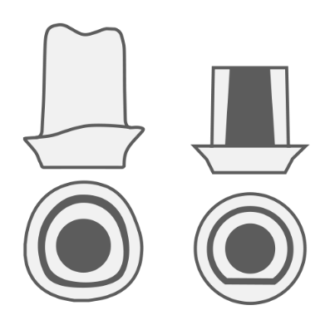
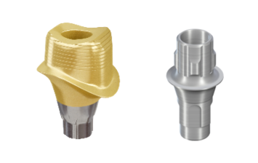
Optimized retention and design
– one size does not fit all
Optimized crown-abutment retention and design
Abutment size and design influences the crown retention¹
– biological shapes are not round or flat
Retention area individually designed to comply with and optimize:
  the total area of crown retention
  the height of abutment core
  crown margin in relation to the soft tissue
  Atlantis CustomBase solution
  vs. Stock titanium-base component
  Biological shapes
  are not round or flat
1. Carnaggio TV, Conrad R, Engelmeier RL, et al. Retention of cad/cam all-ceramic crowns on prefabricated implant abutments: An in vitro comparative study of luting agents and abutment surface area. J Prosthodont 2012;21(7):523-8
Notes:
Optimized retention and design – one size does not fit all
Abutment size and design influences the crown retention¹
– biological shapes are not round or flat
Retention area individually designed to comply with and optimize:
the total area of crown retention
the height of abutment core
crown margin (Cementoenamel Junction - CEJ) in relation to the soft tissue
1. Carnaggio TV, Conrad R, Engelmeier RL, et al. Retention of cad/cam all-ceramic crowns on prefabricated implant abutments: An in vitro comparative study of luting agents and abutment surface area. J Prosthodont 2012;21(7):523-8
Atlantis CustomBase solution vs. Stock titanium-base component
Retention area on Atlanits CustomBase solution (left) is typically considerable larger than a stock titanium-base component (right).
Biological shapes are not round or flat
Atlantis CustomBase solution (left)
Stock titanium-based component (right)

Slide 13
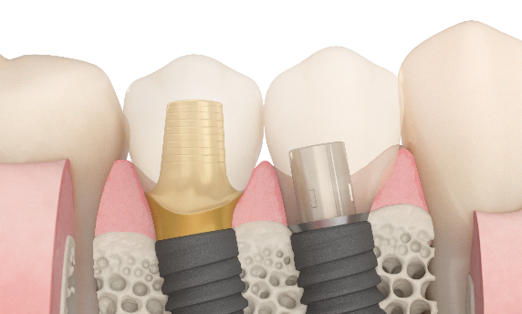
Patient-specific design of core height
  Patient-specific design of core height
  A flexible solution not depending upon
  the implant position, e.g. placed too deep or on a sloped ridge or in cases
  with a lot of soft tissue above the bone or in cases where the intercuspidal space is limited¹.
  Atlantis® CustomBase solution vs. Stock titanium-base component
1. Carnaggio TV, Conrad R, Engelmeier RL, et al. Retention of cad/cam all-ceramic crowns on prefabricated implant abutments: An in vitro comparative study of luting agents and abutment surface area. J Prosthodont 2012;21(7):523-8
Notes:
Patient-specific design of core height
A flexible solution not depending upon the implant position, e.g. placed too deep or on a sloped ridge or in cases with a lot of soft tissue above the bone or in cases where the intercuspidal space is limited¹.
1. Carnaggio TV, Conrad R, Engelmeier RL, et al. Retention of cad/cam all-ceramic crowns on prefabricated implant abutments: An in vitro comparative study of luting agents and abutment surface area. J Prosthodont 2012;21(7):523-8
Atlantis CustomBase solution vs. Stock titanium-based component
Atlantis CustomBase solution (left) can compensate for implant deviation while a stock titanium-based component (right) can not.

Slide 14
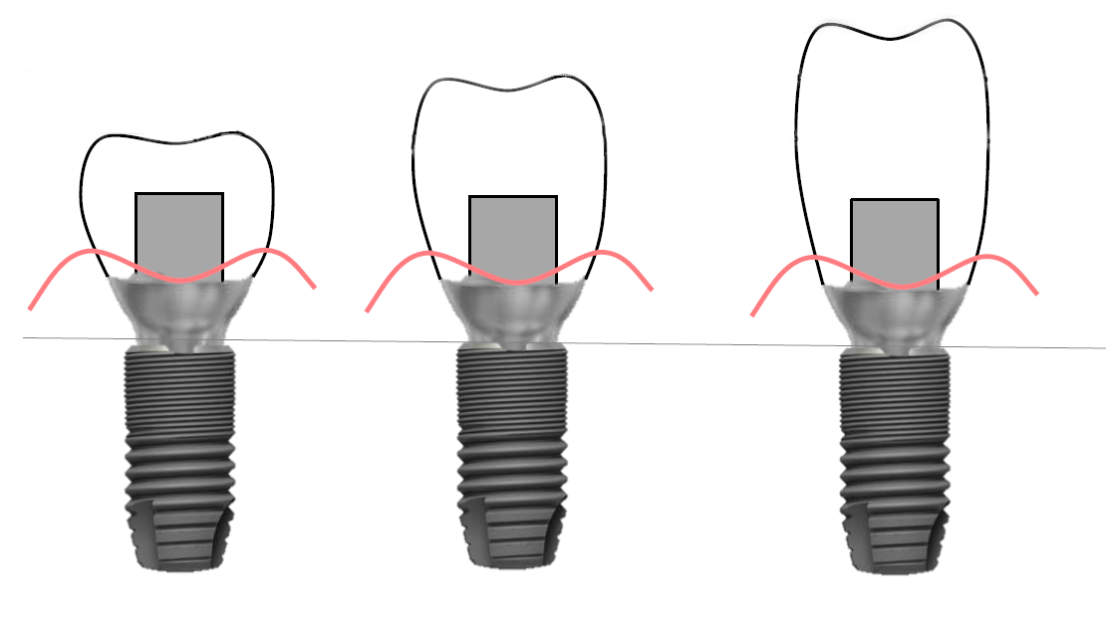
Patient-specific design of core height
  Crown-abutment height ratio is a concern
  With a fixed core height on the stock titanium-base component, the ratio between the crown height and the core is a concern for the strength of the whole restoration.
Courtesy of Dr. Lyndon Cooper, Chicago, USA
Notes:
Patient-specific design of core height
Courtesy of Dr. Lyndon Cooper, Chicago, USA
Crown-abutment height ratio is a concern
With a fixed core height on the stock titanium-base component, the ratio between the crown height and the core is a concern for the strength of
the whole restoration.

Slide 15
Unique, comprehensive solution
Customized emergence
profile for enhanced
soft-tissue management
Placement of material junction
considering biological principles
No need for stock component
Flexibility of abutment material
– titanium or gold-shaded titanium
Optimized retention and design
Patient-specific design of core height
Allows for direct application of porcelain
For extraoral cementation
– avoids potential complications
caused by excess cement
Built-in anti-rotational features created
by the patented Virtual Atlantis Design (VAD) software – facilitates the insertion path of the crown
Notes:
Unique selling points that differentiate an Atlantis CustomBase solution from a stock titanium-base component;
Customized emergence profile for enhanced soft-tissue management
Placement of material junction considering biological principles
Optimized retention and design
Patient-specific design of core height
In addition to the unique selling points for Atlantis CustomBase solution you find other benefits with Atlantis;
No need for stock component
Flexibility of abutment material – titanium or gold-shaded titanium
For extraoral cementation – avoids potential complications caused by excess cement
Allows for direct application of porcelain
Built-in anti-rotational features created by the patented Virtual Atlantis Design (VAD) software – facilitates the insertion path of the crown

Slide 16
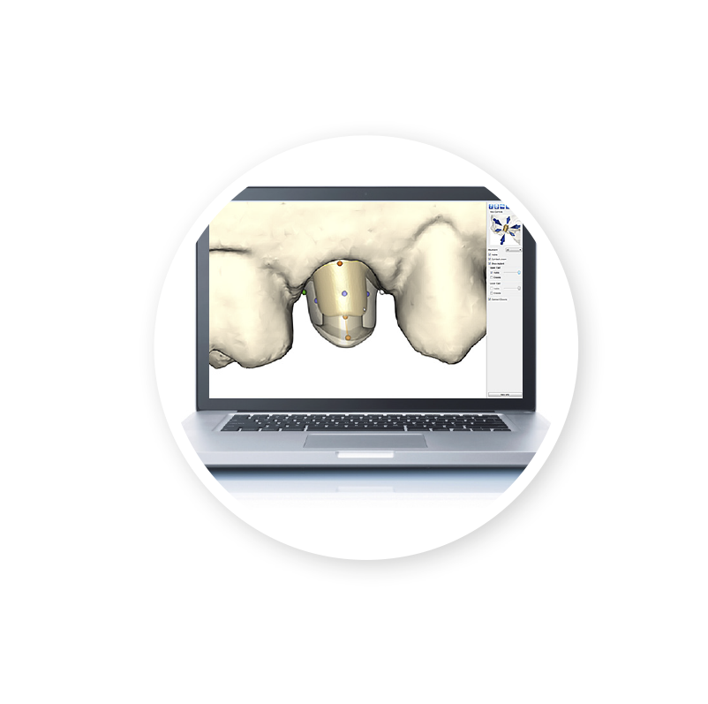
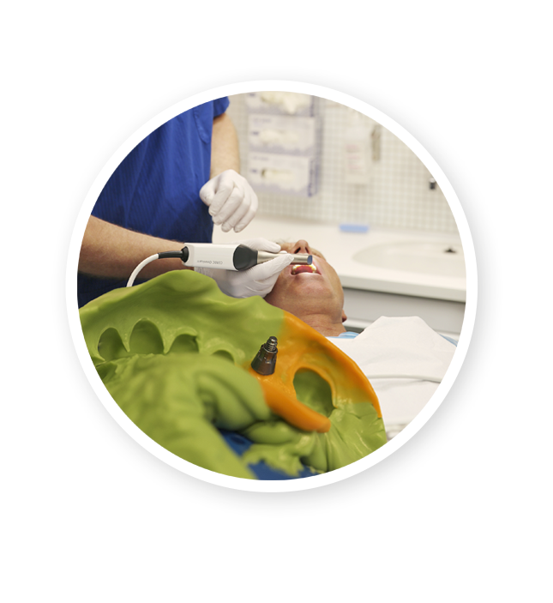

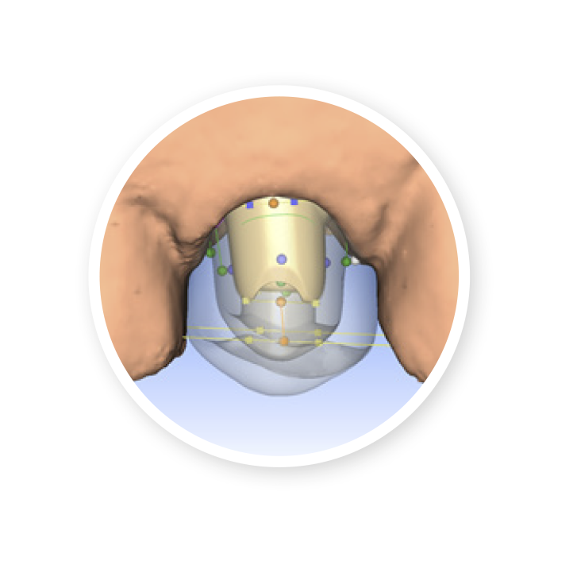
Streamlined digital workflow
– Atlantis® CustomBase solution
Impression
Atlantis® WebOrder
Virtual Atlantis® Design
(VAD) software
Atlantis® Editor
Notes:
Streamlined digital workflow – Atlantis® CustomBase solution
Impression
Conventional or digital impression
Atlantis® WebOrder
Easily order your Atlantis CustomBase solution. Built-in features allow you to adjust porcelain cut-back values and abutment parameters.
Virtual Atlantis® Design (VAD)
Patented design software allows you to take the edentulous space, surrounding teeth and soft tissue anatomy into consideration. The abutment and crown are designed to match the anatomical tooth shape.
Atlantis® Editor
Unique, advanced software enables you to modify the Atlantis Abutment and Atlantis Crown well in advance of the milling process.

Slide 17
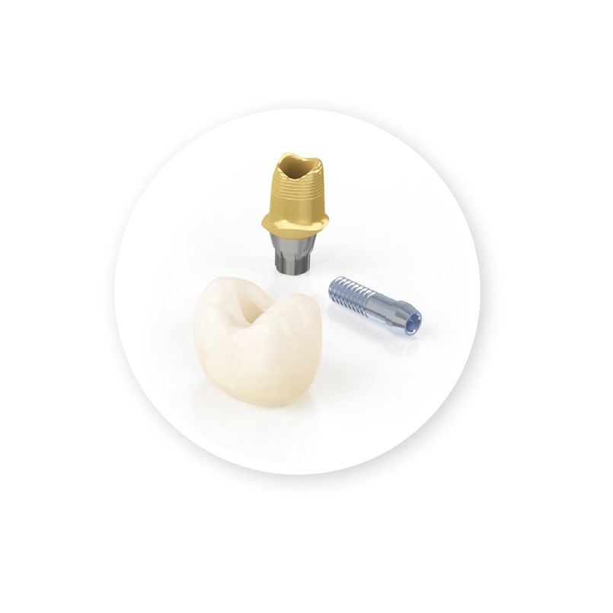
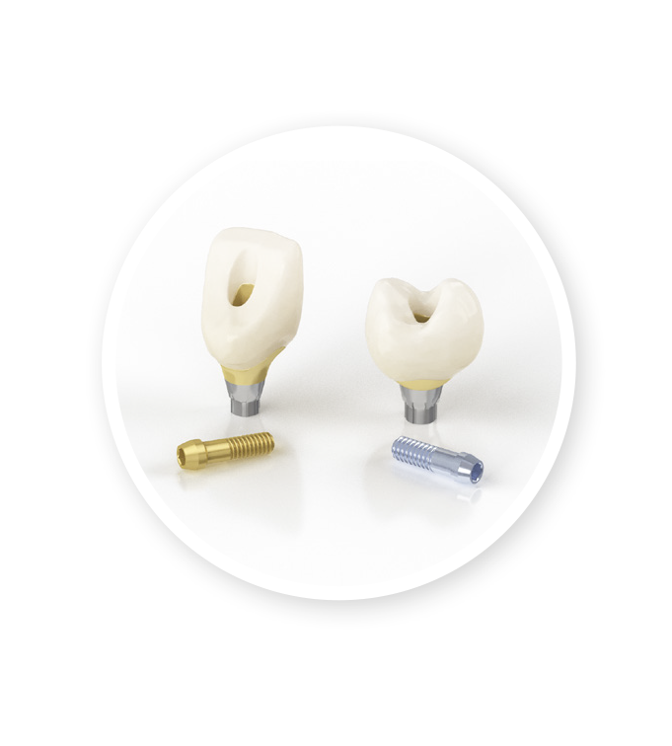
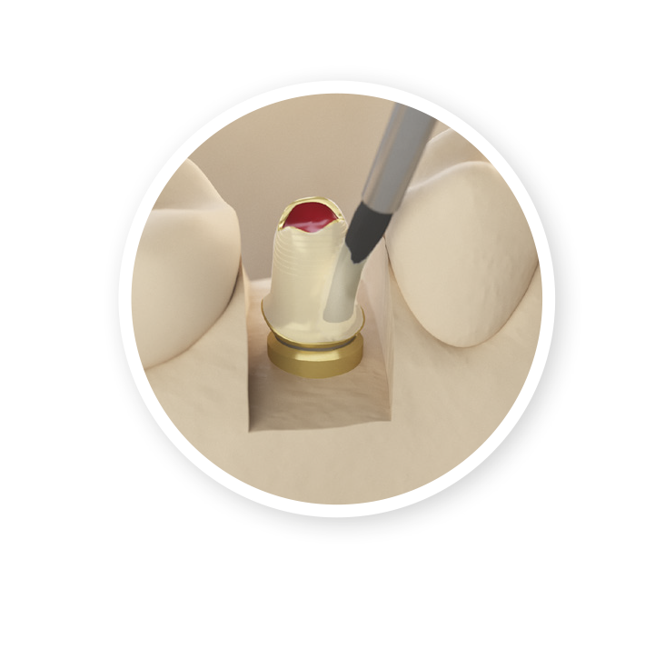
Streamlined digital workflow
– Atlantis® CustomBase solution
Atlantis® CustomBase solution
Extraoral cementation
Installation
Notes:
Streamlined digital workflow – Atlantis® CustomBase solution
Atlantis® solution
The Atlantis CustomBase solution, consisting of an Atlantis Crown, an Atlantis Abutment and an Atlantis Abutment screw, is delivered to the dental laboratory.
Cementation
The crown with a screw access hole is cemented to the abutment extraorally. The Atlantis Crown has a fixed cement space of 40 μm.
Installation
After cementation, the Atlantis CustomBase solution is ready for installation in the patient’s mouth.

Slide 18
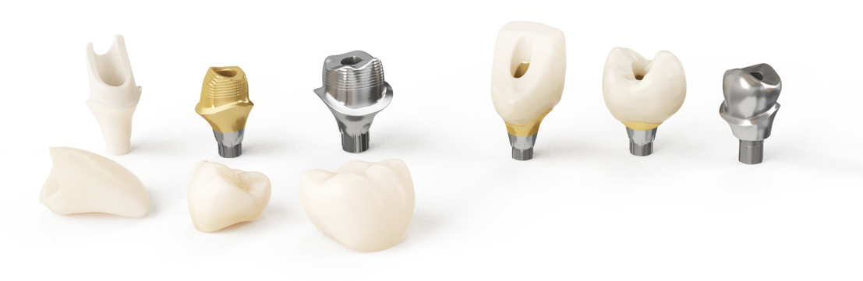
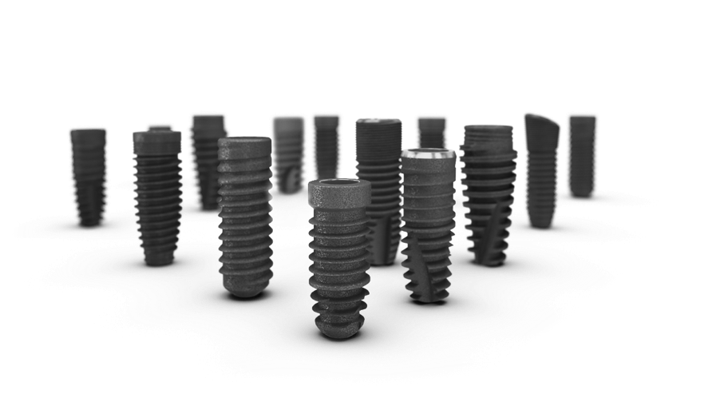
Restorative flexibility
Easily integrate Atlantis solutions into
the way you prefer to work
Compatible with an extensive range of implant connections and an open digital workflow
Notes:
Freedom to choose
Atlantis patient-specific solutions are indicated for all positions in the mouth, and are available for single tooth cement- and screw-retained solutions.
Abutments and crowns come in biocompatible materials including titanium, gold-shaded titanium and different shades of zircona, meeting patient
requirements and preferences for function and esthetics.
Restorative flexibility
With Atlantis solutions, you get an open digital workflow that provides the greatest flexibility for your restorative implant needs. You can easily
integrate Atlantis solutions into the way you prefer to work, facilitating team communication and increasing business profitability. Atlantis solutions
are compatible with an extensive range of implant connections, which allow you to work with your preferred implant system.
All trademarks, company names and implant designs are the property of their respective owners.

Slide 19
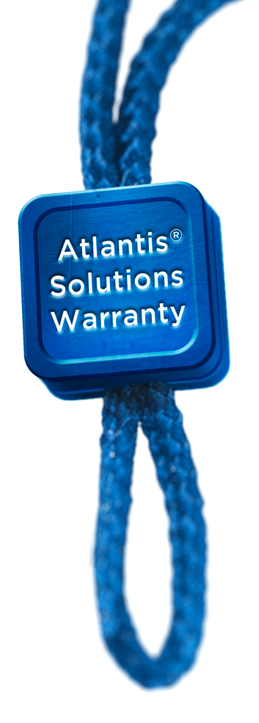
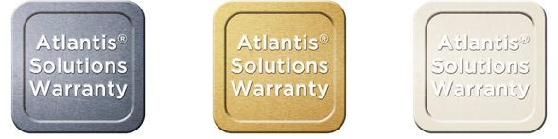
Atlantis Solutions Warranty
If an implant supplier does not honor their warranty, due to the use of Atlantis abutments, Dentsply Sirona will cover both
the abutment, crown and the implant¹.
With its lifetime warranty of titanium abutments, Atlantis abutments comprehensive warranty is unique in the industry.
GOLD-SHADED
TITANIUM
TITANIUM
ZIRCONIA
LIFETIME
LIFETIME
5-YEAR
1. Subject to the terms and conditions of the Atlantis abutments warranty.
Notes:
We’ve got you covered
By choosing Atlantis, you can be assured that the prosthetic solutions you receive are of the highest quality, safety and reliability. This is why Atlantis patient-specific prosthetic solutions come with an exclusive and industry-leading comprehensive warranty program. If an implant supplier does not honor its warranty due to your use of Atlantis abutments, Dentsply Sirona will cover the abutment, the crown and the implant.
1. Subject to the terms and conditions of the Atlantis abutments warranty.

Slide 20
References
Berglundh T, Lindhe J. Dimension of the periimplant mucosa. Biological width revisited. J Clin Periodontal 1996;23(10):971-3. http://www.ncbi.nlm.nih.gov/pubmed/8915028
  ”At sites where the ridge mucosa prior to abutment connection was made thin (< or = 2 mm), wound healing consistently included bone resorption. This implies that a certain minimum width of the periimplant mucosa may be required, and that bone resorption may take place to allow a stable soft tissue attachment to form.”
Carnaggio TV, Conrad R, Engelmeier RL, et al. Retention of cad/cam all-ceramic crowns on prefabricated implant abutments: An in vitro comparative study of luting agents and abutment surface area. J Prosthodont 2012;21(7):523-8. http://www.ncbi.nlm.nih.gov/pubmed/22469271
  ” In addition, abutment size influenced the retention of all-ceramic CAD/CAM restorations”
Finelle G, Papadimitriou DE, Souza AB, et al. Peri-implant soft tissue and marginal bone adaptation on implant with non-matching healing abutments: Micro-ct analysis. Clin Oral Implants Res 2015;26(4):e42-6. http://www.ncbi.nlm.nih.gov/pubmed/24450805
  “The dimension of the horizontal offset would play a minimal role in reducing bone remodeling, whereas the configuration of the transmucosal component would directly influence marginal bone remodeling.”
Lops D, Bressan E, Parpaiola A, et al. Soft tissues stability of CAD/CAM and stock abutments in anterior regions: 2-year prospective multicentric cohort study. Clin Oral Implants Res 2015;26(12):1436-42. http://www.ncbi.nlm.nih.gov/pubmed/25196805
  “In the anterior area, the use of cad-cam abutments is related to a better soft tissue stability. Such a relationship is significant if cad-cam titanium abutments are compared to both titanium and zirconia stock abutments.”

