Slide 1
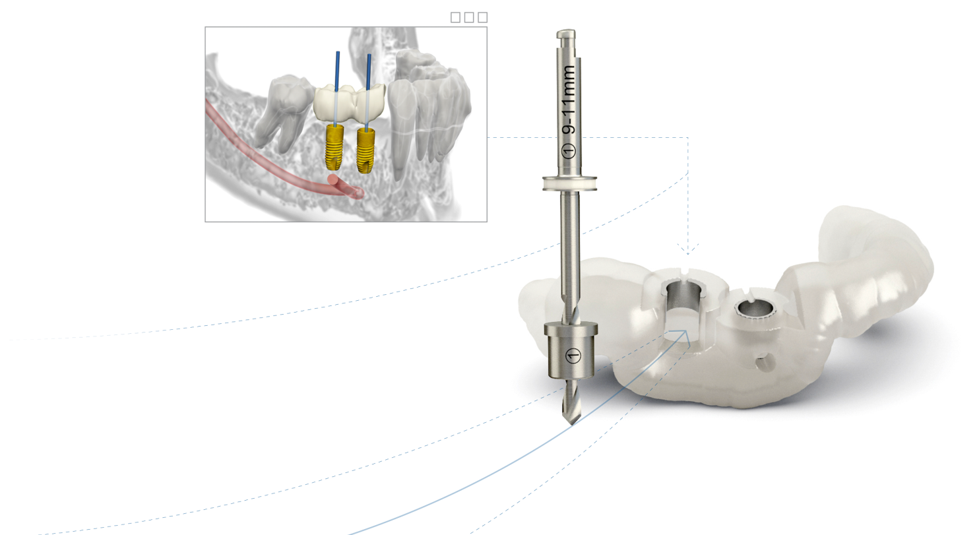
Unlocking digital potential
Simplant computer guided implant treatment with the Astra Tech Implant System EV

Slide 2
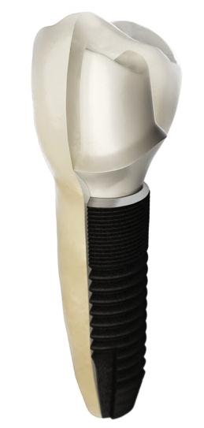
The Astra Tech Implant System EV design philosophy
A site-specific, crown-down approach
  Based upon the natural dentition
  An individual assortment of components
  for each site
Ø 3.0
Ø 3.6
Ø 4.2
Ø 4.8
Ø 5.4
Notes:
The design philosophy of the Astra Tech Implant System EV is based on the natural dentition and utilizes a site-specific, crown-down approach with the desired end result in mind to help ensure a successful outcome.
Multiple considerations are required for each individual tooth; the support needed for the final restoration in the particular position, soft-tissue healing, and implant design and size.
The implant assortment of the Astra Tech Implant System EV provides versatility for meeting the needs of each individual site. This is further supported by corresponding restorative components designed for optimized soft-tissue management and long-term function and esthetics.
The benefit of this approach is an implant system that provides:
A versatile implant assortment providing clinically relevant dimension and designs, which allows you to easily and efficiently manage and adapt to different challenges as they arise.
Restorative components designed to support in all clinical situations and soft tissue sculpturing requirements for final restorations.
Straightforward treatment recommendations for each individual site
A robust implant pillar for each individual site

Slide 3
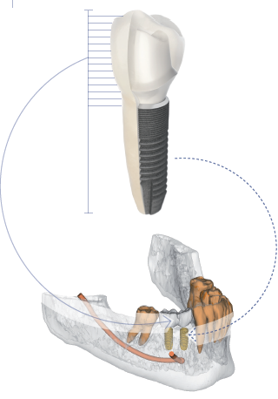
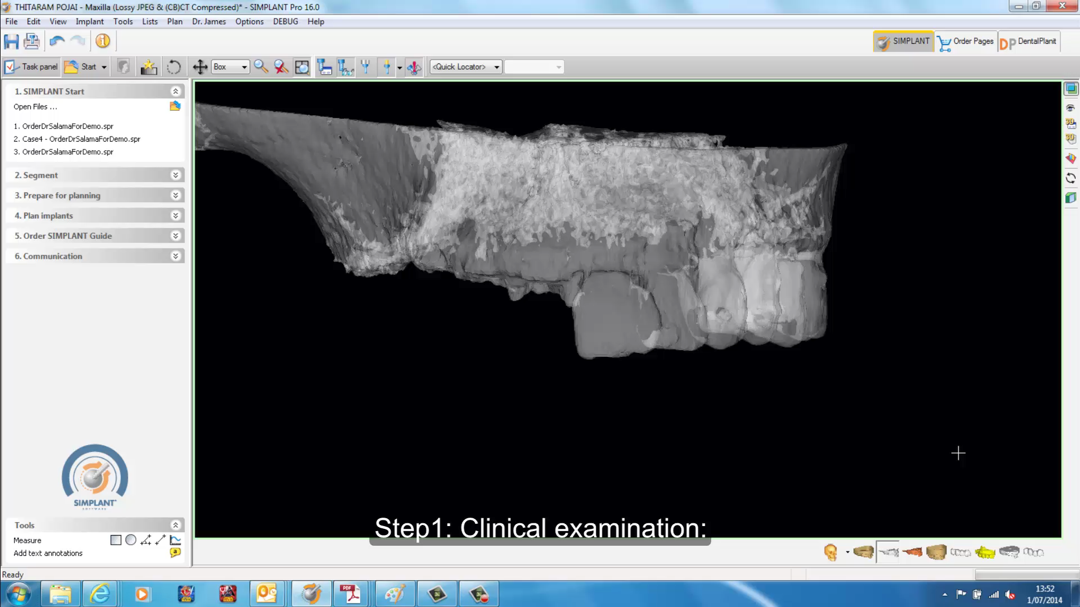
Digitally-driven, crown-down planning
Predictability
Predictable crown-down planning by visualization of the surgical and prosthetic aspects with the Simplant software.
With the courtesy of Dr. Salama and Dr. Garber.

Slide 4
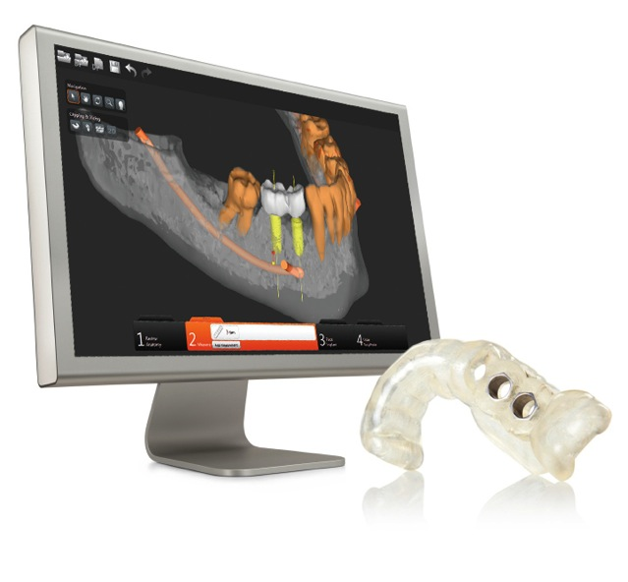
Guided confidence using the Simplant SAFE Guide
Confidence
More precise implant placement with the Simplant SAFE Guide
  Confidence for clinician
  and patient
  Minimally invasive treatment
  Reduced chairtime

Slide 5
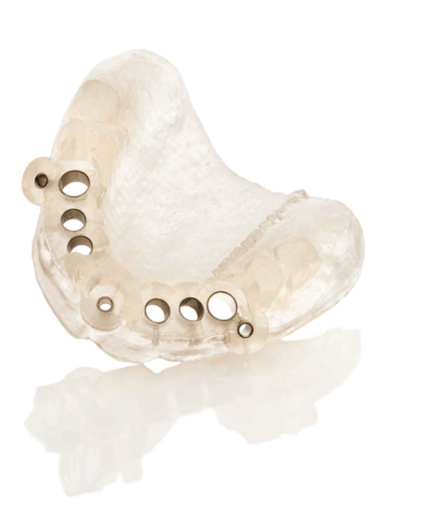
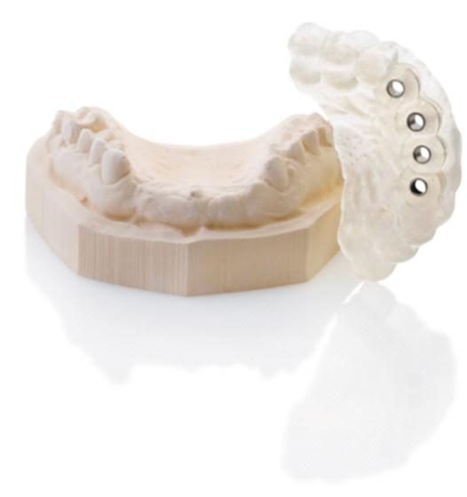
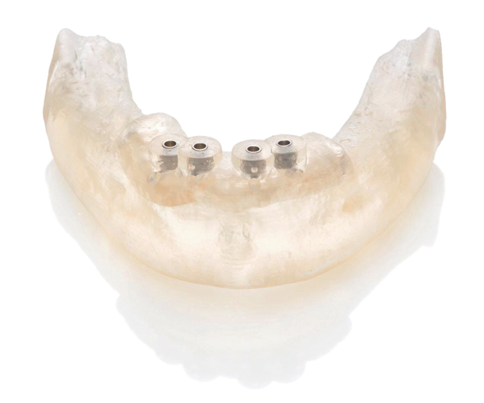
Simplant SAFE Guide options
Flexibility
Tooth-supported
Bone-supported
Mucosa-supported
Notes:
Tooth-supported
Simplant Guide
Placed directly onto the teeth
Recommended for single tooth and partially edentulous cases, when minimally invasive surgery is preferred
Mucosa-supported Simplant Guide
Positioned on the soft tissue
Ideal for fully edentulous cases, when minimally invasive surgery is preferred
Bone-supported
Simplant Guide
Placed on the jawbone
Suitable for partially or fully edentulous cases, when increased visibility is needed

Slide 6
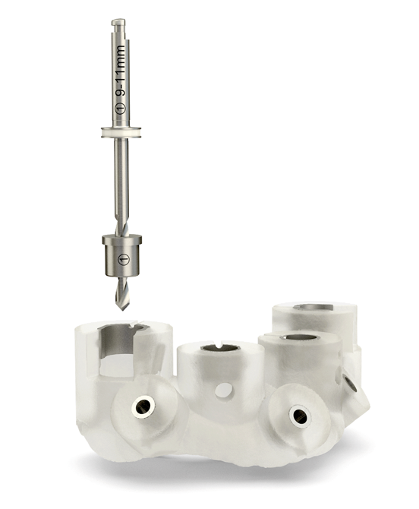
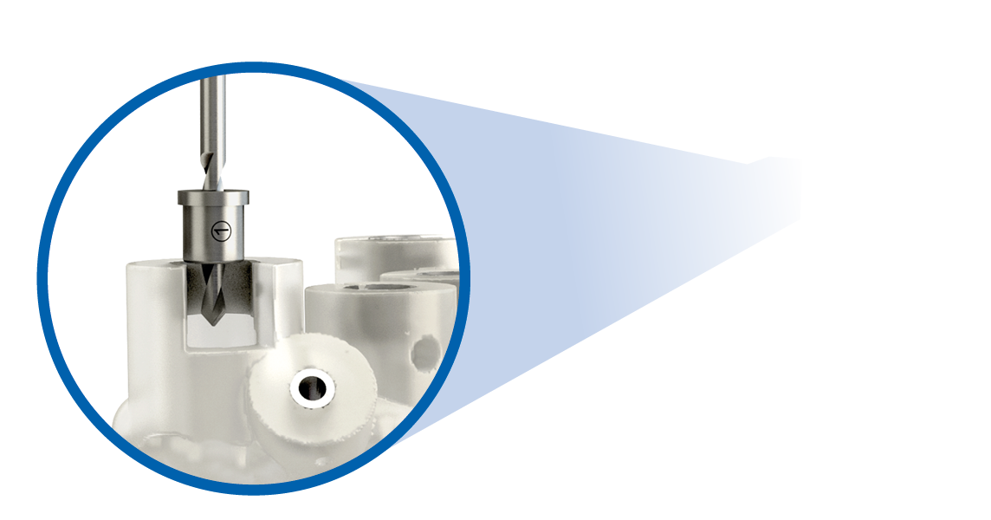
Simplant SAFE Guide
– with lateral access for improved accessibility
Flexibility
*Unique for Astra Tech Implant System EV, Ankylos and Xive implant systems

Slide 7
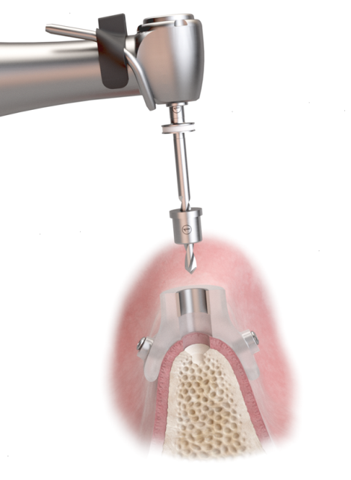
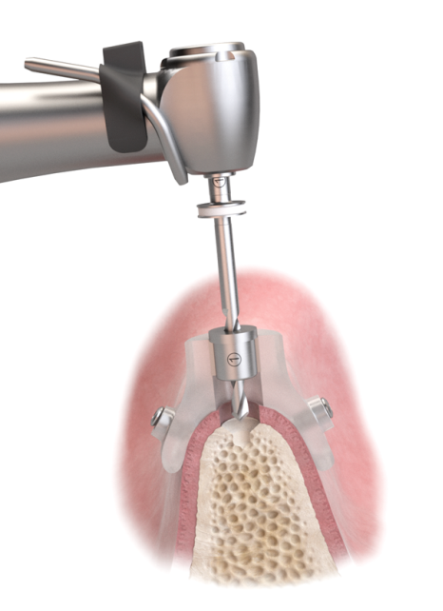
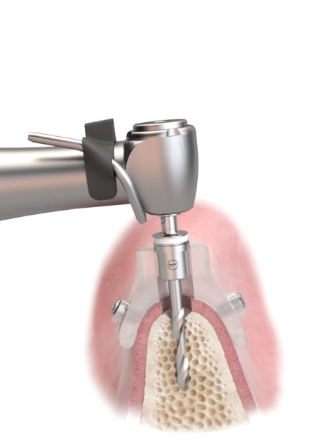
The Sleeve-on-Drill concept
Precision and ease of use
Simplicity
Simple
&
Precise
Sleeve-on-drill instruments for simple and precise drill guidance.
*Unique for Astra Tech Implant System EV, Ankylos and Xive implant systems

Slide 8
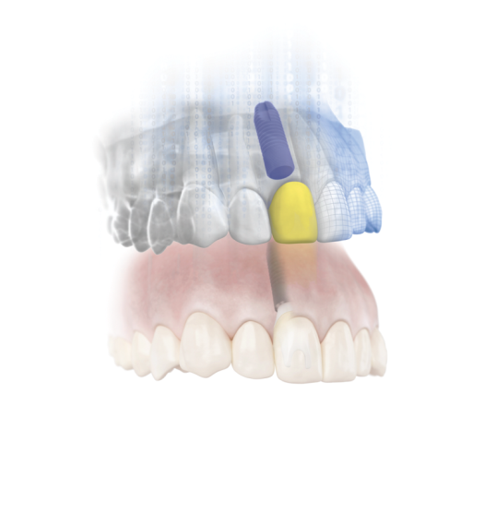
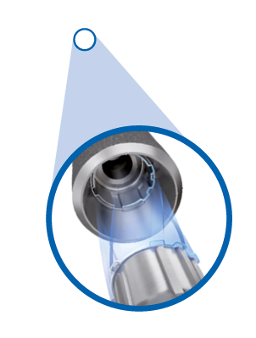
Immediate Smile featuring
Atlantis Abutment
A complete digital workflow
Combines benefits of Simplant guided surgery and Atlantis patient-specific abutment
All components for guided implant placement, Atlantis Abutment and temporary crown are delivered prior to implant installation
Now with the unique one-position-only placement for a simple restorative procedure
One-position-only placement of
Atlantis abutments
Only for Astra Tech Implant System EV
Only for Astra Tech Implant System EV

Slide 9
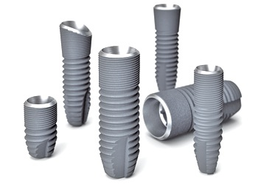
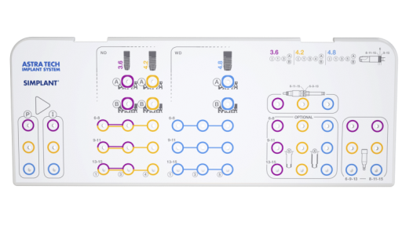
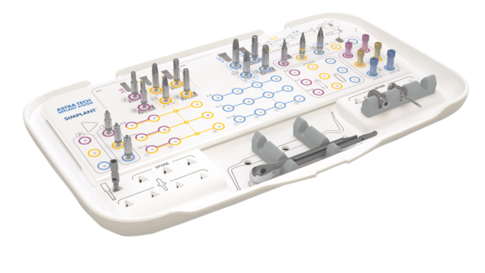
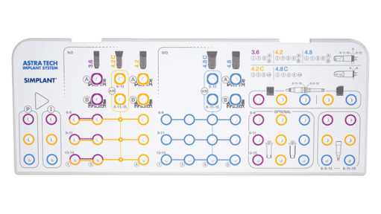
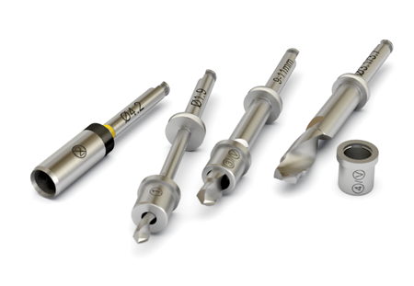
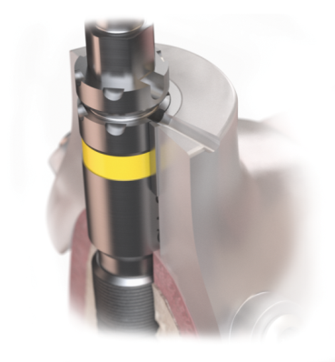

Guided surgery components
– highlights
Simplicity and flexibility
Interchangeable overlays
Versatile implant designs
User-friendly tray
Components designed to support a complete digital workflow
An easy and straightforward drilling procedure
Customized ordering system

Slide 10
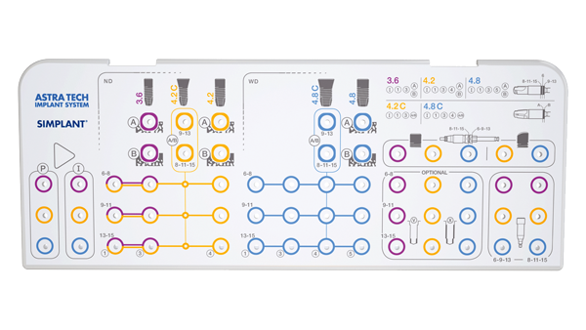

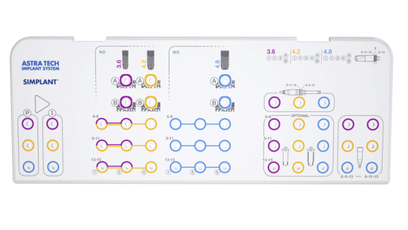
User-friendly tray
Simplicity and flexibility
One tray for all implant designs
  Adaptable according to clinical preference
Color-coded and intuitive layout
Proline Overlay
Streamline Overlay
Notes:
The surgical tray design with two interchangeable overlays allows for adaption of tray content according to your clinical preference. The color-coded tray has an intuitive layout for ease of use, effective handling throughout the surgical procedure and accurate communication among the surgical team.
In addition, the grommet-free tray design simplifies the cleaning process.

Slide 11
Versatile implant designs
Simplicity and flexibility
Simplicity
&
Flexibility
Astra Tech Implant System EV guided surgery components support a unique range of implant designs, including solutions for:
  Limited vertical bone height
  Narrow horizontal and wide spaces*
  Sloped ridge situations**
* 3.0 and 5.4 mm implants are not fully supported with all drilling steps.
**OsseoSpeed Profile EV not yet available.

Slide 12

An easy and straightforward drilling procedure
Simplicity and flexibility
Simplicity
& Flexibility
Based upon the same clinical and logical principles as the standard drilling protocol
The procedure is made simple as a result of the logical numbering and color-coded system

Slide 13
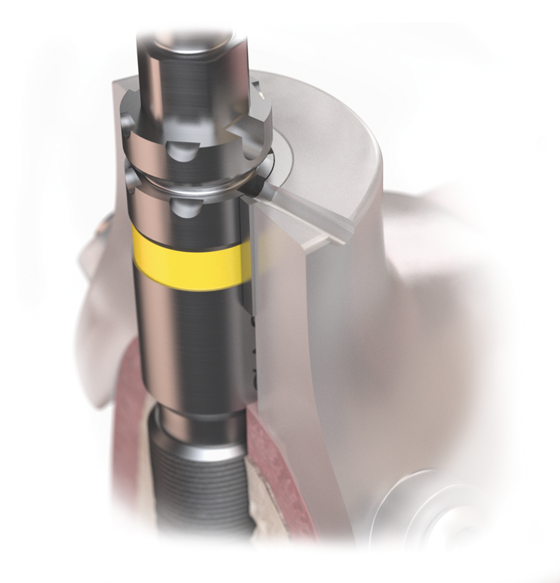
Designed for a complete digital workflow
Simplicity and flexibility
Meeting the needs of a complete digital workflow
Components designed to facilitate one-position-only placement of Atlantis abutments at the time of surgery
  Immediate Smile featuring
  Atlantis abutments
Smart markings on the implant driver to ensure the correct indexing of the implant

Slide 14
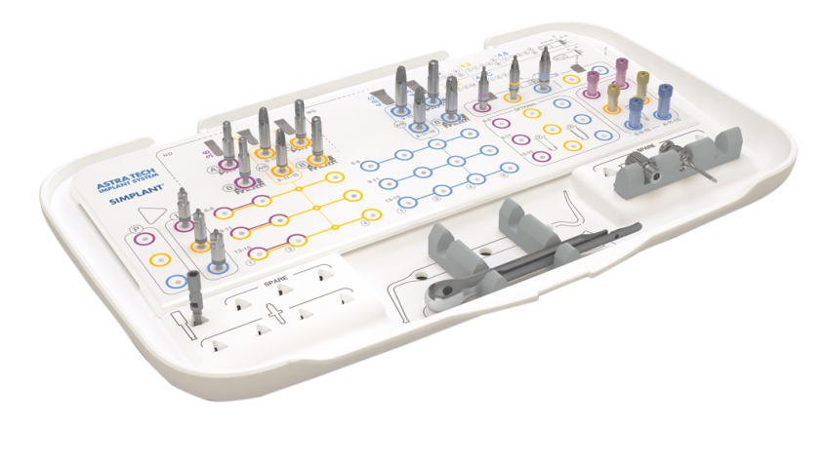
Customized ordering system
Simplicity and flexibility
Simplicity
& Flexibility
The ordering system allows for cost-effective management of your
guided surgery needs
All necessary handling components delivered with the tray and selected overlay
Additional components selected on a case-by-case basis and ordered with
the Simplant SAFE guide

Slide 15
Guided surgery components and instruments
Simplant computer guided implant treatment with the Astra Tech Implant System EV

Slide 16
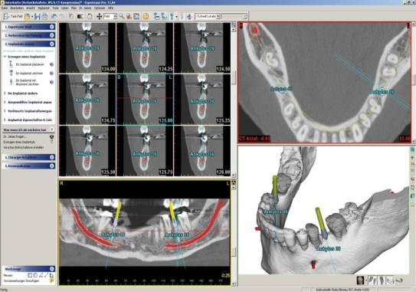
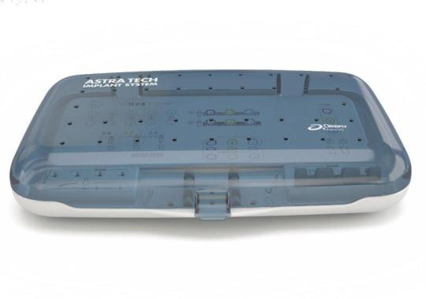
The system
Software | Guide | Instrument & components
Simplant | Simplant SAFE Guide | Astra Tech Implant System EV guided surgery kit

Slide 17
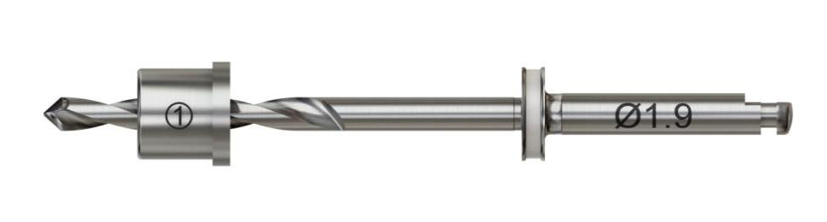
Sleeve-on-Drill concept
Precise and safe
Shortest possible drill used
Easy handling
No “third” hand necessary

Slide 18
The Sleeve-on-Drill concept
Precision and ease of use
Simplicity
Simple
&
Precise
Sleeve-on-Drill instruments for simple and precise drill guidance.
*Unique for Astra Tech Implant System EV, Ankylos and Xive implant systems

Slide 19
Simplant SAFE Guide
– with lateral access for improved accessibility
Flexibility
Flexibility
Simplicity
*Unique for Astra Tech Implant System EV, Ankylos and Xive implant systems

Slide 20
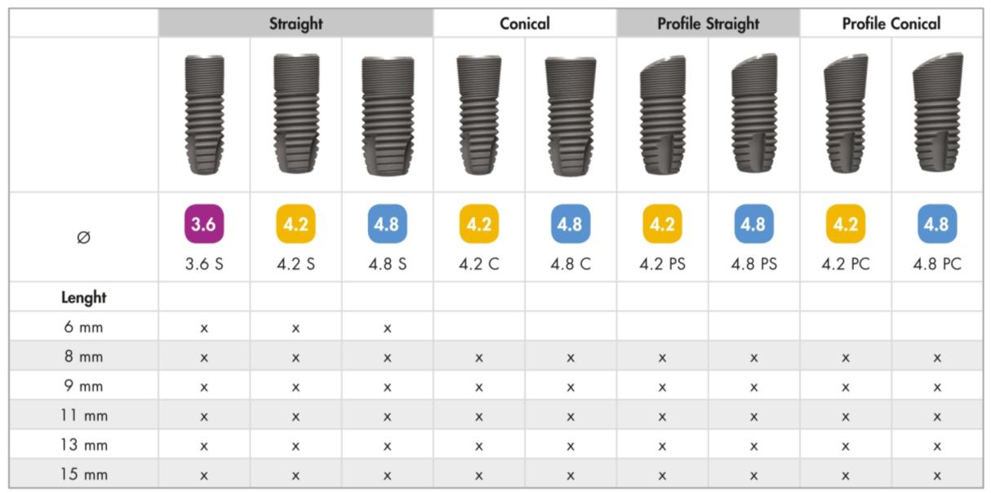
Supported implants and connections
3.0 and 5.4 diameter implants are not fully supported with all drilling steps.

Slide 21

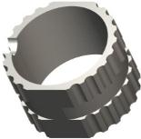
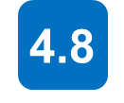
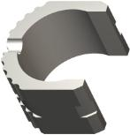
Tube configuration
The two most common implant sizes in same tube:
Closed tubes where mouth opening capacity
is not an issue
  (ND) Narrow Diameter:
  (WD) Wide Diameter:
Open tubes when mouth opening capacity
is limited
Notes:
With open access tubes, clinicians may be able to proceed with guided surgery in cases that otherwise would not have been possible due to patients limited ability to open their mouths wide enough.
A minimum of 4 mms of space can be saved.

Slide 22
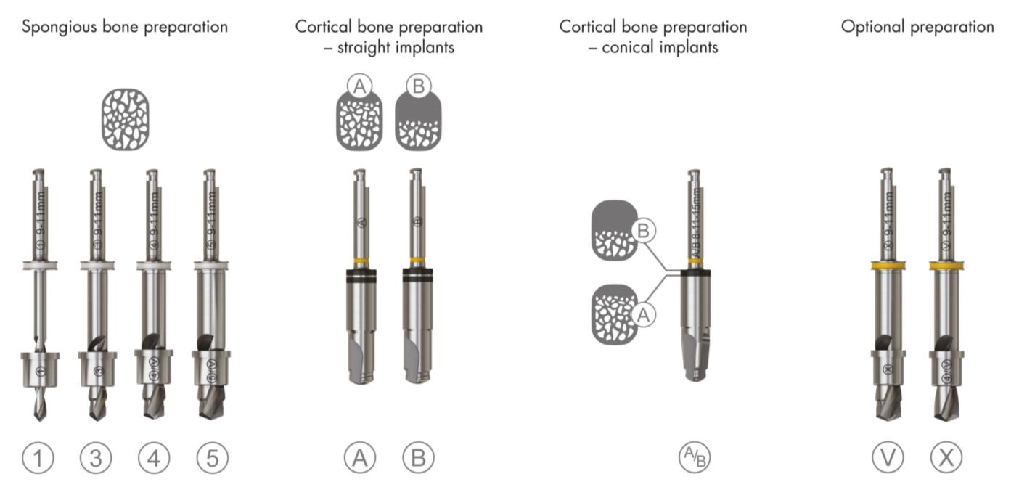


Surgical treatment and drill logics

Slide 23
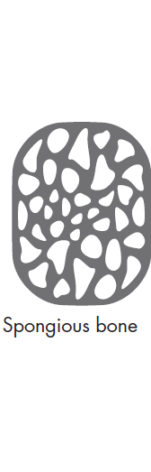
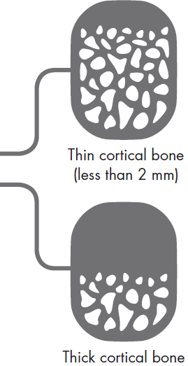
Bone classification
One drilling protocol for preparation of the spongious bone
Two options for preparation of
the cortical bone
Notes:
A unique and simple drilling protocol has been developed to allow for preferred primary stability of the implant:
• One standard procedure that produces a 0.5 mm under-preparation relative to the implant diameter.
• Followed by two options for preparation of the cortical bone based on bone thickness
• In situations when a wider osteotomy preparation is needed, apically and/or along the implant body, additional drills are available.

Slide 24
Drilling protocol
– OsseoSpeed EV Straight

Slide 25
Drilling protocol
– OsseoSpeed EV Conical

Slide 26




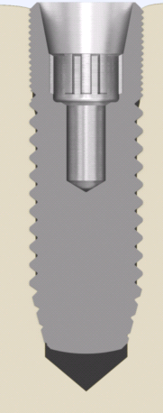
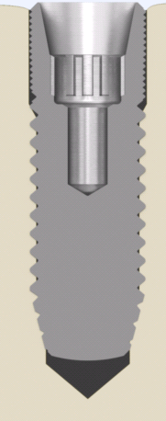
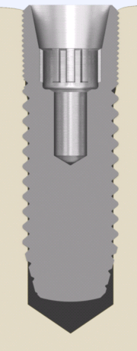
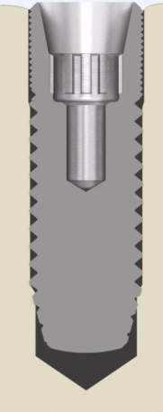
Osteotomy preparation options
– 0.3
– 0.5
– 1.1
– 0.0
– 0.5
– 1.1
– 0.0/ 0.3
– 0.5
– 0.5
– 0.0
– 0.15
– 0.5

Slide 27
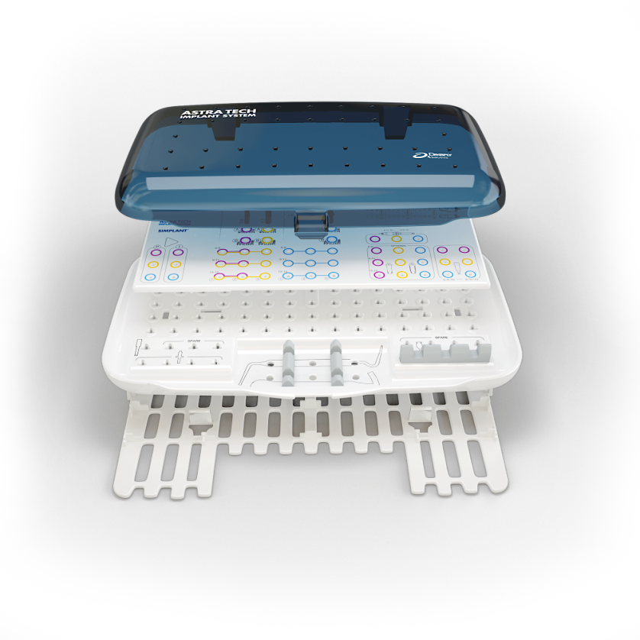
Tray Concept
– one tray for all OsseoSpeed EV implants
Organized to support the user
Color coded and simple layout
Overlay snapped onto the
tray base
Grommet-free tray design
Lid
Overlay
Tray base
Base shield
Notes:
Tray concept
The tray layout and components are organized to support the user throughout the entire surgical procedure.
Tray logics
The color-coded tray has a drill marking system for ease of use and effective handling throughout the procedure, based on the following principles:
One surgical tray – two overlay options
The surgical tray design** with two interchangeable overlays allows for adaption of tray content according to your clinical preferences. The color-coded tray has an intuitive layout for ease of use, effective handling throughout the surgical procedure and accurate communication among the surgical team.
** Patent pending

Slide 28
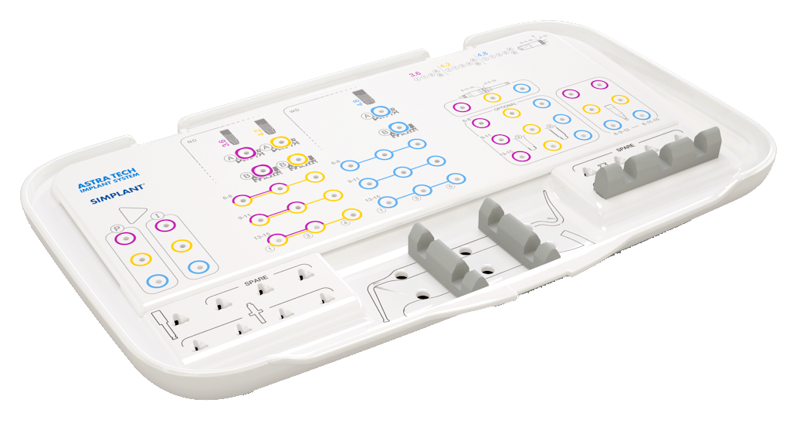


Streamline Overlay

Slide 29
Streamline Overlay

Slide 30
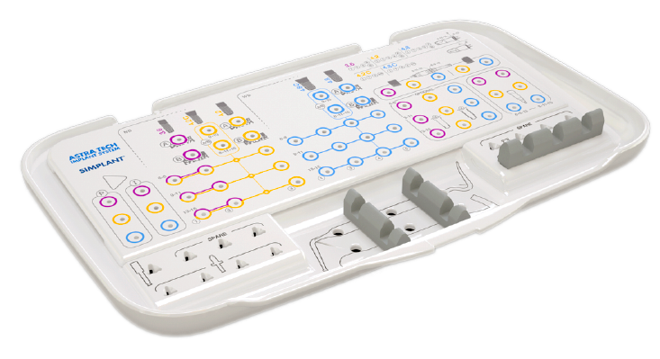



Proline Overlay

Slide 31
Proline Overlay

Slide 32
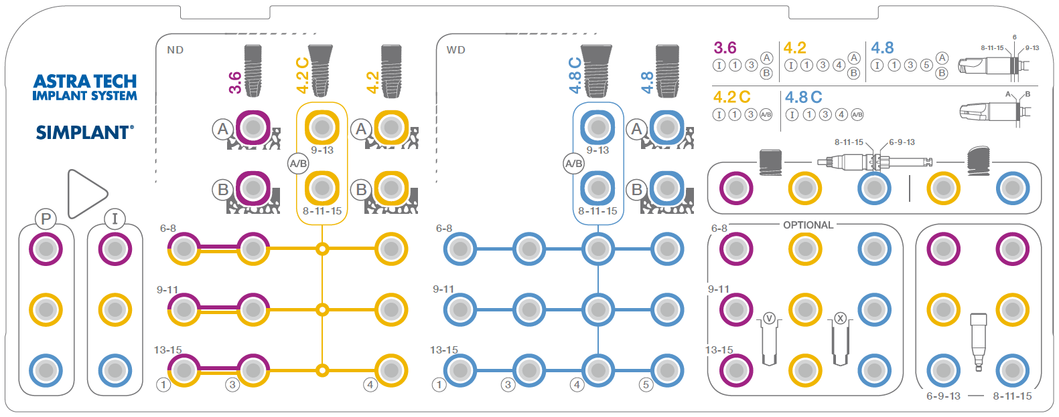
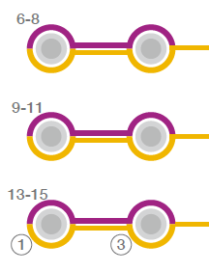
Drills for two implant lengths
Notes:
Each drill accommodates two implant lengths.

Slide 33
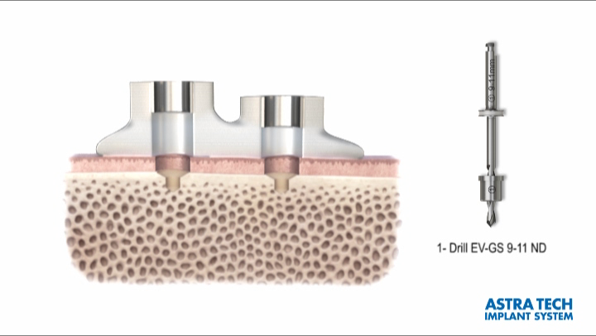
Dynamic Tube position
– spongious bone preparation
Notes:
The tubes are placed at two different heights to support appropriate implant length with one drill. The cylinder on the left is for the 9 mm length implant and the cylinder on the right is for the 11 mm length. PLAY ANIMATION

Slide 34
System logic
Drill Type
Implant Length
Tube diameter
Drill diameter
Notes:
All necessary information is on the components.

Slide 35
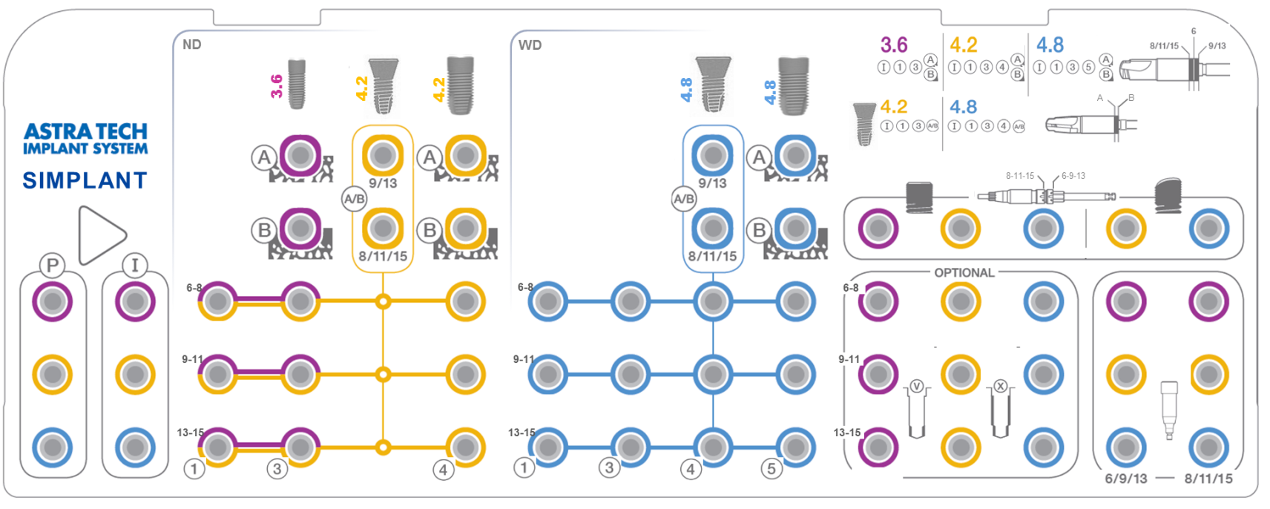
Notes:
Each drill has its appropriate sleeve.

Slide 36
Notes:
The 3 and 4 drill sleeve can also be utilized on the V drill.

Slide 39
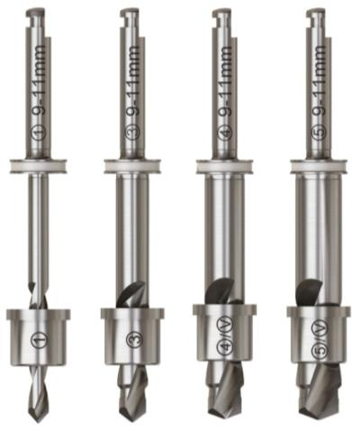
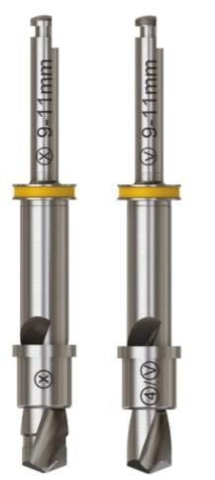
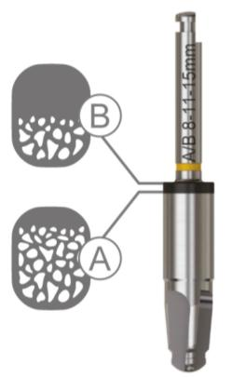

Depth control principles
Drills for spongious bone preparation
  Physical depth stop
Drills for cortical bone preparation
  Depth laser marks

Slide 40
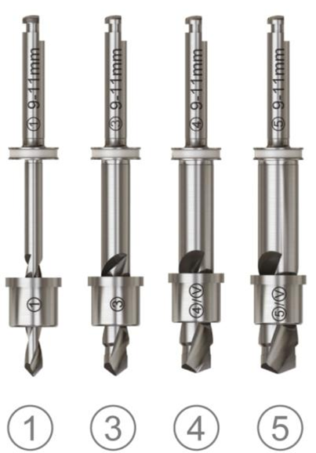
Spongious bone preparation
Physical depth stop
Sleeve-on-drill concept
Laser marking: drill diameter and number, implant length and diameter
Drill lengths available according to the implant length: 6–8 mm, 9–11 mm,
13–15 mm
Drill: delivered sterile and for multiple use, approximately ten cases
Sleeve: sterile and single use only
Delivered together with guides

Slide 41

Soft tissue preparation – Punch
The punch, marked with a P is used to make a minimally invasive circular incision in the soft tissue. It is a single-use punch directly guided in the tube of the guide.
Laser marking corresponds to the implant length and diameter
Color: corresponds to the implant diameter
Single use only
Optional use

Slide 42

Cortical bone preparation – Initial Drill
The Initial drill is used to remove the soft and hard tissue and to prepare the shape of the bone for the first full length drill. The Initial Drill is marked with an I and is directly guided in the tube of the guide.
Laser marking corresponds to the implant length and diameter
Color: corresponds to the implant diameter
Delivered sterile and for multiple use, approximately ten cases

Slide 43




Cortical bone preparation
Directly guided – no sleeve needed
Color: corresponds to implant size
Markings: diameter and drill letter
    A – thin cortical bone < 2 mm
    B – thick cortical bone ≥ 2 mm
Delivered sterile and for multiple use, approximately 10 cases
Note: There is a separate depth
marking for the 6 mm implant.

Slide 44


Cortical bone preparation
Directly guided – no sleeve needed
Color: corresponds to implant diameter
Laser marking: drill letter, implant diameter and length
Two drills available based on implant length: 9-13 mm and 8-11-15 mm
Delivered sterile and for multiple use, approximately 10 cases

Slide 45


Dynamic tube position
– cortical drills
Notes:
Animation

Slide 46


Implant Driver EV-GS
Color: corresponds to implant
Grooves indicate the implant depth in relation to the tube in the guide
Six notches for aligning to the single notch of the tube in the guide for post-surgical manufactured abutments

Slide 47
EV-Stabilization Abutment
The stabilization abutment secures the Simplant SAFE Guide against lateral and horizontal displacement and twisting when multiple implant sites
are prepared.
Color: corresponds to implant
Two lengths available: 6-9-13 mm
and 8-11-15 mm
Handle and Screwdriver interface
Physical depth stop – no movement of
the template in any direction

Slide 48
Immediate Smile featuring
Astra Tech Implant System EV

Slide 49

Immediate Smile featuring
Atlantis Abutment
Combines benefits of Simplant guided surgery and Atlantis patient-specific abutment
All components for guided implant placement, Atlantis Abutment and temporary crown are delivered prior to implant installation
The patient-specific Atlantis abutment and temporary crown are delivered at implant installation
All components for guided implant placement
and immediate temporization are available at
one single surgical visit
Now with the unique one-position-only placement for a simple restorative procedure
Only for Astra Tech Implant System EV

Slide 50


Immediate Smile featuring Atlantis Abutment
-Indexing of implant
Implant driver markings ensure correct indexing of the implant facilitating the one-position-only placement of Atlantis abutments already at the time of surgery.
The single long notch that is to be used for implant indexing is longer and deeper in comparison to the other notches.

Slide 51


Notes:
Animation

Slide 52



The complete digital workflow – overview
1. Computer guided treatment planning
2. Digital design of the abutment
3. Digital design of the crown
See manual for further information
4. Guided implant placement and immediate temporization

Slide 53
The delivery model

Slide 54

Base kits
Components included with the tray:
    Implant drivers 3.6, 4.2, 4.8
    Initial drills 3.6, 4.2, 4.8
    Cortical drills
    Stabilization abutments
    Implant driver extender
    Surgical Driver Handle EV
    Hex Driver EV Manual
    Torque Wrench EV

Slide 55

Case order

Slide 56

Case order
E-mail request to approve the guide design
List of all necessary components according to the implant planning.
By unchecking the drills, only the mandatory single patient sleeves will be delivered.
It is possible to order more components as necessary for the specific case.

Slide 57




Case treatment
Case-specific
Base Kit
P
1
3
4
+ Treatment protocol
Notes:
To the right you can see the components that are delivered with the basic kit.
To the left, are the components that shipped with the guide. This example demonstrates the first time this specific guide with implant size was ordered therefore all the drills necessary are included.

Slide 58

Case treatment
Case-specific
Base Kit
P
1
3
4
+ Treatment protocol
Notes:
This example demonstrates when the #1 drill is not needed because it is already in the kit and just the sleeve is shipped while drills #3 and #4 are included along with their sleeves.

Slide 59


Case treatment
Case-specific
Base Kit
P
1
3
4
+ Treatment protocol
Notes:
In this situation, only the sleeves are ordered in addition to the optional disposable tissue punch drill.

Slide 60

Drilling protocol
Case-specific drilling protocol
will be delivered with all guides

Slide 61


Healing protocol options
One-stage surgical protocol
  HealDesign EV, round or triangular
  Healing Uni EV
Two-stage surgical protocol
    Cover Screw EV, one height
Notes:
The healing components are developed to support the surrounding soft tissue and give a predictable treatment situation by geometries in close correspondence to the final abutments.
HealDesign EV
• Round shapes are primarily indicated for posterior anatomies
• Triangular design for anterior implant sites and to mimic the shape of incisors and canines
• Heights and diameters are designed to correspond with final abutments to provide soft tissue sculpturing
Healing Uni EV
Healing Uni EV is used for soft tissue support during the healing phase and is designed to support and simplify permanent abutment selection
• Harmonized with the heights and diameters for the final Uni Abutment EV
• Laser etched bands for gauging
Cover Screw EV
• One option for each interface connection

Slide 62
Simplant computer guided implant treatment with the Astra Tech Implant System EV
Immediate temporary restoration directly following implant placement

Slide 63
EV-PositioningAid
Immediate temporary restoration directly following the implant placement

Slide 64






Application of the EV-PositioningAid
26039 | EV-PosAid 3.6, 8-11-15
26040 | EV-PosAid 3.6, 6-9-13
26041 | EV-PosAid 4.2, 8-11-15
26042 | EV-PosAid 4.2, 6-9-13
26043 | EV-PosAid 4.8, 8-11-15
26044 | EV-PosAid 4.8, 6-9-13

Slide 65


Application of the EV-PositioningAid
Screw the EV-PositioningAid loosely into the implant replica.

Slide 66

Application of the EV-PositioningAid
Insert the joined components into the respective tube of the guide up to the stop collar.

Slide 67

Application of the EV-PositioningAid
The single notch of the EV-PositioningAid must be aligned with the notch in the tube of the guide.

Slide 68

Application of the EV-PositioningAid
Tighten the screw firmly by hand. The EV-PositioningAid is expanded and it is securely fixed in position in the SAFE Guide.

Slide 69

Application of the EV-PositioningAid
Reposition the Simplant SAFE Guide with the EV-PositioningAid and the connected implant replicas on the plaster cast.

Slide 70

Application of the EV-PositioningAid
Fill the space in order to fix the implant replicas firmly. An initially fabricated silicone cast will help to reproduce the previous model form and mucosal contouring.

Slide 71

Application of the EV-PositioningAid
Carefully remove the screws by using the Hex Driver EV Manual after the plaster has hardened.
Finally, a master cast is created which can be used to produce an immediate temporary restoration.

Slide 72
Summary

Slide 73





Summary
Unlocking digital potential
Unlocking
digital potential
Sleeve-on-drill instruments for an easy and safe surgical handling
Confident implant placement using Simplant SAFE Guide
Improved accessibility using lateral access
Immediate Smile featuring
Atlantis Abutments with
one-position-only placement
for restorative ease
Predictable crown-down
implant planning using the Simplant software
A versatile range of implant designs supported by a user-friendly surgical tray

Slide 74
Summary
Simplant computer guided implant treatment with the
Astra Tech Implant System EV is designed for…
  a wide range of implant designs
  a straightforward drilling procedure
  easy and efficient handling
  a case-specific ordering system
  a complete digital workflow
  a predictable crown-down approach

