Slide 1
For better, safer, faster dental care
Implants

Slide 2
Astra Tech Implant System® OsseoSpeed® Profile EV
Notes:
Hello. My name is [xx] and on behalf of the entire Dentsply Sirona Implants team, I am pleased to welcome you to today’s program on OsseoSpeed Profile EV, the latest innovation in the continuous evolution of the Astra Tech Implant System.

Slide 3
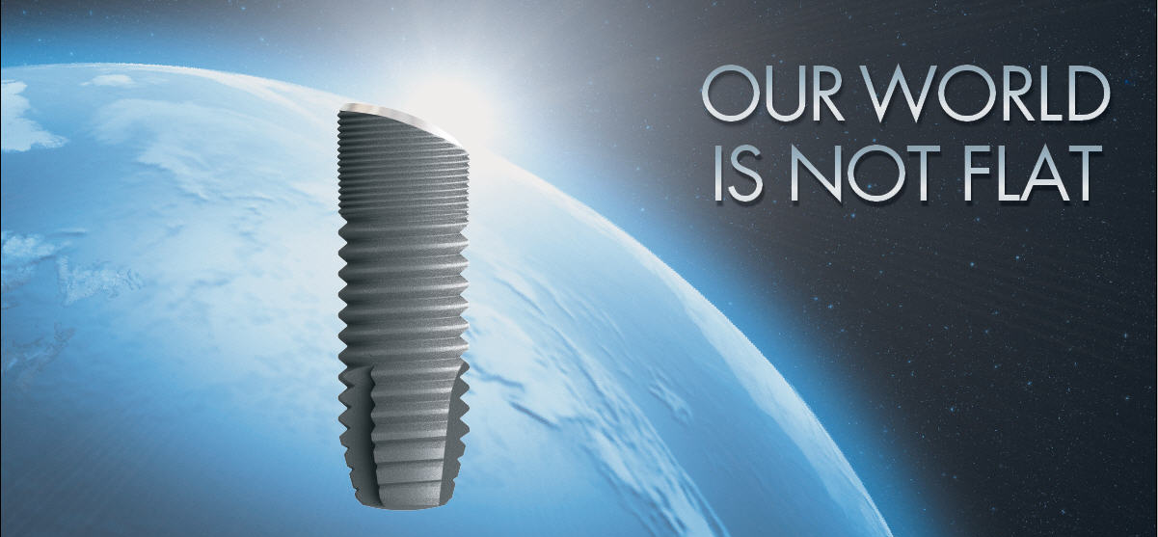
Neither is the anatomy of your implant patients.

Slide 4
Did you know …?
Of all implant sites
38%
present with, a sloped alveolar crest after healing*
Of all
sloped implant sites
58%
have a reduced need for augmentation by utilizing the OsseoSpeed Profile implant*
*Customer survey Austria, Germany, North America, Switzerland; data on file.
Notes:
So why use an implant designed for a sloping anatomy?
According to 67 clinicians surveyed – on average, they estimate that 38% of all implant sites present with a sloped ridge. Furthermore, according to the survey, the need for augmentation was reduced in an average of 58% of those cases as a result of using the OsseoSpeed Profile implant.

Slide 5
Reduced need for augmentation
Need for augmentation could be reduced/eleminated in
22%
of all implant cases if using OsseoSpeed Profile implant
Based upon customer survey DACH, NAM, Data on file
Notes:
This means that by using OsseoSpeed Profile EV, you can reduce treatment time by eliminating the need for augmentation procedures for at least one out of every five implant cases.

Slide 6
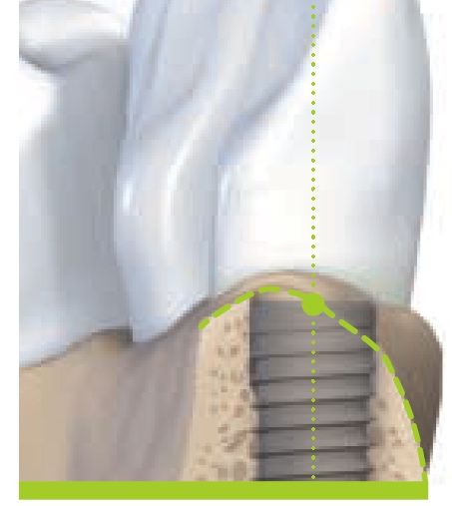
Working around nature
“In a scalloped situation, place the mesial/distal point of the outer rim of the implant to bone level. The lingual/palatinal wall will then extend slightly over the top line of the implant. The buccal wall is located somewhat below the implant edge.” *
* Sample from other implant manufacturer’s guidelines
Notes:
In fact, cases where a sloped ridge is present, are so prevalent, that implant manufacturers have to provide additional guidance on how to manipulate a flat-top implant to best fit the sloping anatomy.

Slide 7
Isn’t it time to challenge conventional thinking?
Notes:
So – isn’t it time to challenge conventional thinking?

Slide 8
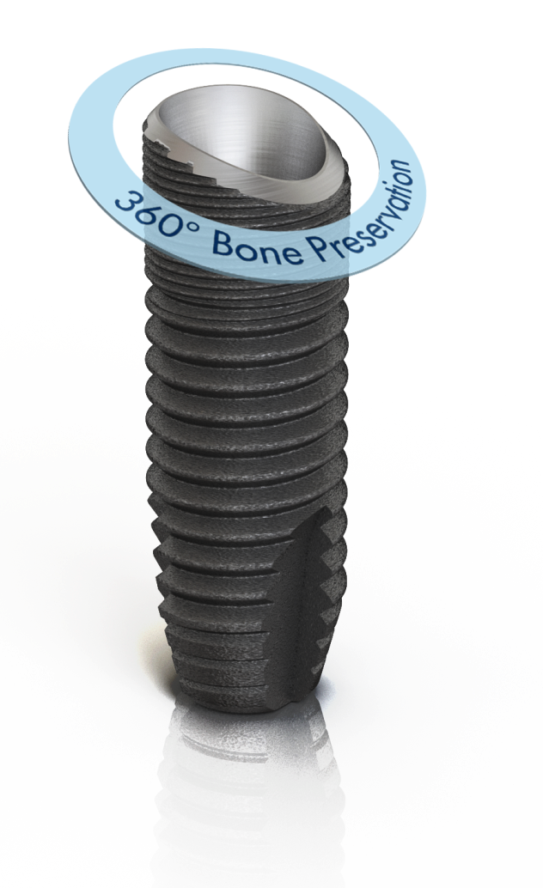
OsseoSpeed™ Profile EV
A uniquely shaped patented implant, specifically designed for sloped ridge situations that preserves the marginal bone and supports the soft tissue all around the implant.
Notes:
Because this patented implant is specifically designed for sloped ridge situations, the marginal bone is preserved and the soft tissue is supported 360 degrees around the implant. The implant can be used for single, partial or fully edentulous cases. For full flexibility, there are solutions for cement-, screw- and attachment-retained restorations.

Slide 9
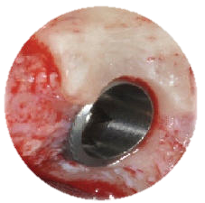
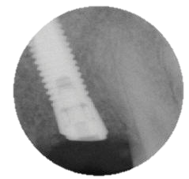
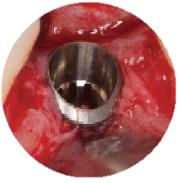
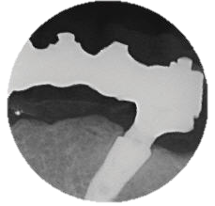
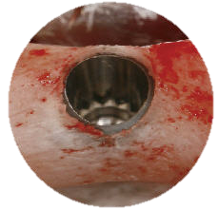
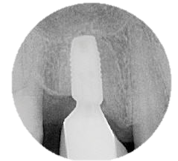
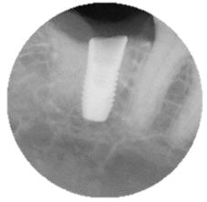
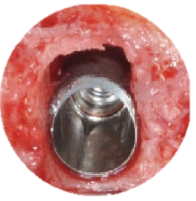
Maximize existing bone
1
8
Of all implant sites
38%
present with, a sloped alveolar crest after healing
7
2
Because our world is not flat
— every millimeter counts.
3
6
^{Courtesy of:}
1. Dr. Homa Zadeh, USA. Palatally sloping bone after grafting procedure
2. Dr. Christian Mertens, Germany. Narrow alveolar crest in the posterior mandible.
3. Dr. Robert Nölken, Germany. Sloped alveolar crest in posterior mandible.
4. Dr. Homa Zadeh, USA. Immediate implant placement.
5. Dr. David Barack, USA. Distally sloping alveolar crest.
6. Dr. Barry Levin, USA. Distally sloping alveolar crest.
7. Dr. Marco Toia, Italy. Tilted implant positions.
8. Dr. David Barack, USA. Distally sloping alveolar crest.
4
5
Notes:
An anatomically-designed implant helps you to maximize the existing bone. Consider this: for every case, you work hard to keep every millimeter of bone possible to achieve the best possible outcome for you patients. However, it is also a fact that when a conventional, flat-top, implant is placed into a sloped ridge, the bone is often flattened or left unsupported, resulting in resorption over time. So why loose this valuable bone when there is an alternative to maximize the existing bone?
With OsseoSpeed Profile EV, you can leverage the unique implant design to follow the natural contours of the sloped anatomy, maximizing the existing bone, for optimized esthetics and marginal bone preservation.
(Make sure to walk the audience through the clinical examples. Remind them of that bone is sloping in many different directions and by using their clinical creativity they will find numerous ways to maximize the existing bone.)

Slide 10
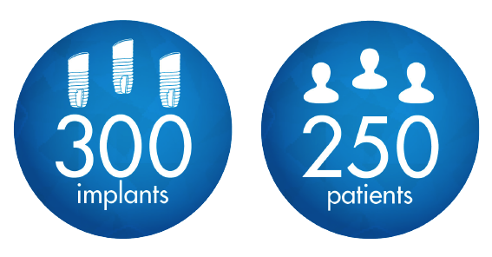
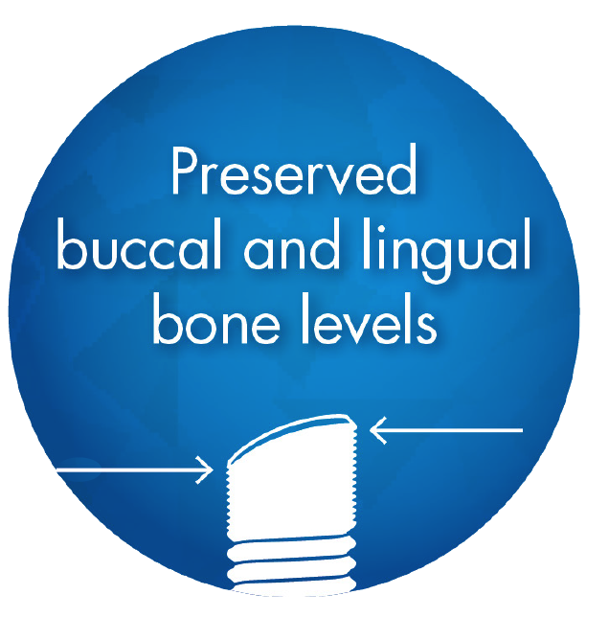
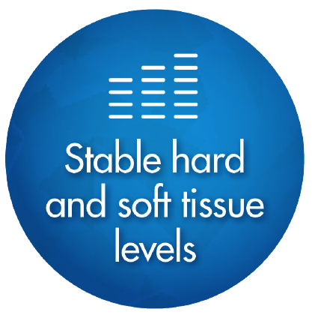
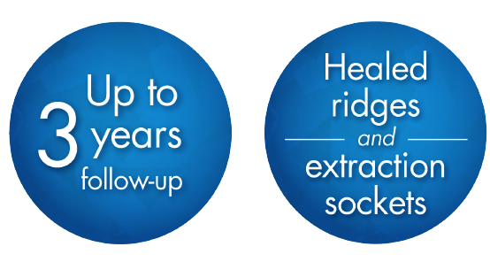
Documented for peace of mind
Refer to dentsplyimplants.com/science for the latest clinical documentation.
Notes:
OsseoSpeed Profile EV is backed by extensive scientific documentation – giving peace of mind and confidence for you and your patients.
There are a number of ongoing studies sponsored by DENTSPLY Implants, covering:
-250 patients and 300 implants
-Healed ridges and extraction sockets
-Up to three years follow-up
The main conclusions are:
- High implant survival rate
- Stable hard and soft tissue levels
- Preserved discrepancies between buccal and lingual bone levels

Slide 11
Manage risk and reduce complexity
Because our world is not flat
– Challenge conventional procedures.
”Profile implants have worked very well over the past five years I have used them. Because of the slope of the implant platform, I have had to perform less alveoloplasty or bone graft to reconstruct those sites.”
- Dr. Homa Zadeh, USA
Of all sloped
implant sites
58%
have a reduced need of augmentation by utilizing the OsseoSpeed Profile implant*
* Based upon customer survey DACH, NAM, Data on file.
Notes:
How do you handle your sloped ridge situations today when using a traditional flat-topped implant?
Are you spending time on site reconstruction, alveoloplasty procedures, local or horizontal bone augmentation?
How do you manage the additional considerations for high risk patients with a complex medical history who are in need of these procedures?
By avoiding unnecessary augmentation procedures you can reduce the complexity and manage your risk-patients more easily.

Slide 12
Making it easier for patients
to say “YES”
“I don’t like the thought of surgery in general, so it was important that the procedure be as easy and gentle as possible.”
^{– Martha, 52}
“I am really happy that my doctor could provide me with a simpler treatment solution despite my medical history and the medications I’m taking.”
^{– Paul, 67}
“To accommodate my busy work schedule I needed a solution that required fewer appointments and still gives me a great result.”
^{– Anna, 40}
“I really wanted to get an implant but did not like the idea of going through any type of bone procedure.”
^{– David, 32}
^{*Not actual patients shown.}
Notes:
OsseoSpeed Profile EV can also support increased case acceptance by allowing you to address patient concerns with treatment time, which can be extended with augmentation procedures. There are also patients who do not want any type of bone augmentation procedure at all. It can also be an option for patients who cannot undergo a bone augmentation procedure due to their current medical condition.
By incorporating OsseoSpeed Profile EV into your ”treatment offering” you are able to provide additional treatment options that help you to better meet your patient’s individual needs making it easier for them to say ”yes” to the proposed treatment plan.

Slide 13
Maximize existing hard and soft tissue
Provides 360° bone preservation while maintaining
soft tissue esthetics.
Reduce the need for augmentation
Saves time and costs by reducing the need to augment
and manipulate the implant site.
Increase case acceptance
Helps to address patient concerns regarding pain
and treatment time.
Notes:
With the innovation of OsseoSpeed Profile EV, you can move to the next level of patient-focused, implant therapy and achieve greater efficiency without compromise.
It’s now time to challenge conventional thinking.

Slide 14
Let’s take a closer look…
Notes:
So what is behind the development of the OsseoSpeed Profile implant?

Slide 15
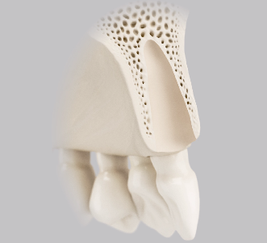
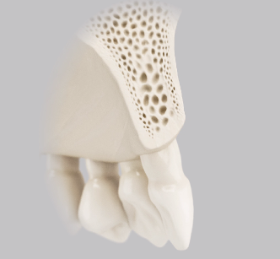
Clinical realities (1) – bone remodeling after tooth loss
Alveolar ridge remodeling occurs after tooth extraction and tooth loss
Remodeling is often more pronounced on the buccal side than on the palatal/lingual side, resulting in a sloped alveolar ridge
Notes:
It is a well-known fact that the bone crest resorbs after tooth extraction or tooth loss. Remodeling has been shown to often be more pronounced on the buccal side than on the palatal/lingual side, resulting in a sloped ridge in a palatal/lingual to buccal direction.

Slide 16
Clinical realities (1) – bone remodeling after tooth loss

Slide 17
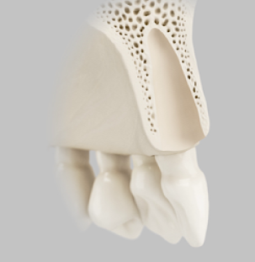
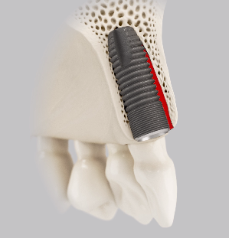
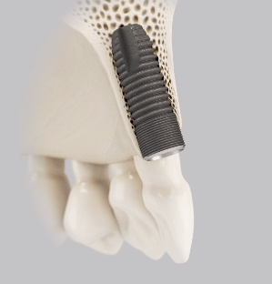
Clinical realities (2) –bone remodeling after immediate installation
Immediate implant placement in extraction sockets does not prevent alveolar ridge remodeling.
Notes:
In a Company Initiated multicenter study, implants (OsseoSpeed ) were placed in extraction sockets and a re-entry surgery was done after 4 months. The main conclusion was that bone remodeling occurs and the reduction in the vertical height of the bone crest was more pronounced on the buccal than on the palatal side resulting in a slope in the buccal direction.
The reduction of the alveolar crest occurs despite the placement of an implant directly into the socket.
Reference:
A prospective, randomized-controlled clinical trial to evaluate bone preservation using implants with different geometry placed into extraction sockets in the maxilla
Sanz M., Cecchinato D., Ferrus J., Pjetursson E. B., Lang N. P. and Lindhe J.
Clin Oral Impl Res 2010;21(1):13-21
Other studies also report on similar findings.

Slide 18
Clinical realities (2) –bone remodeling after immediate installation
Notes:
Will self-play

Slide 19
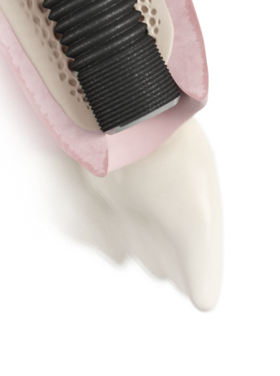
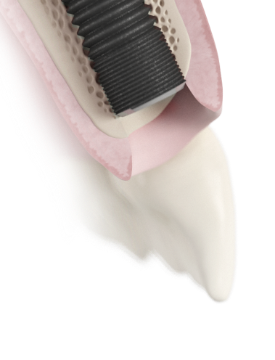
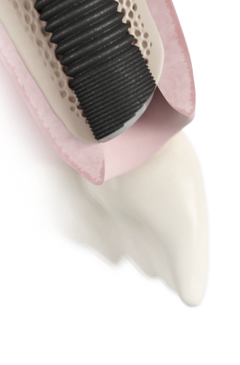
The clinical challenge
Flat-top implant design
OsseoSpeed™ Profile EV
Can result in:
Discoloration of the soft tissue margin
Compromised esthetics
Can result in:
Loss of bone and soft tissue height
Compromised esthetics
The ideal solution in a sloped ridge
Notes:
When the alveolar ridge has a sloped profile, a flat-top implant does not fit well - the placement has to be a compromise. Let me show you.
(image 1) If an implant is positioned level with the lingual marginal bone, the implant neck is exposed and the esthetic result is compromised. This situation may require complimentary bone augmentation procedures prior to implant placement.
(image 2) When positioned level with the buccal marginal bone, the unsupported palatal/lingual marginal bone will be lost. The mesial and distal marginal bone levels, as well as soft tissue height, are compromised.
(Image 3) With OsseoSpeed™ Profile EV, you don’t have to compromise between marginal bone levels and esthetics in sloped ridge situations. Because bone-to-implant support is three-dimensional, it is important to have marginal bone support around the entire implant.

Slide 20
The clinical challenge
Notes:
Will self-play

Slide 21
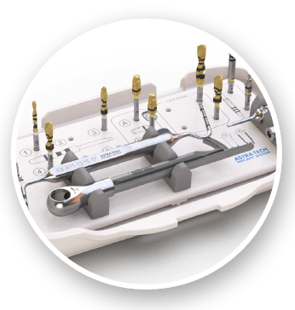
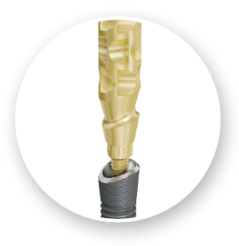
Simplifying the workflow
”With the new one-position feature and
new impression copings, the prosthetic
part of the treatment is simplified.”
- Dr. Marcus Dagnelid, Sweden
Small Tray EV – supporting a procedure-based workflow
One-position-only placement of all indexed components
Self-guiding impression components for an accurate and predictable workflow
Notes:
With OsseoSpeed Profile EV, you can count on surgical flexibility and restorative ease. One key design aspect is the one-position-only placement of restorative components which ensures an accurate and predictable workflow. With the recent introduction of the Small Tray EV, you can create a kit just for your sloped anatomy cases.

Slide 22
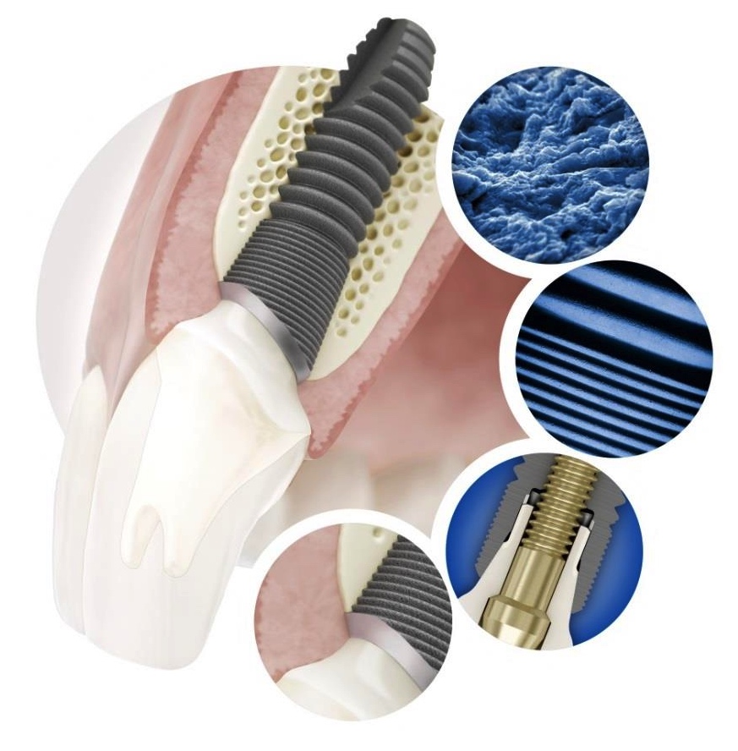
An integral part of the Astra Tech Implant System™ EV
Surgical simplicity and flexibility
Primary stability
Restorative ease
System logics
Robustness
Astra Tech Implant System BioManagement Complex™ maintained.
Notes:
Just like with the Astra Tech Implant System EV, OsseoSpeed Profile EV’s design philosophy is based on the natural dentition utilizing a site-specific, crown-down approach supported by an intuitive surgical protocol and a simple prosthetic workflow, for increased confidence and satisfaction of all members of the treatment team.
The foundation of this evolutionary step remains the unique Astra Tech Implant System BioManagement Complex, well-documented for its long term marginal bone maintenance and esthetic results.

Slide 23
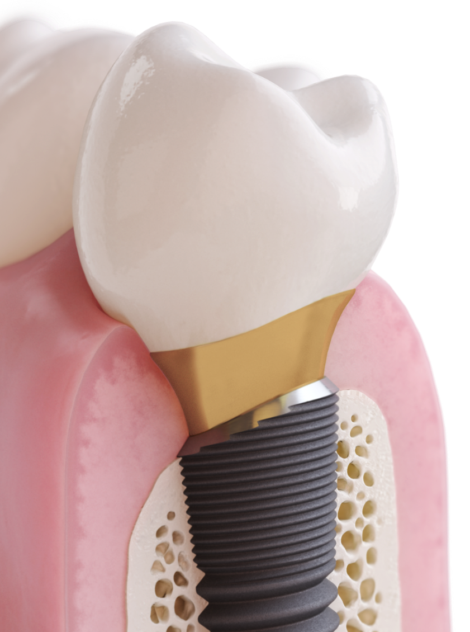
A unique implant specifically designed for sloped ridges
Maximize existing hard and soft tissue
Reduce the need for augmentation
Increased case acceptance
One-position-only components allowing a simple and accurate workflow
Notes:
With OsseoSpeed Profile EV, you can:
READ BULLETS

Slide 24
Thank You

