Slide 1
Astra Tech Implant System EV Restorative components and instruments

Slide 2
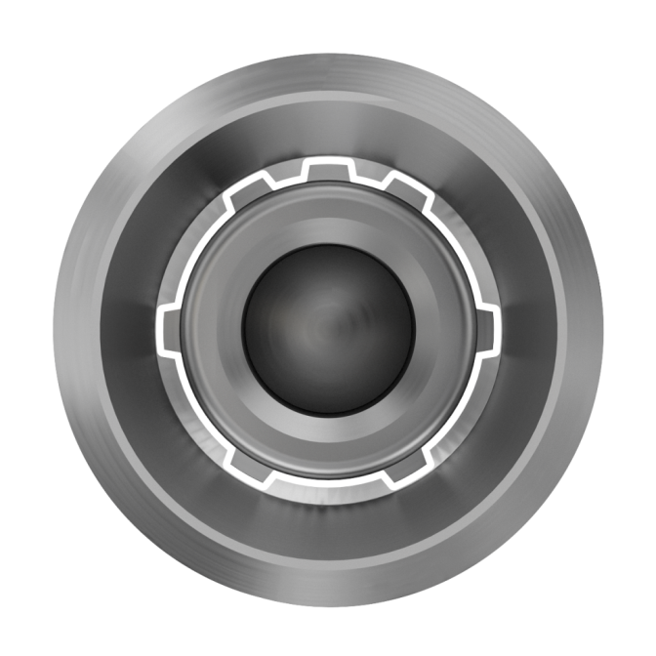
One interface - three indexing solutions
Notes:
The unique OsseoSpeed EV implant-abutment connection with three indexing solutions
One-position-only
Six positions
Index free
The interface design and indexing solutions have a patent pending.

Slide 3
One interface - three indexing solutions
One-position-only
Notes:
The unique OsseoSpeed EV implant-abutment connection with three indexing solutions has a
1. One-position-only
Atlantis patient-specific CAD/CAM abutments will seat in one position only

Slide 4
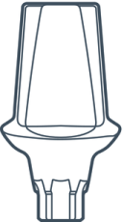
One interface - three indexing solutions
One-position-only
Six position
Notes:
The unique OsseoSpeed EV implant-abutment connection with three indexing solutions has a
2. Six positions
Indexed abutments will seat in six available positions

Slide 5
One interface - three indexing solutions
One-position-only
Six position
Index free
Notes:
The unique OsseoSpeed EV implant-abutment connection with three indexing solutions has a
3. Index free
Index-free abutments will seat in any rotational position.

Slide 6
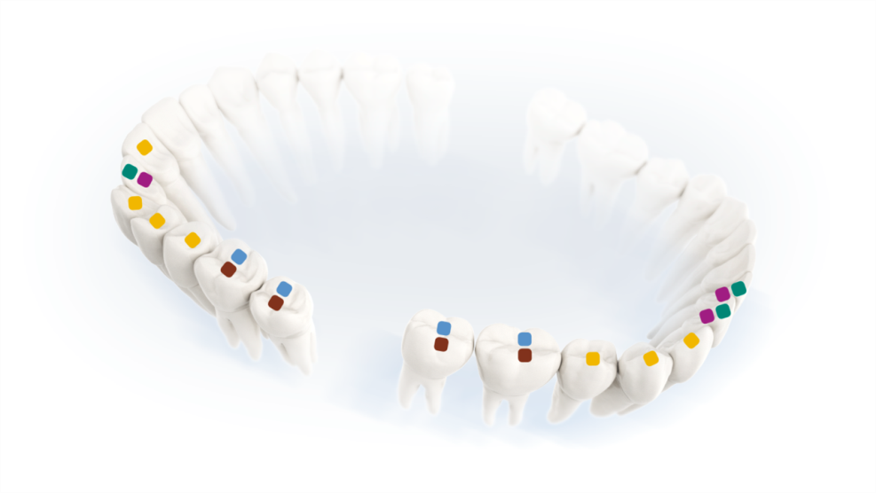
The design philosophy
A site-specific, crown-down approach
based upon the natural dentition
an individual assortment of components for each site
Clinical relevance
Designed for the different sites
Notes:
The success of an implant treatment is defined not only by function, but also by esthetics. The design philosophy of the ASTRA TECH Implant System EV is based on the natural dentition and utilizes a site-specific, crown-down approach with the desired end result in mind to help ensure a successful outcome.

Slide 7
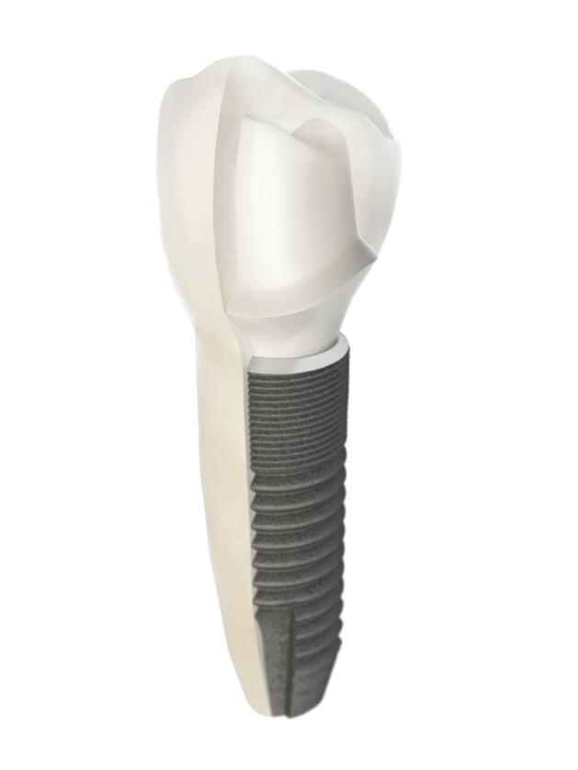
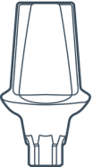
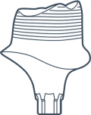
A site-specific, crown-down approach
Options for capturing the sculptured soft tissue.
The one-position-only placement is supporting the crown-down planning
Site-specific restorative components including round and triangular options.
Versatile implant designs meeting the anatomical demands
Notes:
Multiple considerations are required for each individual tooth; the support needed
for the final restoration in the particular position, soft-tissue healing, and implant
design and size.
The implant assortment provides versatility for meeting the needs of each individual
site. This is further supported by corresponding restorative components designed
for optimized soft-tissue management and long-term function and esthetics.
Note: OsseoSpeed Profile EV is not yet available.

Slide 8
Color-coding - restorative and lab components
Abutment screws
Implant Pick-up components
Lab components
Implant Transfer components
Healing components
Notes:
The implant-abutment connection size is identified by a specific color, which is used consistently throughout the
system. The color is applied directly to components and instruments, as well as on packaging and informational
material, where appropriate.

Slide 9
Color-coding - restorative and lab components
Notes:
The following products on implant level are color-coded:
Healing components – Healing Uni EV and HealDesign EV
Impression components – Implant Pick-Up EV, Implant Pick-Up Design EV and Implant Transfer EV
Lab components – Lab Abutment Screw EV and Implant Replica EV
Abutment screws – Abutment Screw EV

Slide 10
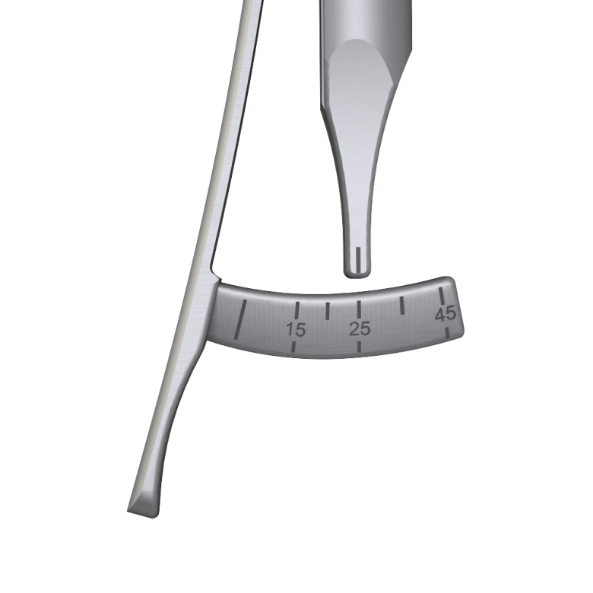
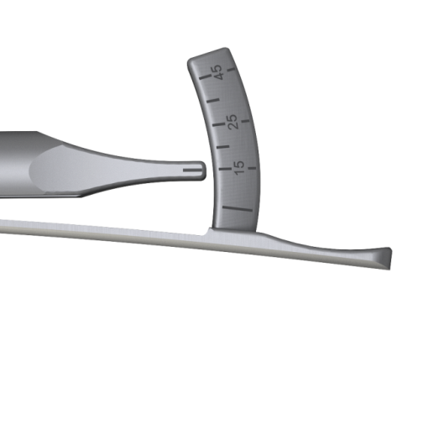
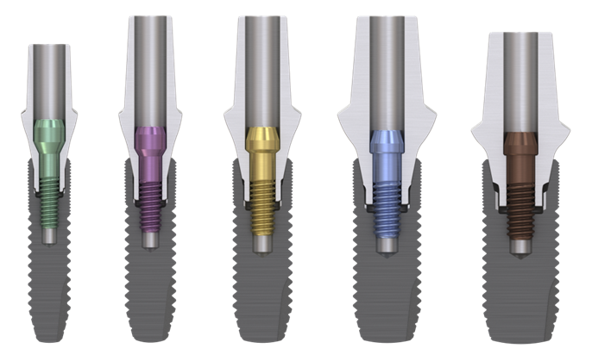
One system – one torque
25/15
25 Ncm for final abutments
15 Ncm for temporization and restorative level (Bridge Screw)
Notes:
Torque values
• All final abutments are designed for a uniform torque (25 Ncm), for added simplicity.
• Due to clinical considerations, the temporary abutments have been verified for a lower torque (15 Ncm).
• A lower torque (15Ncm) is also applied on the restorative level for the bridge screws.

Slide 11
Visual simplicity
Procedure and product symbols
Procedure sequences for different therapies
Easy step-by-step communication
Recommended workflows
Notes:
Symbols illustrates different procedures/handling, design of products and product groups.
Procedure sequence illustrates the different restorative stages and in which order the products should be used. Can be found throughout e.g. manuals for easy reference.
The stage of the treatment procedure being reviewed is highlighted with a circle.

Slide 12
Restorative cement retained options - implant-level solutions

Slide 13
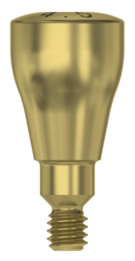
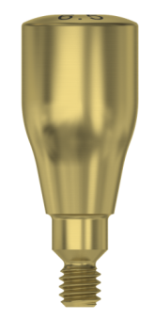
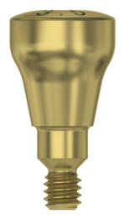
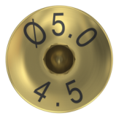
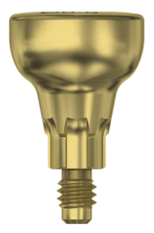
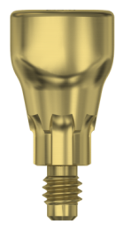
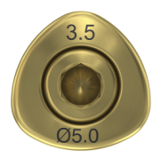
HealDesign EV
Heights and diameters are harmonized with the final abutments and with the expected tooth positions
Notes:
HealDesign EV
• Round shapes are primarily indicated for posterior positions, and in cases with thicker soft tissue
• Triangular shapes are designed for anterior implant sites and mimic the specific shape for incisors and canines
• With possibilities to sculpture individual soft tissue shapes

Slide 14
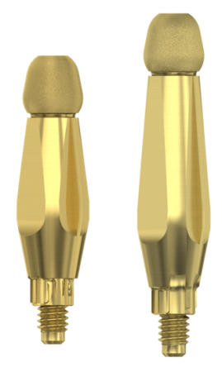
Implant Pick-Up EV Implant Pick-Up Design EV Implant Transfer EV
Self-guiding positioning for all abutment connections
Safe and efficient design promoting one-hand procedure
Notes:
Implant Pick-Up EV
Implant Pick-Up Design EV
Implant Transfer EV
• Self-guiding impression components; engages into the implant only when correctly seated
• One hand procedure; carrying and tightening with the Screwdriver in one sequence
• Supports all indexing options; one-position-only,six position and index free
• Integrated pin for safe handling
• Capturing individualized sculptured soft tissue (Implant Pick-Up Design EV)

Slide 15
Handling – Self-guiding Implant Pick-Up EV
Notes:
Implant Pick-Up EV, Implant Pick-Up Design EV and Implant Transfer EV
The self-guiding installation procedure is applicable for all implant-level impression components

Slide 16
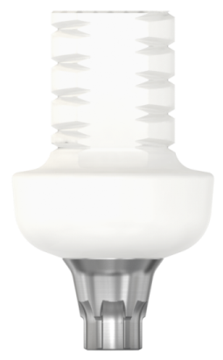
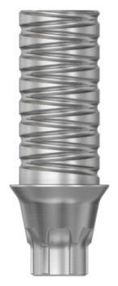
TempDesign EV and Temp Abutment EV
Dynamic designs offering both reduction and build-up technique allow for further sculpturing of the soft tissue
Two optional abutments; Titanium-PEEK-plastic or Titanium
Notes:
TempDesign EV
• Designed for reduction technique
• Developed for esthetic temporization
• Design compensates for off-set positions
• For clinical use up to 180 days
Temp Abutment EV
• Designed for build-up technique with composite or acrylic
• Developed for multi-unit restorations (cementable)
• Designed for long-term temporization

Slide 17
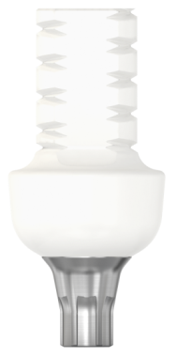
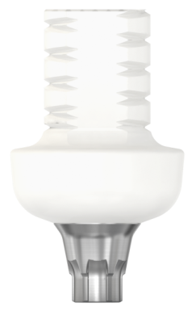
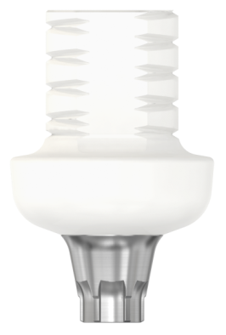
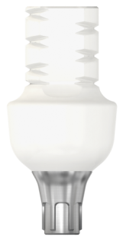
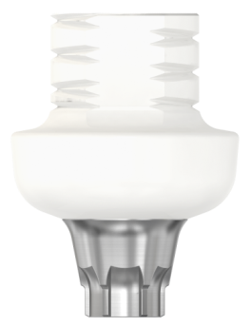
TempDesign EV
Dynamic design for reduction and technique for detailed soft tissue sculpturing allow for further sculpturing of the soft tissue
Titanium-PEEK-plastic
Notes:
TempDesign EV
• Designed for grinding at low speed and light pressure
• Design may compensate for a dislocated implant in respect to the natural tooth location

Slide 18
Atlantis Abutment
Astra Tech Implant System EV is supported by Atlantis patient-specific solutions
Unique interface with one-position-only placement of Atlantis patient-specific abutments
Notes:
Atlantis Abutment
• Patient-specific, CAD-CAM abutments individually designed from the final tooth shape
• One-position-only seating on OsseoSpeed EV implants
• Abutment Screw EV is color coded according to the implant connection

Slide 19
Atlantis Abutment
Notes:
Atlantis Abutment
The Atlantis Abutment will only seat in the one-position-only , unique for the ASTRA TECH Implant System EV

Slide 20
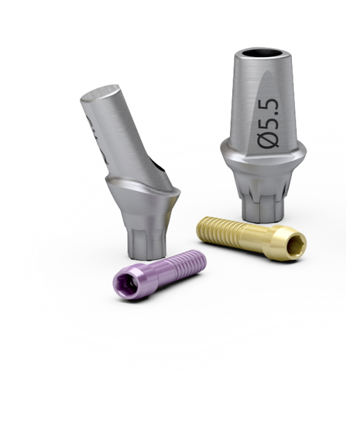
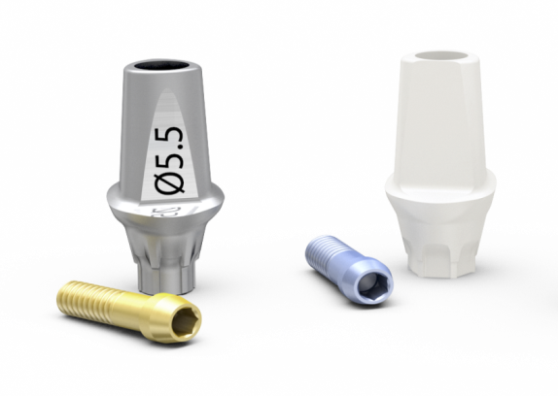
TiDesign EV and ZirDesign EV
Anatomically prefabricated abutments in clinical relevant designs supporting the crown down approach
Triangular design mimics anterior teeth anatomies
Angled design with a sloped margin
Notes:
TiDesign/ZirDesign
The round and triangular options mimic a variety of tooth shapes and are harmonized with the soft tissue sculpturing created by HealDesign EV
• Round – design for the majority of restorative situations
• Triangular – primarily for incisors and canines with distinct triangular shape
• Angled – for offset situations both in the anterior and posterior regions, compensating for implants in a restoratively unfavorable position
• Abutment Screw EV is color coded.

Slide 21
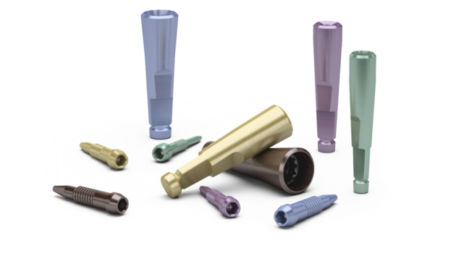
Laboratory components
Implant Replica EV
Removal possibility from master model
Serves all abutment placement options
Lab Abutment Screw EV
Guiding tip for safe and efficient handling (fits replica only)
Notes:
Implant Replica EV
Can be removed and repositioned without sectioning the master model after simple modification of the replica apex
Lab Abutment Screw EV
• Fits only into the Implant Replica EV and not into the implant due to its specific guiding tip
• Guide tip supports efficient lab handling

Slide 22
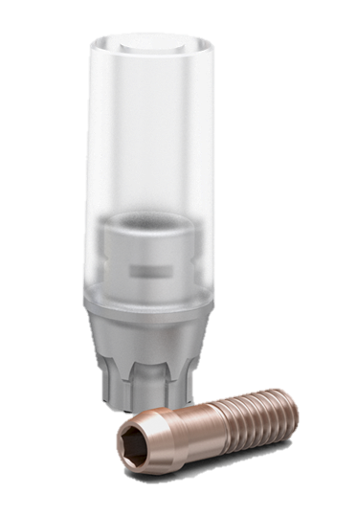
CastDesign EV
For cases requiring angulation corrections up to 30° using regular wax-up and cast-to techniques.
Cement-retained – single, partial and fully edentulous situations
Screw-retained – single situations only
Note: In cases where high bite forces are expected, it is recommended to select a titanium abutment if possible. CastDesign EV should primarily be regarded as an abutment used when no titanium option is available.
Notes:
CastDesign EV
The CastDesign EV is a non-oxidizing high precious abutment designed and manufactured at the laboratory.
Note: For screw-retained restoration, CastDesign EV should be used for single-tooth applications only.
Use of this product outside the listed indications will compromise the function of the Conical Seal Design and void the DENTSPLY Implants Warranty.

Slide 23
Restorative module - cement-retained options - abutment-level solutions

Slide 24
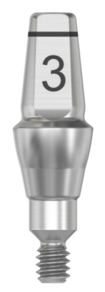
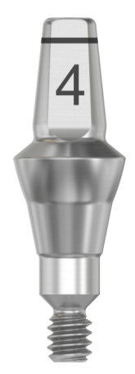
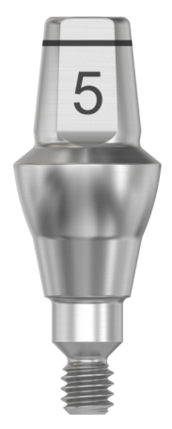
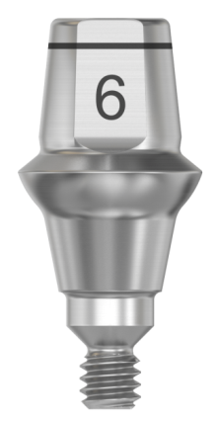
Direct Abutment EV
Designed to meet the clinicians’ demands for conventional crown and bridge procedures and restorative simplicity
The sterile abutment comes in a separate package not included in the Direct EV API kit
Notes:
Direct Abutment
Direct Abutment EV is a one-piece abutment, available in different diameters and heights for all implant connections sizes, in different diameters and heights,
mimicking preparations of natural teeth.
Note: the Direct Abutment EV has to be ordered separately as it is not included in the Direct API-kit

Slide 25
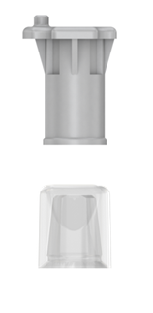
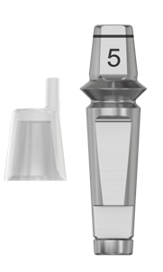
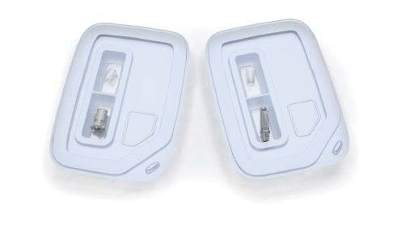
Direct EV API - two in one
Clinic
Lab
Notes:
Direct EV API
All necessary components for the restorative and laboratory procedures, including pick-up, healing cap, replica and burnout cap
Delivered in a non-sterile, Direct EV API kit, consisting of one clinical and one laboratory container

Slide 26
Restorative module screw-retained options - abutment-level solutions

Slide 27
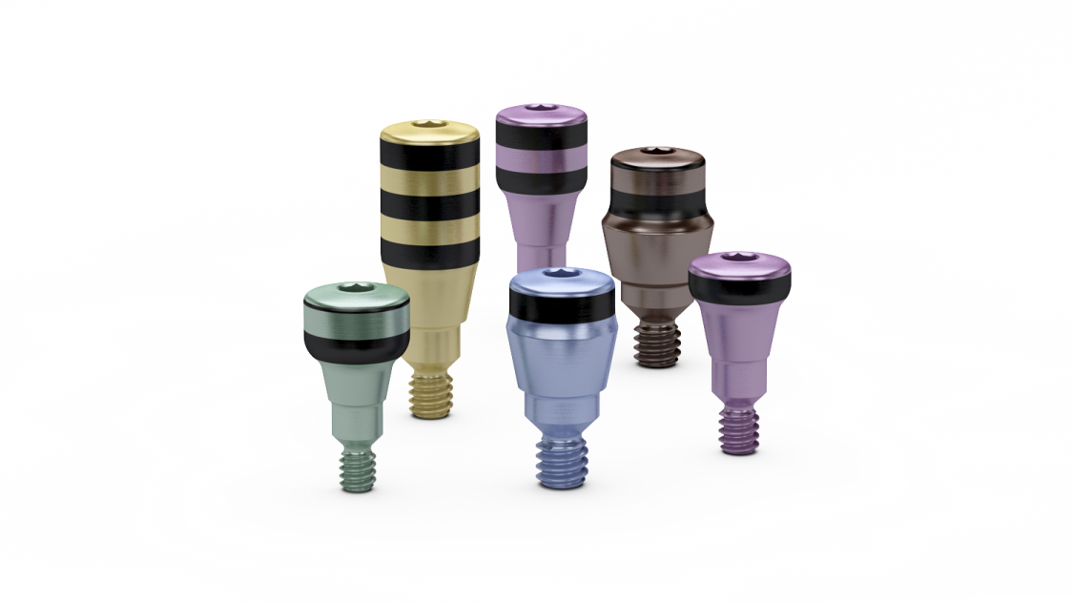
Healing Uni EV
Developed to support the surrounding soft tissue
Give a predictable treatment situation by geometries in close correspondence to the final abutments
Notes:
Healing Uni EV
• Used for soft tissue support during the healing phase
• Designed to support and simplify permanent abutment selection
• Harmonized with the heights and diameters for the final Uni Abutment EV
• Laser etched bands for gauging

Slide 28
Healing Uni EV
Abutment Depth Gauge EV
Measure height
Installation
One tip design for each implant connection.
A waist on the tip for identification of 4–5mm depth mark.
Color: according to implant.
The abutment depth gauges corresponds with the Healing Uni EV laser etched bands.
Pick up and install the sterile Healing Uni EV directly from the blister package using the Hex Driver EV.
Manually seat and secure the healing abutment using light finger force (5–10 Ncm)

Slide 29
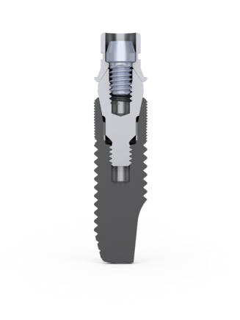
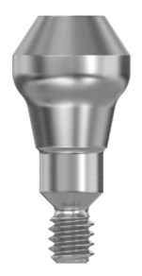
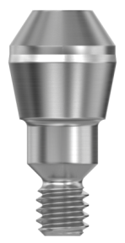
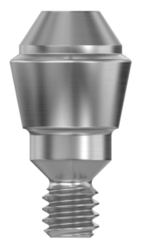
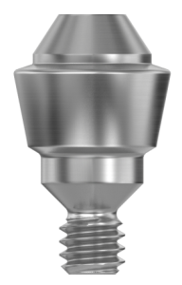
Uni Abutment EV
Notes:
Uni Abutment EV
• A solid prosthetic interface with a 33° top cone
• Compatible with Atlantis ISUS restorations
• For all implant interface connections (3.0–5.4).
• Similar restorative heights as previous Uni Abutment 20/45 Uni Abutment

Slide 30
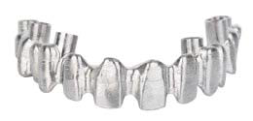
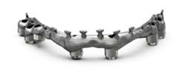
Uni Abutment EV
Only one reusable tool needed for installation or removal of a Uni Abument EV
Atlantis suprastructures compatible
Notes:
Uni Abutment EV
• Uni Driver EV facilitates a convenient procedure for both carrying, installing and retrieving the Uni Abutment EV
• Several different restorative Atlantis ISUS solutions for Uni Abutment EV
- Atlantis ISUS Bridge
- Atlantis ISUS Hybrid
- Atlantis ISUS Bar

Slide 31
Uni Abutment EV
Notes:
Uni Abutment EV & Uni Driver EV
The reusable Uni Driver EV with its snap-in function clicks into place in the Uni Abutment EV and facilitates the installation procedure

Slide 32
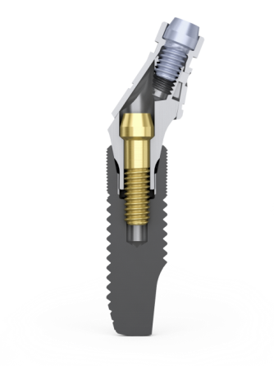
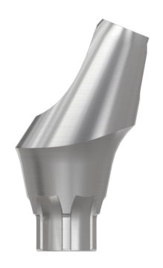
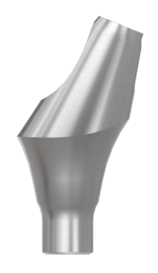
Angled Abutment EV
Facilitates implant situations with unfavorably situated bridge screw channels
Altering the bridge screw access channel away from the axial direction of the implant
20° top cone for three implant connection sizes - one common assortment on abutment level
Six position - 3.6/4.2/4.8 & Indexed-free - 4.2/4.8
Notes:
Angled Abutment EV
Developed for implant connections 3.6/4.2/4.8 (to be strong enough for high angulated prosthetics)
Angled Abutment EV is available in two marginal heights and has six position and index-free connection possibilities
Note: Not ISUS compatible at this time

Slide 33
Restorative module screw-retained options - implant-level solutions

Slide 34
Atlantis Crown Abutment
Patient-specific abutment for single-tooth, screw-retained restorations
Eliminates need for coping and cement
Allows for easy retrieval, if needed
Abutment design supports porcelain build-up
Seats in one-position-only
Notes:
Atlantis Abutment
• Patient-specific CAD-CAM abutments individually designed from the final tooth shape
• One-position-only seating on OsseoSpeed EV implants
• Abutment Screw EV is color coded according to the implant connection

Slide 35
Restorative module attachment-retained options

Slide 36
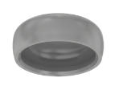
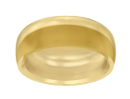
Attachement-retained solutions
Locator Abutment™ EV
Ball Abutment EV
Uni Abutment EV
Complementary components
Locator™ Core Tool
Locator™ Inserts
Dalbo Plus Lamellae retention insert E
Dalbo Plus Screwdriver/Activator
Lab Bridge Screw EV
Polishing Protector Uni EV
Uni Driver EV
8

Slide 37
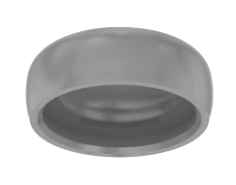
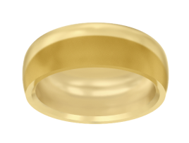
Locator Abutment EV
Provides long-term stability
Managing limited occlusal space with low vertical height
Cases with non-parallel implants
Notes:
Locator Abutment EV
• Developed for implant connections 3.6/4.2/4.8 (clinically most relevant)
• Updated assortment with 2 new inserts, grey and orange in the extended range male assortment
• Non-splinted Locator abutments are recommended in the lower jaw only

Slide 38
Locator Abutment EV
Clinical procedure
Abutment selection
Installation
Impression
Before abutment installation, remove the healing abutment and register the soft tissue height for proper selection of the permanent abutment. The appropriate height of the Locator Abutment EV is where the outer retention geometry is at a supra gingival height.
Note: Healing Uni EV design supports the permanent Locator Abutment EV configuration and creates a matching soft tissue contour.
Mount the Locator Abutment EV and the plastic holder/sleeve onto the driver, a part of the Locator Core Tool.
Seat the Locator Abutment EV manually.
Use the Locator Driver EV in the restorative Driver Handle EV with the Torque Wrench EV. Tighten the abutment to recommended torque (25 Ncm).
Firmly attach the Locator Abutment Pick-ups on the Locator Abutments and check to ensure that they are securely in place.
Take the abutment-level impression in a standard or customized impression tray with an elastomeric impression material.
Remove the impression once the impression material has set.
Verify that the impression is correct and send it to the laboratory.

Slide 39
Locator Abutment EV
Laboratory procedure
Clinical procedure
Model
Overdenture
Final restoration
Firmly place the Locator Abutment Replica into the Locator Abutment Pick-up in the impression.
Fabricate a master model in high-quality stone material.
Place the spacer over the head of each Locator Abutment Replica, mimicking the resilient situation, and attach the Locator Processing Caps to the replicas.
Fabricate the overdenture by curing the female part into the acrylic.
Use a burr to remove excess acrylic, and polish the overdenture base.
Remove the overdenture from the model and discard the black processing inserts using the Locator Insert Removal Tool,
a part of the Locator Core Tool.
Send the final overdenture with the Locator Abutment inserts to the clinician.
Place the preferred Locator inserts into the metal housing (Processing Cap), using the Insert Seating Tool, a part of the Locator Core Tool.
Check and adjust the final fit of the overdenture. Make corrections to the occlusion relation as needed.

Slide 40
Ball Abutment EV with Dalbo Plus TE Basic
Dalbo Plus TE Basic parts:
Lamellae retention insert
Reducing wear on the Ball Abutment
Can be adjusted with the Screwdriver/Activator
Easily replaced with a new insert using the Screwdriver/Activator
Housing
In titanium
Notes:
Ball Abutment EV & Dalbo Plus
• Developed for the implant connections 3.6/4.2/4.8 (clinically most relevant)
• Reduction of wear together with Dalbo Plus female part TE in gold
• The Dalbo Screwdriver/Activator manages adjustment of retention and removal/insertion of lamellae

Slide 41
Ball Abutment EV with Dalbo Plus TE Basic
Clinical procedure
Abutment selection
Abutment Installation
Impression
Before abutment installation, remove the healing abutment and register the mucosal height for proper selection of the permanent abutment. The appropriate height of the ball abutment is the highest point of the soft tissue margin corresponding at, or slightly ”apical” to the tapered neck of the abutment.
Note: Healing Uni EV design supports the final Ball Abutment EV configuration and creates a matching soft tissue contour.
Attach the Ball Driver EV to the restorative Driver Handle EV.
Attach the driver to the Ball Abutment EV.
Connect the Ball Driver EV with the Torque Wrench EV. Tighten the abutment to the recommended torque (25 Ncm).
Take the abutment-level impression in a standard or customized impression tray with an elastomeric impression material.
Remove the impression once the impression material has set.
Verify that the impression is correct and send it to the laboratory.

Slide 42
Ball Abutment EV with Dalbo Plus TE Basic
Laboratory procedure
Clinical procedure
Model
Overdenture
Final restoration
Place the Ball Abutment EV Replica firmly into the impression. The parallel bevels on the abutment and the replica facilitates the positioning.
Fabricate a master model with the ball replica and high-quality stone material.
Determine a common path of insertion for the ball attachment-retained overdenture.
Place the duplicating aid onto the replica.
Fabricate the overdenture
Remove the duplicating aid for making space in the prosthesis for the female part
Cure the female part into the acrylic
Use a burr to remove excess acrylic, polish the overdenture base.
Send the final overdenture to the clinician.
The preferred retention of the inserts is adjusted to the patient’s requirements. The activation is made with the Dalbo Plus Screwdriver by rotating clockwise, acquiring more retention, or counter clockwise acquiring less retention.
Changing to a new or another insert is done with the screwdriver.
Check and adjust the final fit of the overdenture. Make corrections to the occlusion relation as needed.

Slide 43
Restorative module Instruments

Slide 44
Instruments
Abutment Depth Gauge EV
Hex Screwdrivers (manual)
Hex Drivers (machine)
Uni Driver EV
Locator Driver EV
Ball Abutment Driver EV
Direct Driver EV Ø3.3 Ø4
Notes:
Abutment Depth Gauge EV
• One tip design for each implant connection size.
• A waist on the tip for identification of the 4–5mm depth mark.
• Color: according to implant.
Hex Screwdrivers (manual)
• New grip pattern
• Three lengths
Other Drivers (machine)
All with Contra Angle connection

Slide 45
Torque Wrench EV
Torque Wrench EV
Driver Handle, Surgical
Driver Handles, Prosthetic
Notes:
Torque Wrench EV
• Can be used as both torque wrench and as ratchet wrench
• Restorative Driver Handle for abutment installation only (lower torque values)
• Surgical Driver Handle for implant installation and removal (high torque values)

Slide 46
System overview – key points - restorative
Site-specific restorative components
New unique interface design with one-position-only placement for Atlantis patient-specific abutments
Self-guiding impression components
One system – One torque
Notes:
New triangular healing and restorative options for simplified soft tissue sculpturing
New Atlantis patient specific CAD/CAM abutments
Innovative design that requires only one hand for precise seating of the impression components
Harmonized torque value of 25Ncm for all final abutments for increased simplicity

Slide 47
Thank You

