Slide 1
Astra Tech Implant System EV Surgical components and instruments

Slide 2
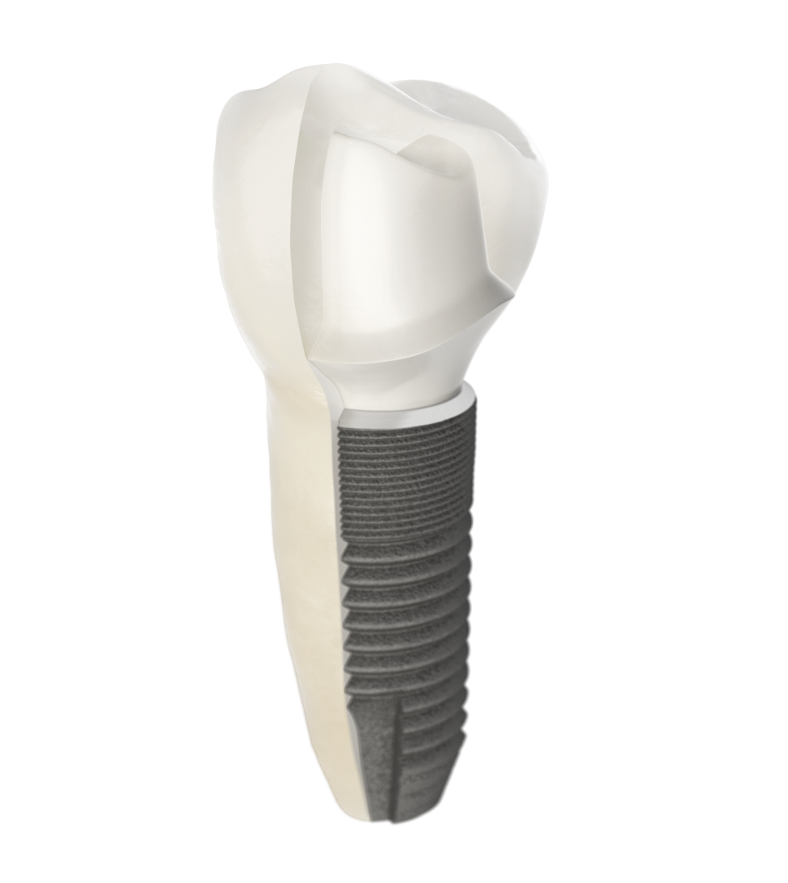
A site-specific, crown-down approach
Notes:
The design philosophy of the Astra Tech Implant System EV is based on the natural dentition utilizing a site-specific, crown-down approach supported by an intuitive surgical protocol and a simple prosthetic workflow.
Multiple considerations are required for each individual tooth; the support needed for the final restoration in the particular position, soft-tissue healing, and implant design and size.

Slide 3
The foundation - Astra Tech Implant System BioManagement Complex
Notes:
The Astra Tech Implant System EV is designed for ease of use and versatility in providing treatment solutions for your implant patients.
The foundation , the unique Astra Tech Implant System BioManagement Complex, which has been proven to predictably provide long-term marginal bone maintenance and esthetic results has been maintained.

Slide 4
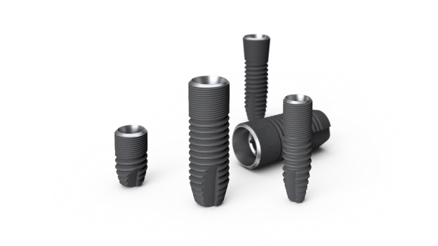
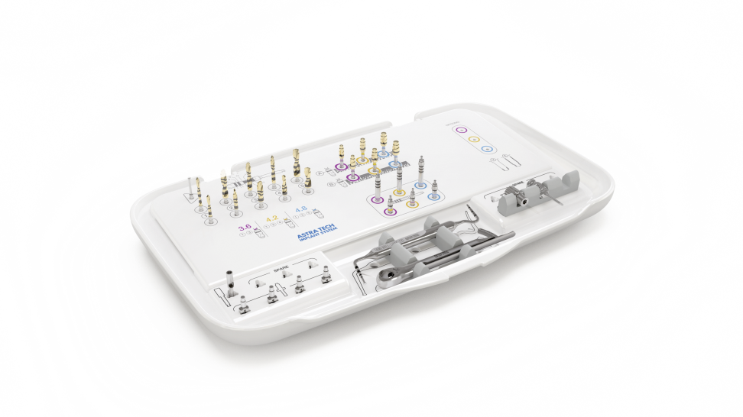
Surgical simplicity and flexibility
Versatile implant designs
Drilling protocol allows for preferred primary stability
An intuitive, color-coded surgical tray
Notes:
Versatile implant assortment
The Astra Tech Implant System EV consists of a unique range of OsseoSpeed EV implants, including solutions for:
– Limited vertical bone height
– Narrow horizontal space
This allows you to easily and efficiently manage and adapt to different challenges as they arise, including:
Flexible drilling protocol that allows for preferred primary stability
The drilling procedure is made easy by using color-coding and a simple numbering system. The options within the drilling protocol help ensure proper preparation of the marginal bone and allow for the preferred level of primary stability to be achieved.
One surgical tray – three overlay options
The surgical tray design with three interchangeable overlays allows for adaption of tray content according to your clinical preferences. The color-coded tray has an intuitive layout for ease of use, effective handling throughout the surgical procedure and accurate communication among the surgical team.

Slide 5
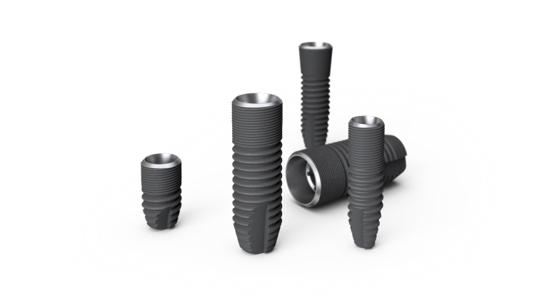
Versatile implant designs
One system for all indications
Suitable for both one-stage and two-stage surgery
Designed for immediate and early restoration
Notes:
Versatile implant assortment
The Astra Tech Implant System EV consists of a unique range of OsseoSpeed EV implants, including solutions for:
– Limited vertical bone height
– Narrow horizontal space
– Sloped ridges
This allows you to easily and efficiently manage and adapt to different challenges as they arise, including:
– One- and two-stage surgery
– Immediate and early restoration

Slide 6
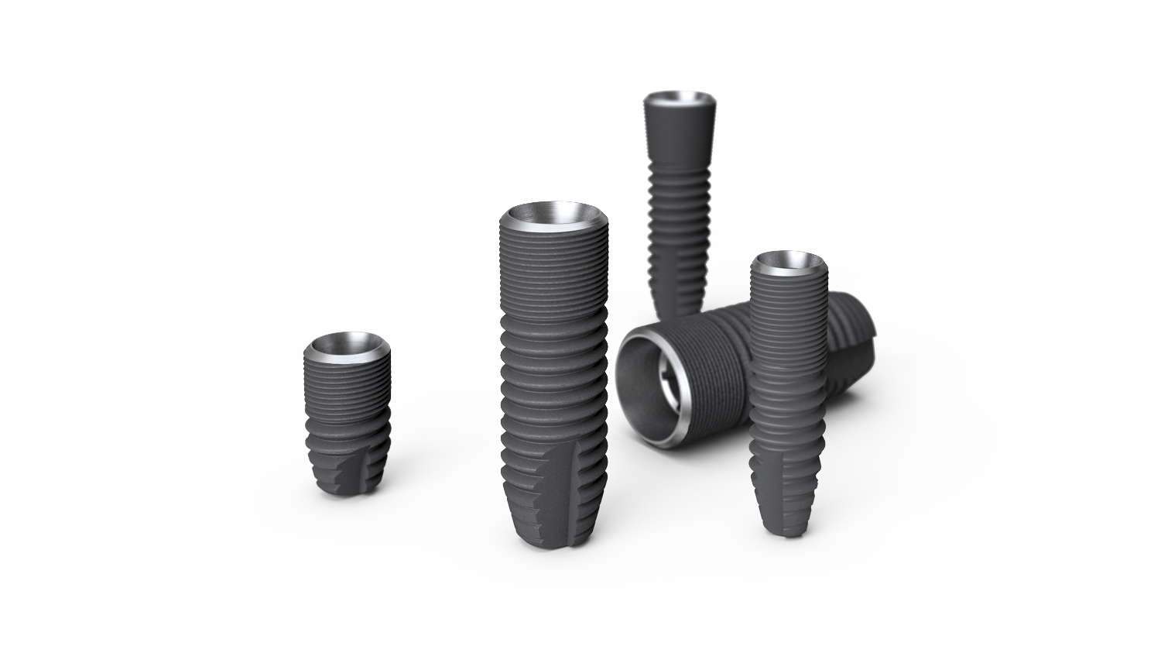
Implant assortment
Notes:
Implant assortment
OsseoSpeed EV implants are available in a versatile range of shapes, diameters and lengths for all indications, including situations with limited space and/or bone quantity.
Specific colors have been assigned to the different implant/ abutment connection sizes, which are consistently used throughout the system and identified by symbols and colors.
Green - 3.0, Purple – 3.6, Yellow – 4.2, Blue – 4.8, Brown 5.4.

Slide 7
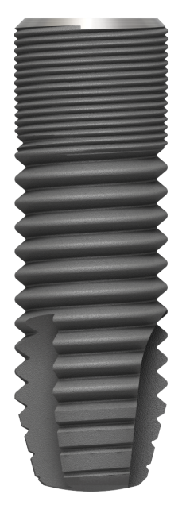
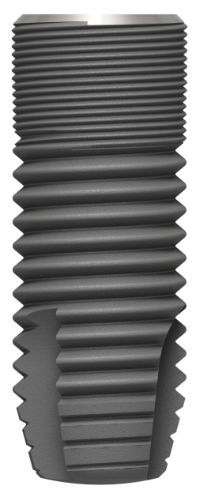
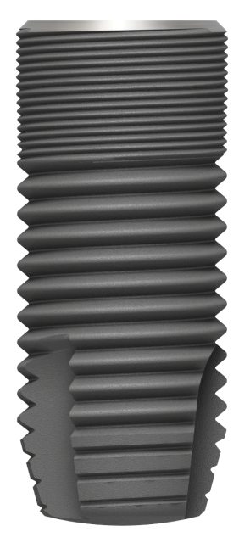
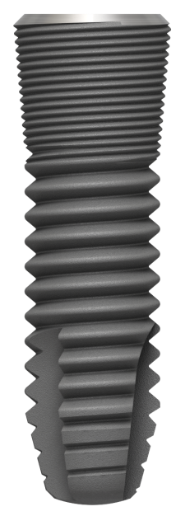
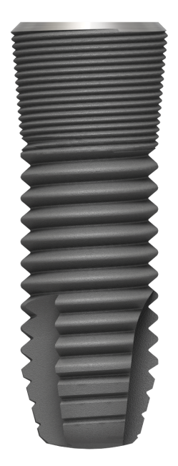
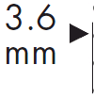
Implant design - OsseoSpeed EV
Green
1.8 mm
2.5 mm
3.1 mm
3.7 mm
4.3 mm
2.5 mm
3.1 mm
Notes:
Implants from diameter 3.0 to 5.4 and lengths from 6 mm to 17 mm

Slide 8
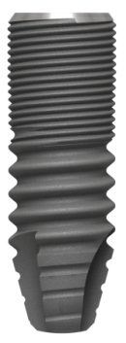
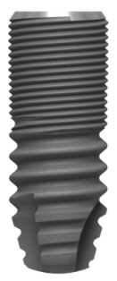
Ø 3.0 mm implant
A two-piece implant solution optimal for cases with limited horizontal space in lower anteriors or upper laterals
8 mm
9 mm
11mm
13 mm
15 mm
Notes:
OsseoSpeed EV 3.0 S - 8, 9, 11, 13 and 15 mm

Slide 9
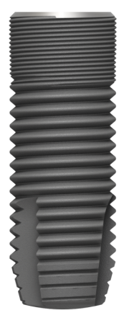
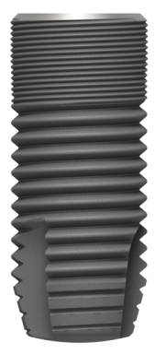
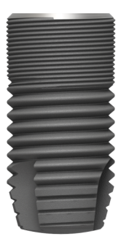
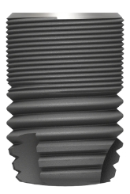
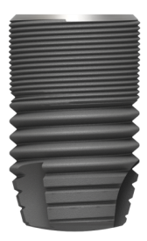
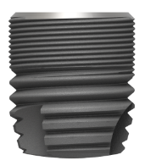
Ø 5.4 mm implant
A 5.4 mm implant diameter option for treatment of the molar region
6 mm
8 mm
9 mm
11mm
13 mm
15 mm
Notes:
OsseoSpeed EV 5.4 S - 6, 8, 9, 11, 13, 15 mm

Slide 10
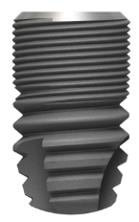
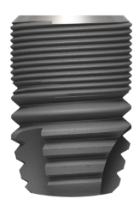
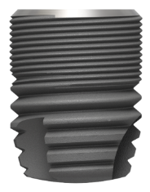
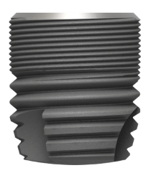
6 mm implant length option
Ideal for cases with limited vertical bone height
Helps reduce the need for bone augmentation
Notes:
Additional 6 mm implant length options for cases with limited bone height.

Slide 11
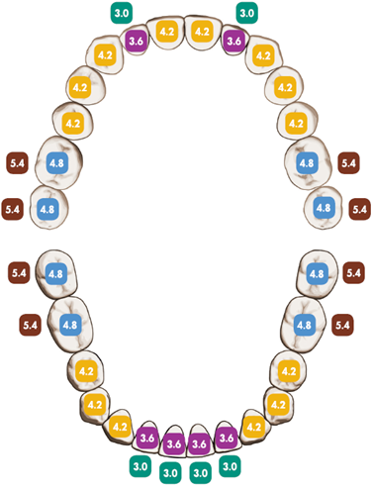
Implant size / tooth position
Recommended implant sizes in relation to the natural dentition
Notes:
Implant size(s) in relation to tooth position, provided there is sufficient bone volume and space in relation to the adjacent dentition.
Multiple considerations are required for each individual tooth, the support needed for the final restoration in the particular position, soft-tissue healing, and implant design and size.

Slide 12
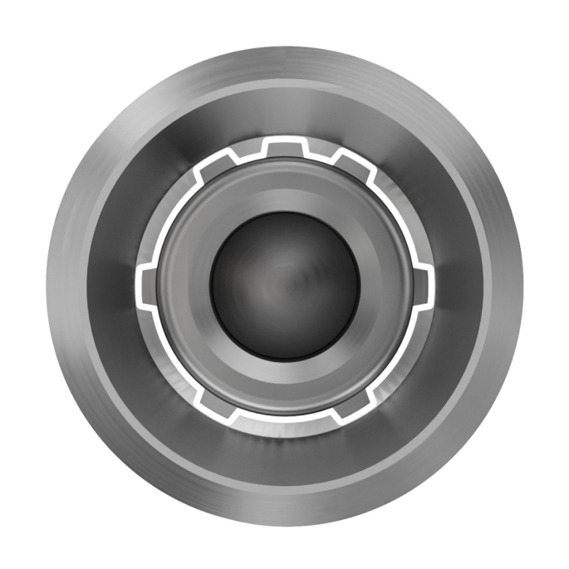
One interface – three indexing solutions
One-position-only
ATLANTIS patient-specific abutments seat in one position only.
Six positions
Indexed abutments seat in six available positions.
Index free
Index free abutments seat in any rotational position.
Notes:
The OsseoSpeed EV implant has a unique interface for one-position-only placement of ATLANTIS patient-specific abutments. The interface also allows for the flexibility of six-position indexing of pre-fabricated abutments, while index-free abutments can be seated in any rotational position.

Slide 13
Bone classification
One drilling protocol for preparation of the spongious bone
Two options for preparation of the cortical bone
Notes:
A unique and simple drilling protocol has been developed to allow for preferred primary stability of the implant:
• One standard procedure that produces a 0.5 mm under-preparation relative to the implant diameter.
• Followed by two options for preparation of the cortical bone based on bone thickness
• In situations when a wider osteotomy preparation is needed, apically and/or along the implant body, additional drills are available.

Slide 14
Drills
Excellent cutting properties
Twist drills and step drills
Sterile packaging
Multiple-use with option for single-use
Color-coded and marked with diameters and drill letter/number
Additional tip depth is maximum 1.0 mm
Notes:
All drills except Precision Drill EV can be used for approximately ten cases. They should be carefully cleaned and sterilized after each surgery, and shall be replaced as soon as their cutting ability diminishes.
6 mm marking on all twist and step drills

Slide 15
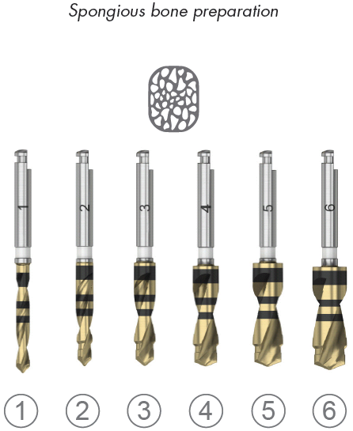
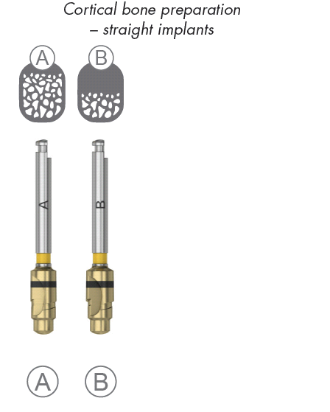
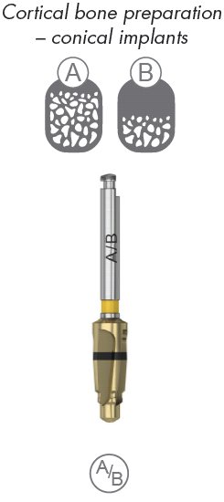
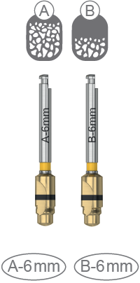
Drill logics
Notes:
Spongious bone preparation
Twist Drill: Used for initial preparation and evaluation of the bone; drill no 1 .
Step Drill: Used for site preparation – allows for a stepped osteotomy that provides guidance during the drilling process; drills 2 – 6 . The stepped osteotomy design ensures proper preparation of the marginal bone for implant placement, while achieving the preferred level of primary stability.
• Color: white
• Markings: diameter and drill number
• Length: available in short (6–13 mm) and long (6–17 mm)
Cortical bone preparation – straight implants
Used for the preparation of the cortical layer to reduce pressure in the bone around the implant neck.
• Color: corresponds to implant
• Markings: diameter and drill letter
• Length: one option
Note: There are separate cortical drills specific for the 6 mm implant.
Cortical bone preparation – conical implants
Used for the preparation of the cortical layer to reduce pressure in the bone around the implant neck.
• Color: corresponds to implant
• Markings: diameter and drill letter
• Length: one option

Slide 16
Guide Drill EV / Precision Drill EV
Notes:
Guide Drill EV / Precision Drill EV
Used for marking and creating a starting point.
Note: The Precision Drill EV is an extremely sharp,
single-use-only drill and should never be handled manually once out of its package.

Slide 17
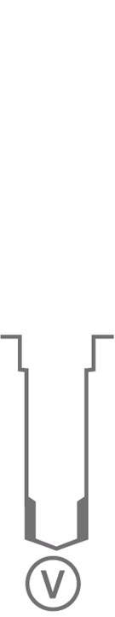
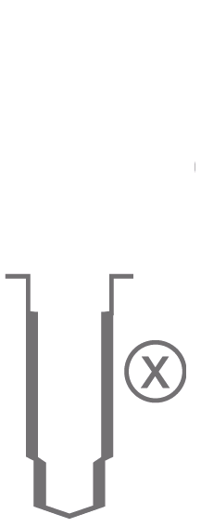
Drill logics - optional osteotomy preparation
Notes:
V-Twist Drill – optional extra apical preparation
Following opening of the marginal cortical layer with cortical drill A , B or conical drill A/B , the V drill can be used to widen the apical part of the osteotomy.
• Color: corresponds to implant Note: for conical implants, this color refers to implant body diameter.
• Markings: diameter and V
• Length: 6–17 mm.
X-Step Drill – optional extra body preparation
Following opening of the marginal cortical layer with cortical drill B or conical drill A/B , the X drill is used to widen the remaining osteotomy below.
• Color: corresponds to implant Note: for conical implants, this color refers to implant body diameter.
• Markings: diameter and X
• Length: 6–13 mm.

Slide 18
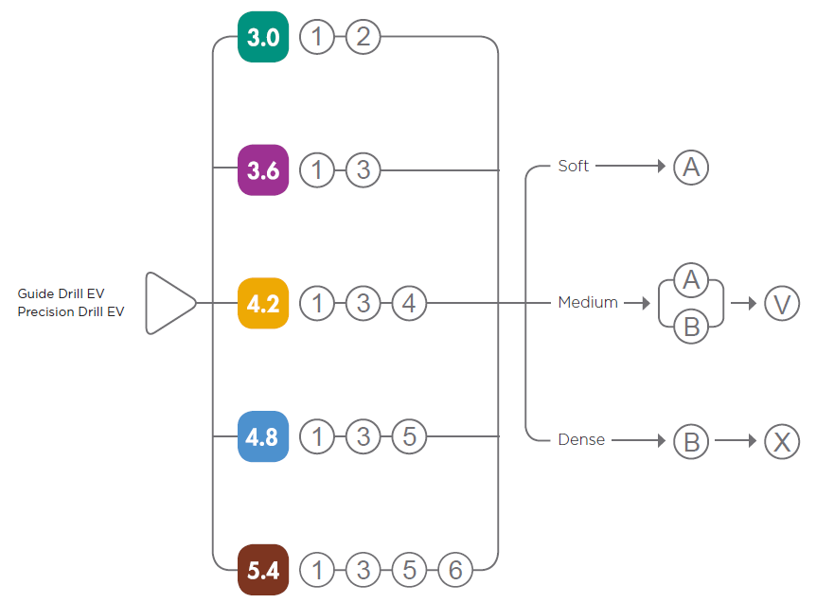
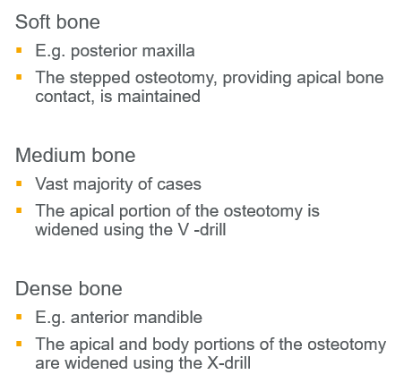
Drilling protocol – OsseoSpeed® EV straight
Notes:
Flexible drilling protocol that allows for preferred primary stability
The drilling procedure is made easy by using color-coding and a simple numbering system

Slide 19
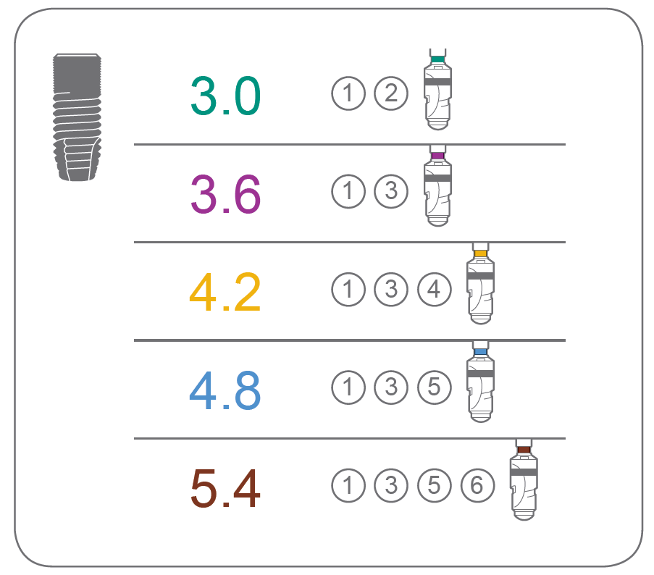
Drilling protocol - OsseoSpeed EV straight
Notes:
The drilling protocol is available on the tray.
Example:
If you are installing a 4.2 S implant you simply use the drill number 1, 3 and 4
followed by a yellow cortical drill A or B depending on the thickness of the cortical bone.

Slide 20
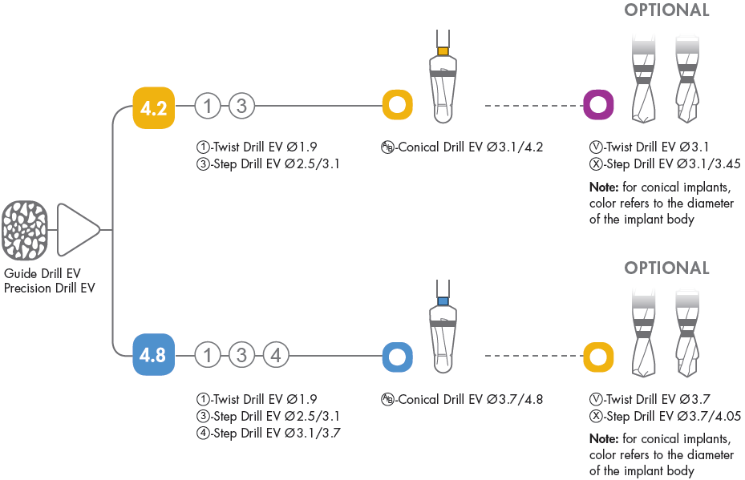
Drilling protocol - OsseoSpeed EV - conical
Notes:
Drilling protocol for OsseoSpeed EV – conical
Note: If an optional osteotomy preparation with V or X drills is utilized, use the color of the drill that refers to the implant body diameter.

Slide 21
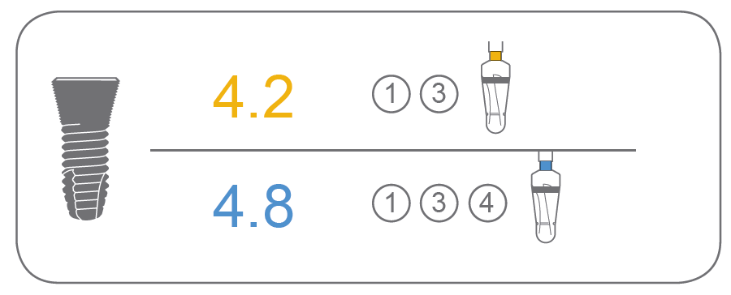
Drilling protocol - OsseoSpeed EV - conical
Notes:
For a conical implant you also follow the drilling protocol e.g. for an OsseoSpeed EV 4.2 C implant,
drills number 1, 3 and a yellow conical drill.

Slide 22
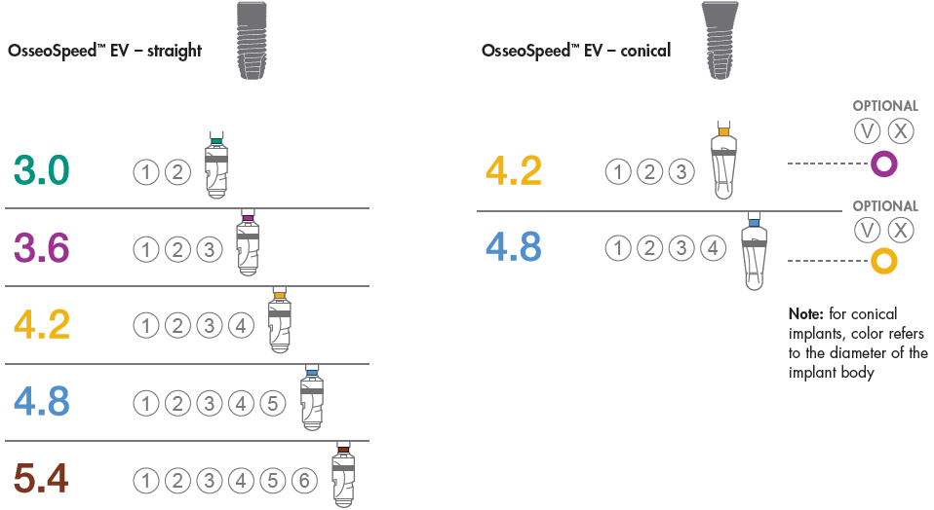
Expanded drilling protocol - OsseoSpeed EV straight and conical
Notes:
Expanded drilling protocol
In sites with compromised bone, the drilling protocol can be expanded to provide further guidance with more drilling steps.

Slide 23
Flexible drilling protocol - providing the preferred primary stability
The stepped osteotomy design ensures proper preparation of the marginal bone for implant placement, while achieving the preferred level of primary stability
4.0 mm
Notes:
Flexible drilling protocol that allows for preferred primary stability
The options within the drilling protocol help ensure proper preparation of the marginal bone and allow for the preferred level of primary stability to be achieved.
The protocol includes the flexibility of a wider osteotomy preparation apically or along the entire osteotomy, as needed.
The Step Drill design provides tactile control and guidance. The excellent cutting properties ensure efficient site preparation.

Slide 24
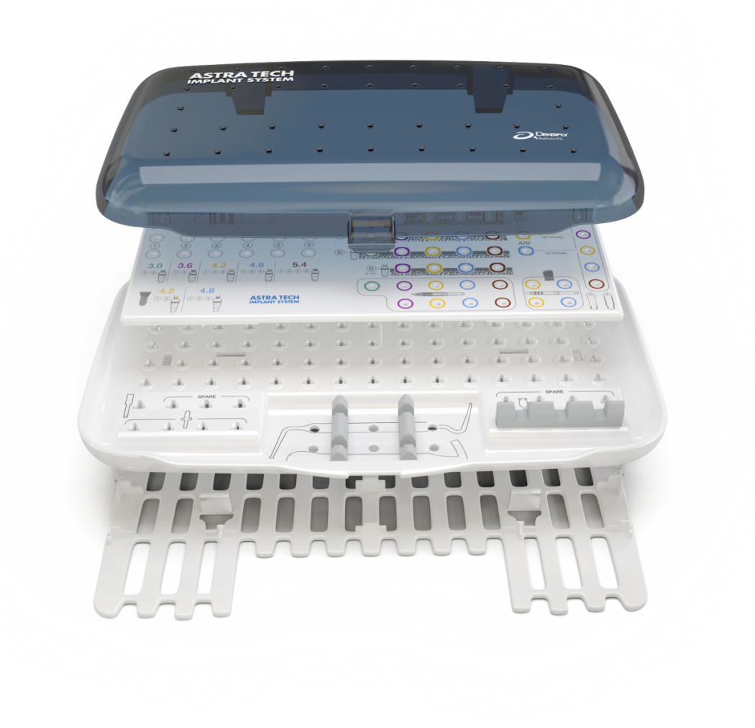
Tray Concept - one tray for all OsseoSpeed EV implants
Organized to support the user
Color-coded and simple layout
Overlay snapped onto the tray base
No rubber grommets
Lid
Overlay
Tray base
Base shield
Notes:
Tray concept
The tray layout and components are organized to support the user throughout the entire surgical procedure.
Tray logics
The color-coded tray has a drill marking system for ease of use and effective handling throughout the procedure, based on the following principles:
One surgical tray – three overlay options
The surgical tray design** with three interchangeable overlays allows for adaption of tray content according to your clinical preferences. The color-coded tray has an intuitive layout for ease of use, effective handling throughout the surgical procedure and accurate communication among the surgical team.
** Patent pending

Slide 25
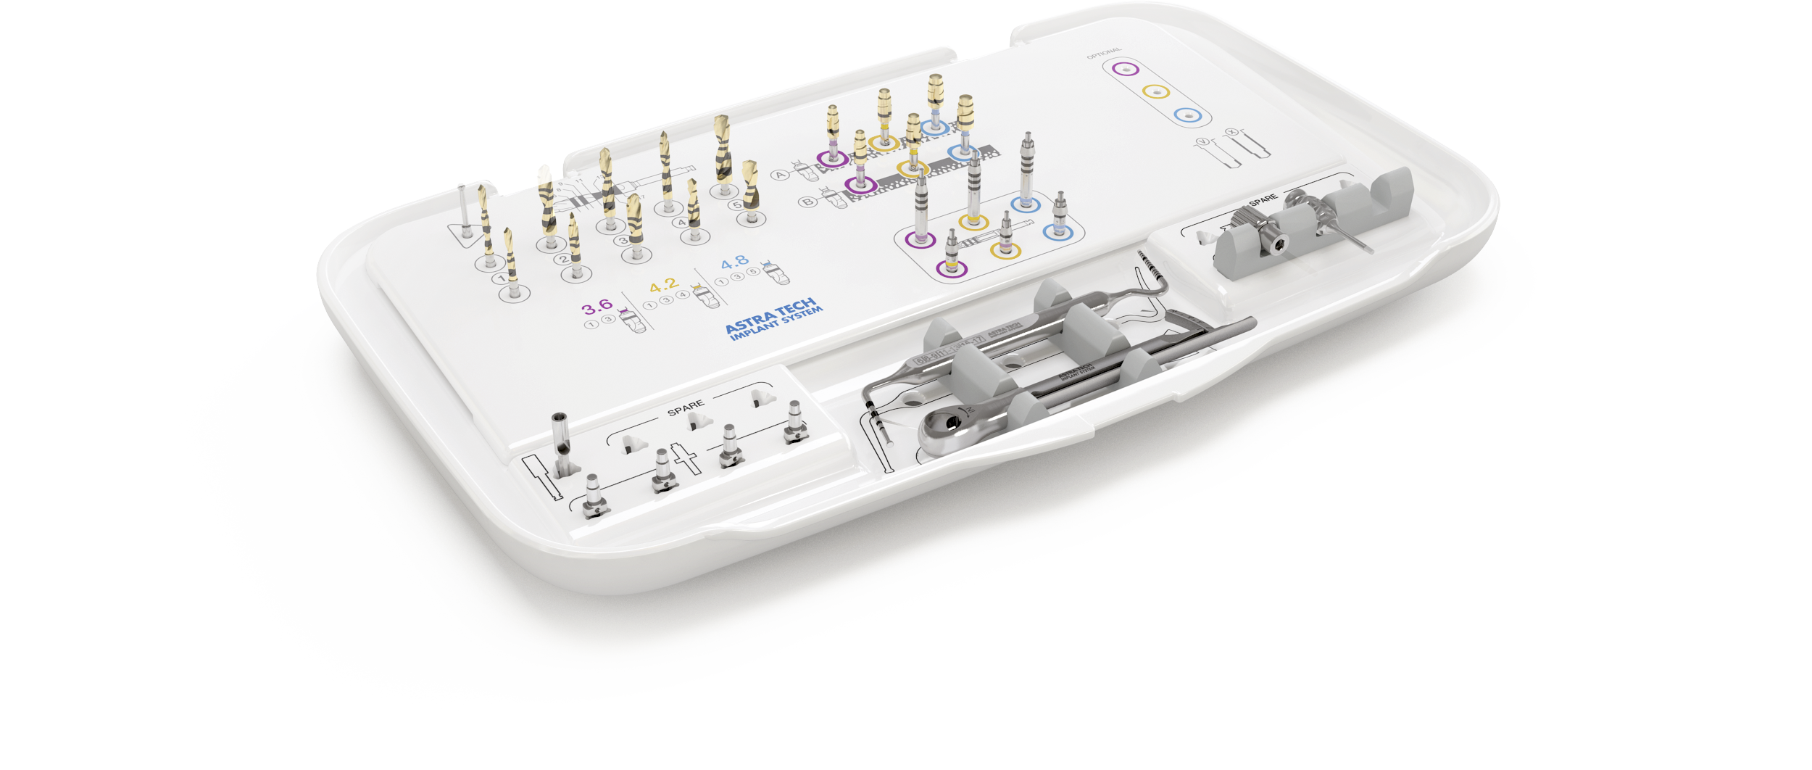
Overlay 1
Notes:
Overlay 1
Streamlined content for the most commonly used straight implants; 3.6, 4.2 and 4.8

Slide 26
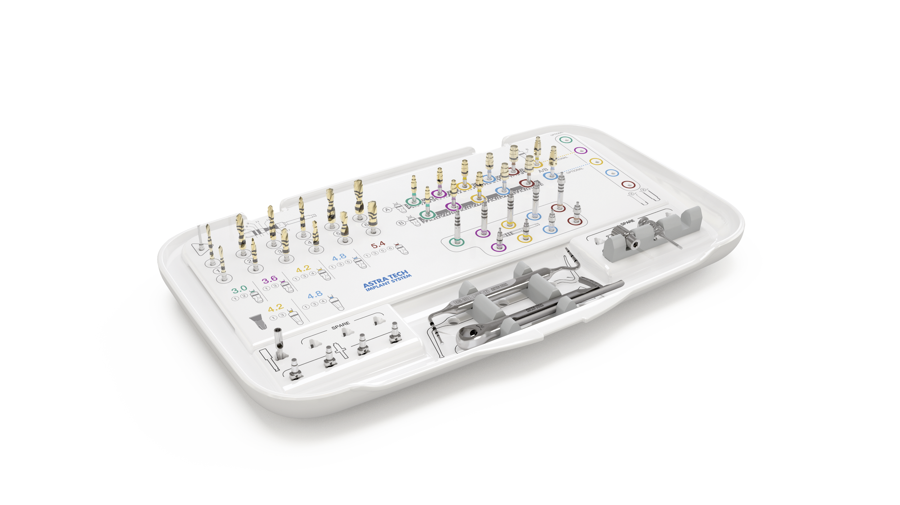
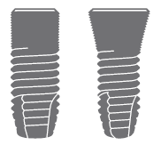
Overlay 2
Notes:
Overlay 2
Designed to accommodate the complete range of diameters for straight and conical implants.

Slide 27
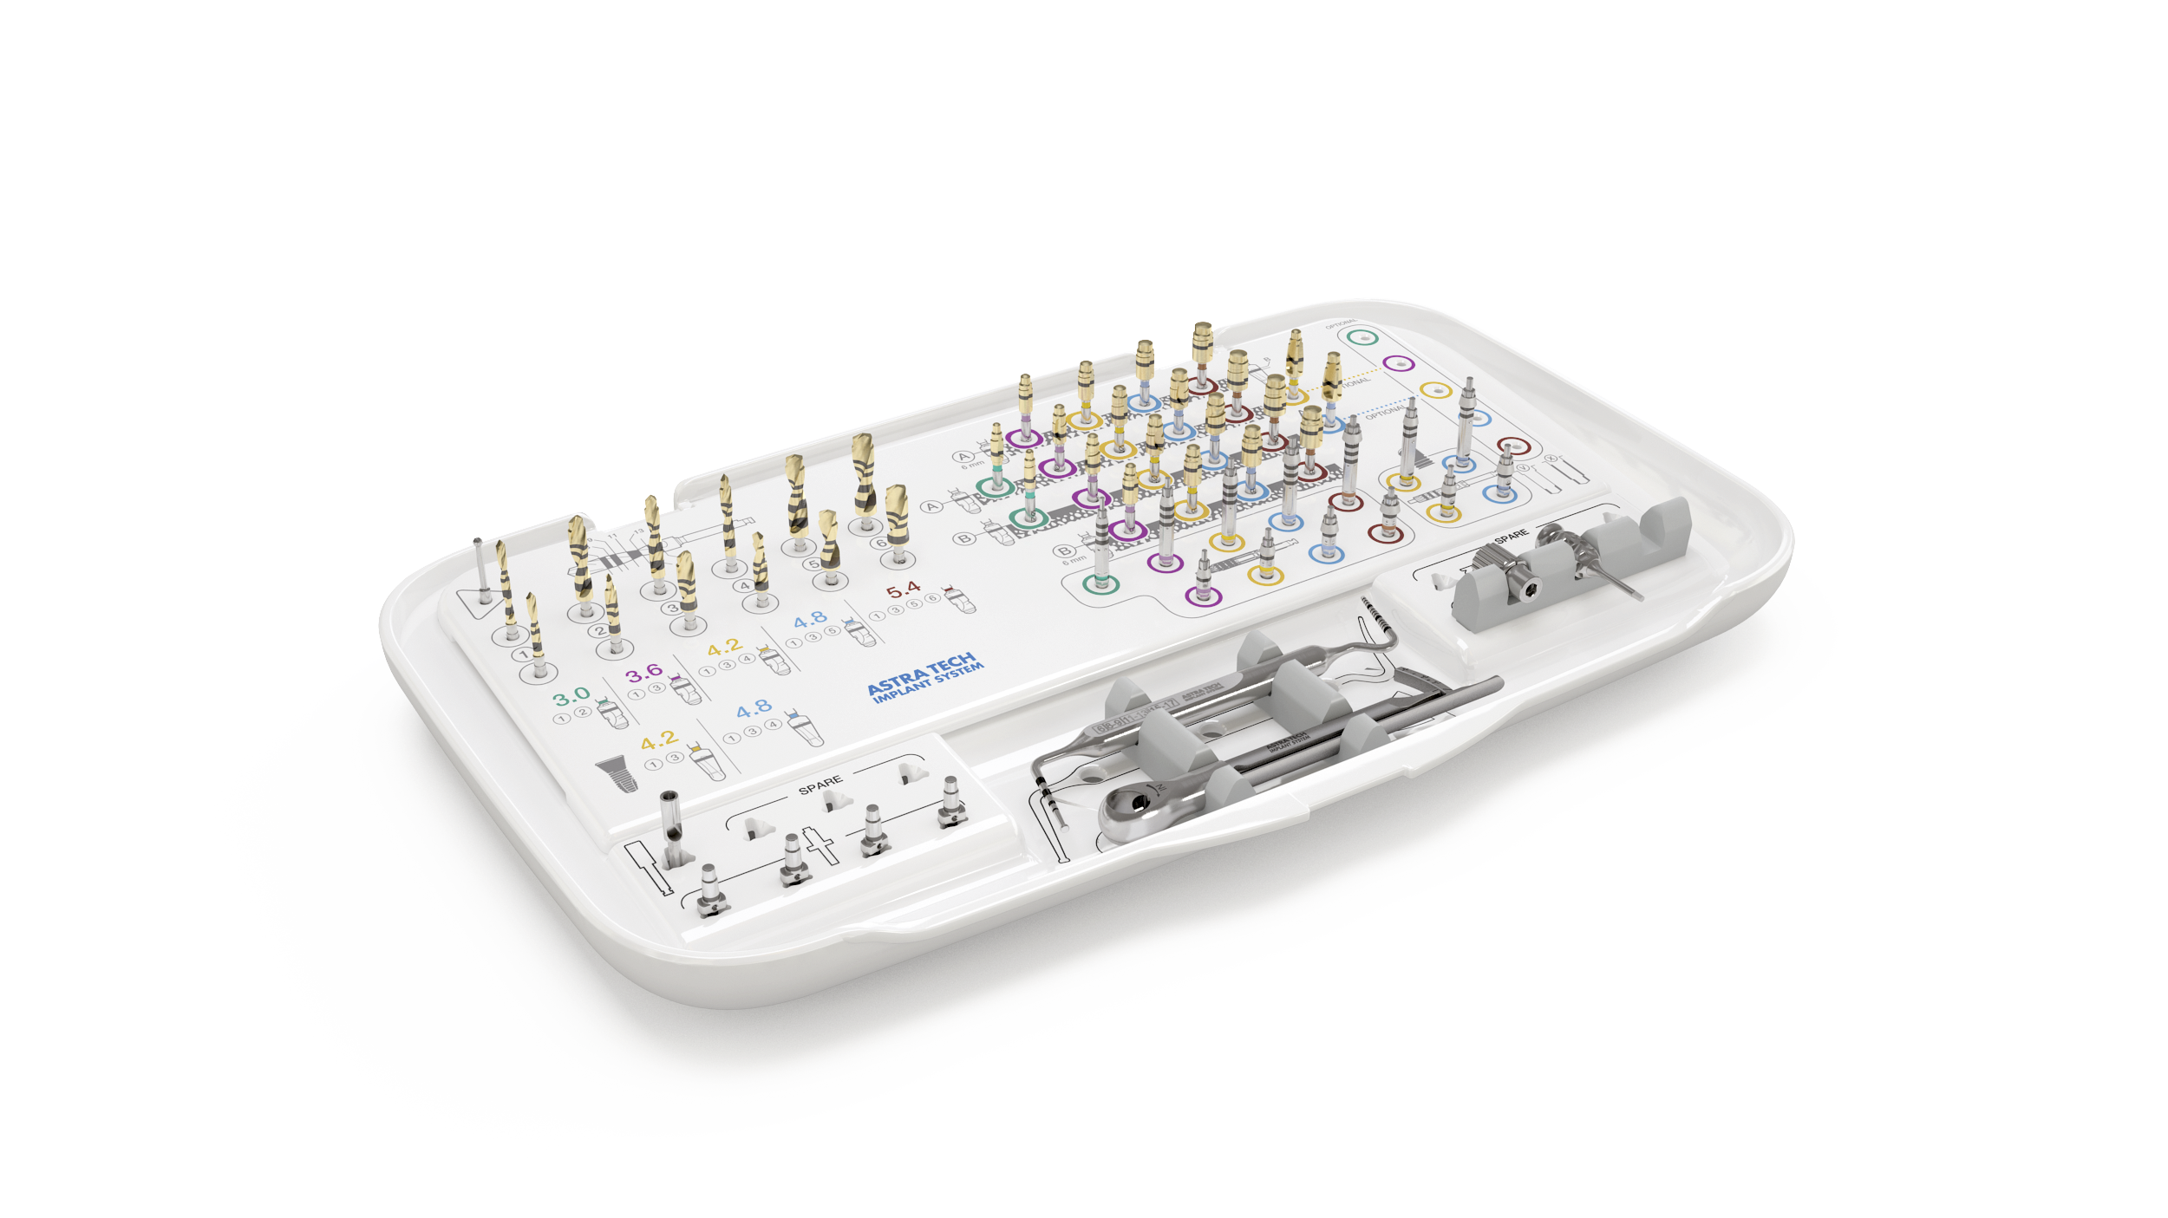
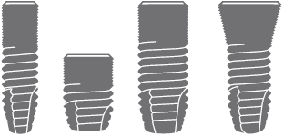
Overlay 3
Notes:
Overlay 3
Supports the full implant assortment including short and OsseoSpeed Profile EV implants*.
* OsseoSpeed Profile EV is not yet available

Slide 28
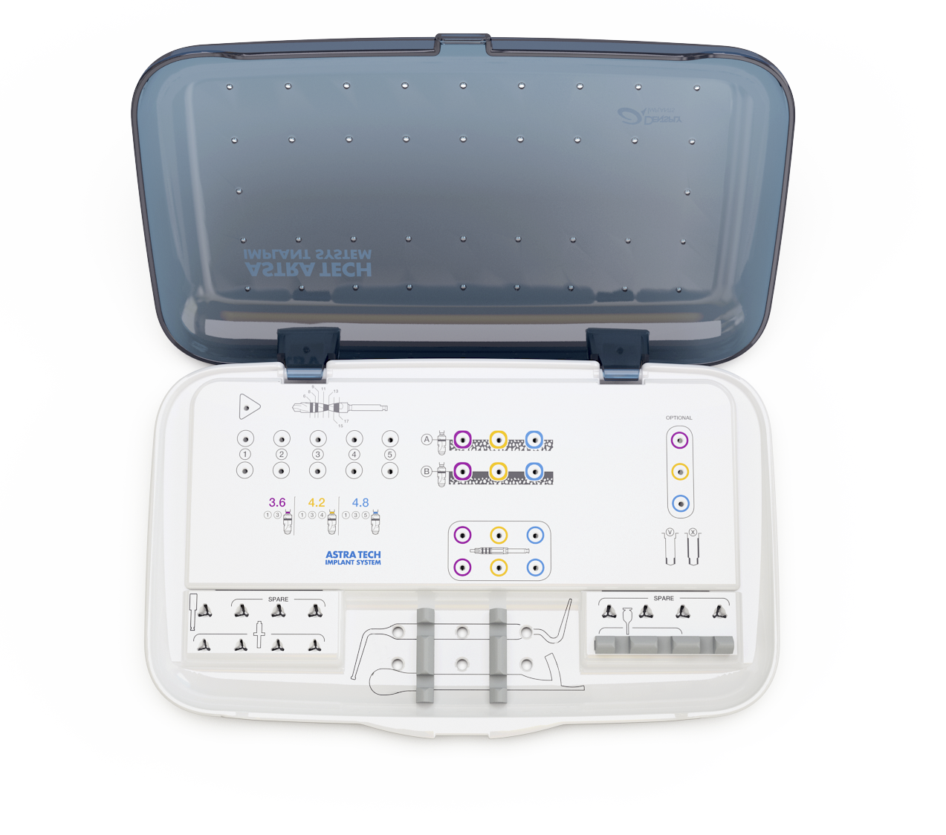
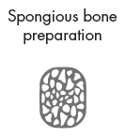
Space for Guide Drill
Drill with markings
Optional drilling
Drilling protocol
Implant Driver EV
Drill Extension EV Spare Implant Depth Gauge EV Hex Screwdriver EV Spare Direction Indicator EV Torque Wrench EV
Notes:
Go through the tray
Drilling protocol for the most common straight implant sizes, 3.6S, 4.2S and 4.8S
Drills 1 to 6 for the spongious bone preparation, color white.
Drills A and B for the cortical bone preparation. Color: corresponds to implant size.
Optional drills extra apical or body preparation, V or X. Color: corresponds to implant size.
Implant Drivers EV, short and long
Space for additional instruments
Space for Guide Drill
Drill symbol showing depth markings on twist- and step drills (symbol not actual size)

Slide 29
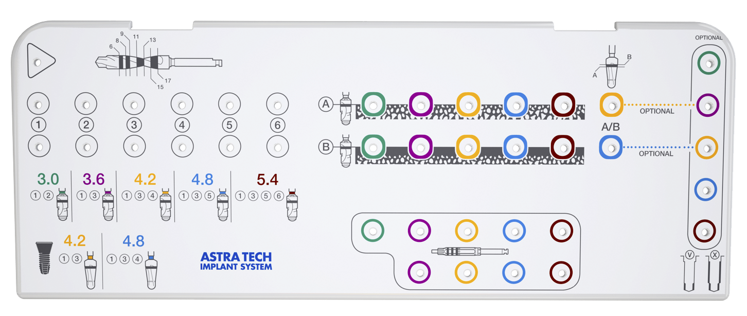
Drilling protocol - OsseoSpeed EV - conical
Notes:
Drilling protocol OsseoSpeed - conical
Note: Important, if an optional osteotomy preparation with V or X drills is utilized, use the color of the drill that refers to the implant body diameter.

Slide 30
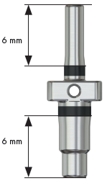
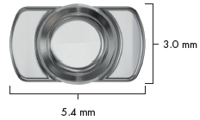
Direction Indicator EV
Narrow end is used after drill
Wider end is used after drill
A laser marking indicates the 6 mm depth

Slide 31
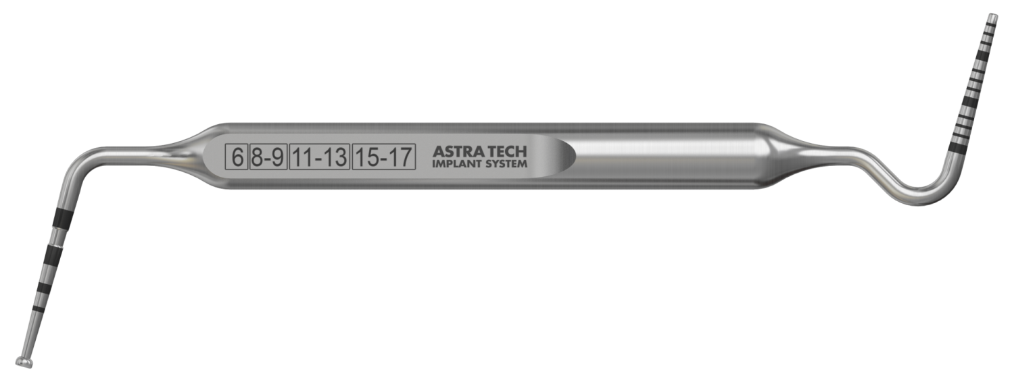
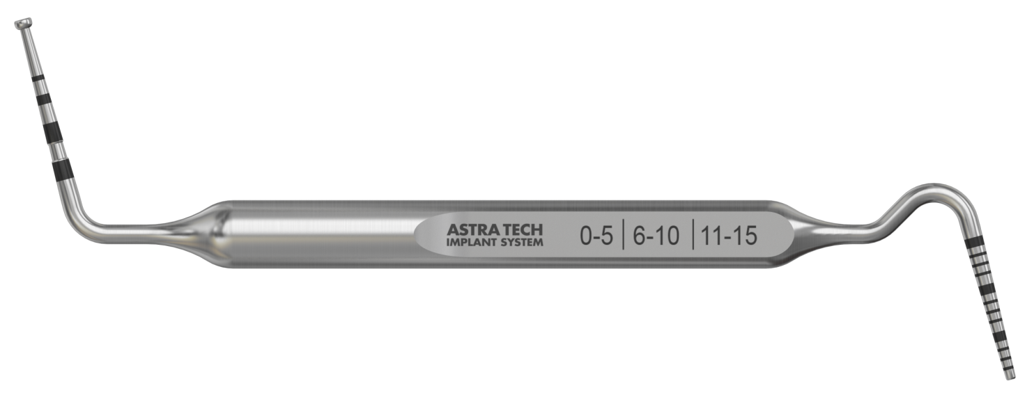
Implant Depth Gauge EV
Notes:
Implant Depth Gauge EV
Used for measuring the depth of the implant site.
• Markings: corresponds to implant lengths 6–17 mm.
The opposite side of the gauge can be used as an measuring probe.
• Markings: 0–15 mm.
Note: A waist is on the depth gauge to facilitate the identification of the 13–15 mm marking.

Slide 32
Implant Driver EV
Notes:
Implant Driver EV
Note: To facilitate optimal placement of pre-designed abutments, align one of the dimples buccally.
The reference point (“0”) of the depth markings is the intended bone level, i.e., the lowest point of the bevel.
• Color: corresponds to implant
• Markings: depth and diameter
• Length: two options, except for 3.0, only long version

Slide 33
Torque Wrench EV
Torque Wrench EV
Driver Handle, Surgical
Driver Handles, Prosthetic
Notes:
A torque wrench together with Surgical Driver Handle is used for implant installation and adjustment of implants.
It can also be used for tightening of abutment screws and/or bridge screws together with Restorative Driver Handle.

Slide 34
Implant packaging
Notes:
The implant packaging is marked with implant size (implant– abutment connection size) as well as implant length.

Slide 35
Implant packaging
Notes:
Packaging
Packages contain protective blisters that hold the components.
Labels
Three peel-off labels are provided for the patient’s treatment record and for communicating with the restorative team.

Slide 36
Implant pick-up
Notes:
Implant container
• After opening the blister package….
• Remove the cap from the container using a twisting motion to expose the top of the implant.
Note: Marked with implant size and length
Implant pick up
• Attach the appropriate Implant Driver EV to the contra angle.
• Make sure that the implant driver is fully seated into the implant.
• Press downwards to activate the carrying function before picking up the implant.
Manual implant pick up
Engage the Implant Driver EV to the Surgical Driver Handle EV for manual implant pick up.

Slide 37
Drill packaging
Notes:
Packaging
• Secure the drill by squeezing the blister.
• Expose the drill shaft by bending back the top of the blister.
Pick-up
Engage the drill with the contra angle.
Note: The Precision Drill EV is an extremely sharp, single-use-only drill and should never be handled manually once out of its package.

Slide 38
Drilling
Notes:
Twist Drill EV 1.9 1
If preferred, Guide Drill EV or Precision Drill EV can be used to create a pilot hole prior to the Twist Drill 1 .
Drill in the planned direction to the appropriate depth.
The drilling will provide valuable information about the cortical and spongious bone.
Insert the smaller end of the Direction Indicator EV into the site to visualize/verify the direction.
Note: The depth should allow the implant to be level with or slightly submerged in relation to the adjacent marginal bone.
Step Drill EV 2.5/3.1 3
Drill in the planned direction to the appropriate depth.
Insert the larger end of the Direction Indicator EV into the site to visualize/verify the direction.
Step Drill EV 3.1/3.7 4
Drill the implant site to the appropriate depth.
Cortical Drill EV
Finalize the osteotomy by drilling to the full depth as indicated by the marked line. Use the cortical drill based on the cortical bone thickness:
Cortical Drill A for a thin cortical bone
Cortical Drill B for a thick cortical bon

Slide 39
Implant installation
Notes:
Implant Depth Gauge EV
Verify the implant site depth after drilling using the Implant Depth Gauge EV.
Note: The depth should allow the implant to be level with or slightly submerged in relation to the adjacent marginal bone.
Implant installation
• Install the implant with the contra angle at low speed (25 rpm) under profuse irrigation and the maximum torque set to 45 Ncm.
• Allow the implant to work its way into the osteotomy. Avoid applying unnecessary pressure.
Note: Do not exceed 45 Ncm when installing the implant. If not completely seated before reaching 45 Ncm, reverse/ remove the implant and widen the osteotomy appropriately
It is recommend to have a titanium forceps available in case the implant driver does not provide sufficient carrying function during the removal procedure.
Positioning
• Position one of the dimples on the implant driver buccally to facilitate optimal placement of pre-designed abutments using the Torque Wrench EV together with Surgical Driver Handle.

Slide 40
Healing options
One-stage surgical protocol
HealDesign EV, round or triangular
Healing Uni EV
Two-stage surgical protocol
Cover Screw EV, one height
Notes:
The healing components are developed to support the surrounding soft tissue and give a predictable treatment situation by geometries in close correspondence to the final abutments.
HealDesign EV
• Round shapes are primarily indicated for posterior anatomies
• Triangular design for anterior implant sites and to mimic the shape of incisors and canines
• Heights and diameters are designed to correspond with final abutments to provide soft tissue sculpturing
Healing Uni EV
Healing Uni EV is used for soft tissue support during the healing phase and is designed to support and simplify permanent abutment selection
• Harmonized with the heights and diameters for the final Uni Abutment EV
• Laser etched bands for gauging
Cover Screw EV
• One option for each interface connection

Slide 41
Thank You

