Slide 1
For better, safer, faster dental care
Implants

Slide 2
Atlantis Conus concept A little friction is a good thing

Slide 3
The Atlantis Conus concept – a conometric solution
Notes:
This innovative concept redefines stability and comfort for edentulous patients.
[NEXT SLIDE]

Slide 4
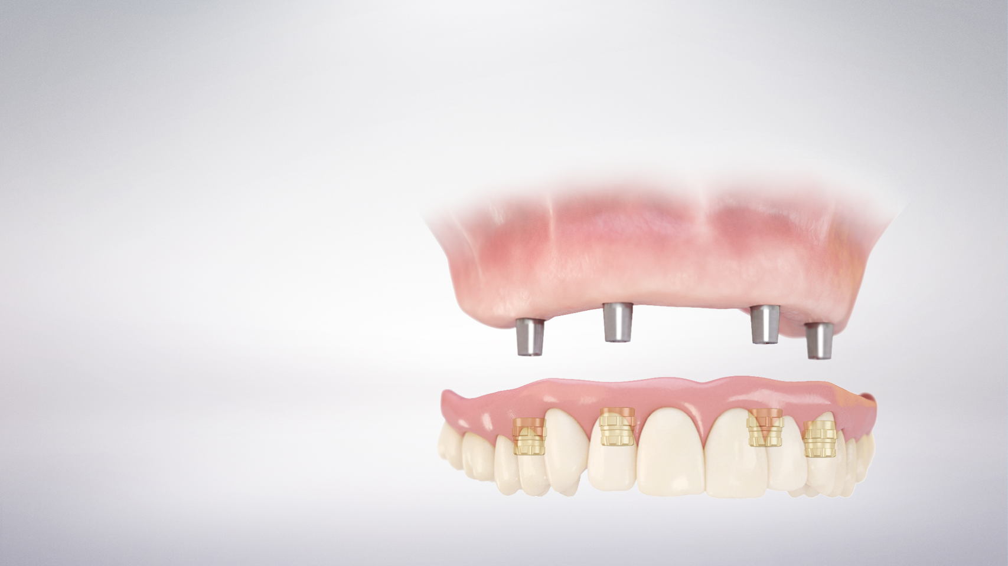
Save time and increase profitability
A patient-specific, digital solution planned from the restorative perspective.
Notes:
Supported on four or more implants, and through the use of parallel conical abutments…
[NEXT SLIDE]

Slide 5
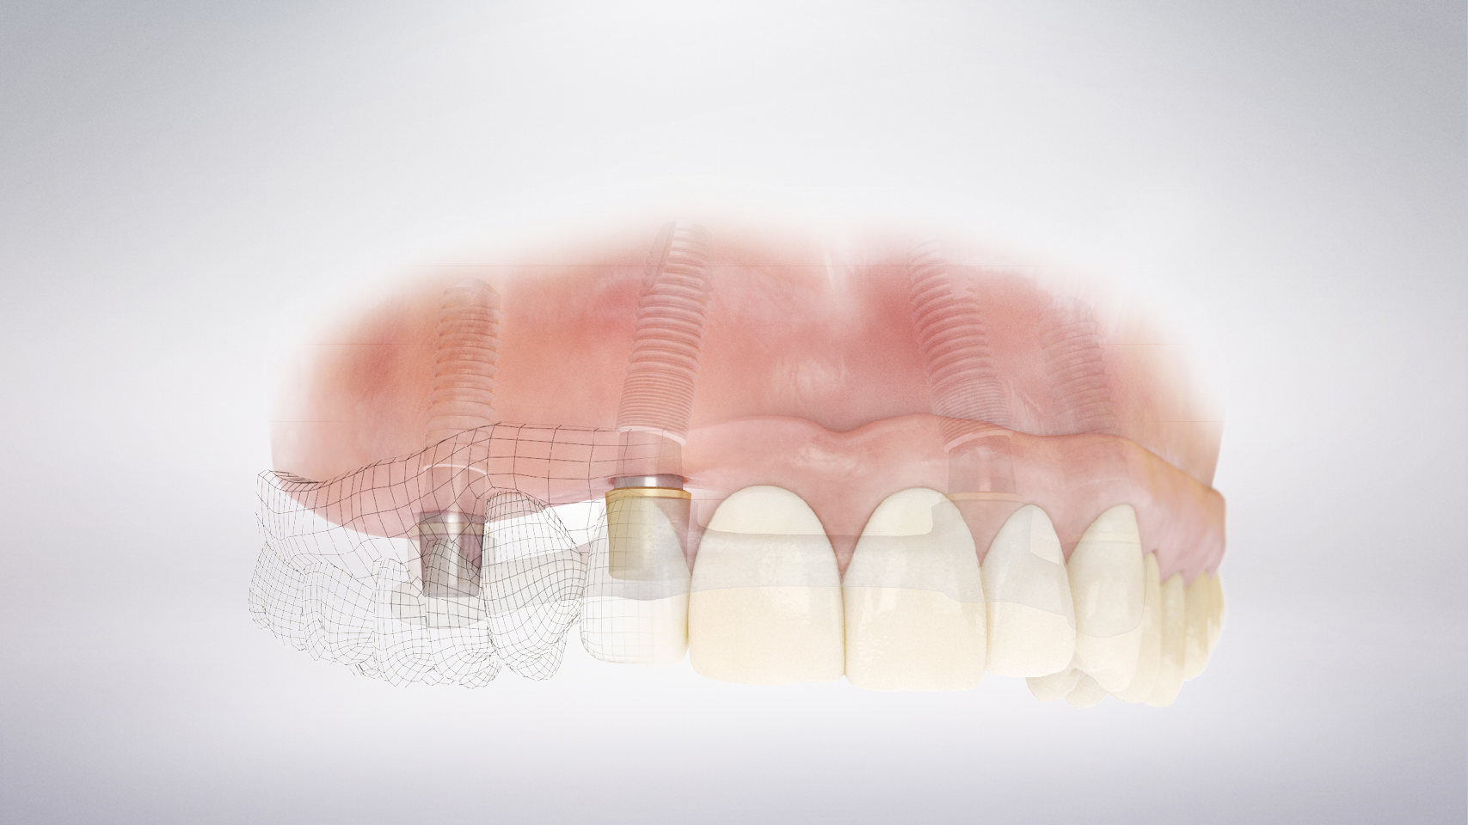
A solution that provides you with:
Compensation for malposition
Tension-free fit
A palate-free option
Parallel patient-specific abutments
An option of a metal framework
Reduction of prosthesis body for esthetic result
Notes:
Deliver a solution that can…
Improve phonetics – Compared to a fixed restoration, Atlantis Conus concept does not need space under the construction to allow for cleaning
Improve taste with a palate-free option
Improve esthetics, with a a reduced prosthesis body thickness
Treat more cases, because it can compensate for resorption and malposition of the alveolar ridge where the use of fixed solutions may be limited
[NEXT SLIDE]

Slide 6
Patients will receive:
An easy-to-clean prosthesis
A stable yet removable prosthesis, offering the perception and security of a fixed restoration
Optimal chewing function and sense of taste thanks to the free-palate option
A cost-effective solution
Desirable phonetic function and esthetic results
Notes:
In addition, the Atlantis Conus concept delivers a prosthesis to your patients that is…
Non-resilient, rigid; fixed; friction-retained
Easy-to-remove, because the force to remove is the same every time
Cost-effective, because there no retention elements to wear out and a long-term temporary can be created from a patient's existing denture
Highly esthetic - unlike the large constructions necessary with fixed bridges, the Atlantis Conus concept prosthesis does not need to be as thick
Additionally, the Atlantis Conus concept prosthesis can often improve phonetics; the gaps necessary for cleaning under a fixed bridge, which can suck air into the mouth when speaking, are not there.
[NEXT SLIDE]

Slide 7
Deliver the best of both worlds
–Why choose between stability and easy maintenance?
Notes:
Atlantis Conus concept allows you can deliver the best of both worlds…
The stability of a fixed restoration with the flexibility of a removable prosthesis.
[NEXT SLIDE]

Slide 8
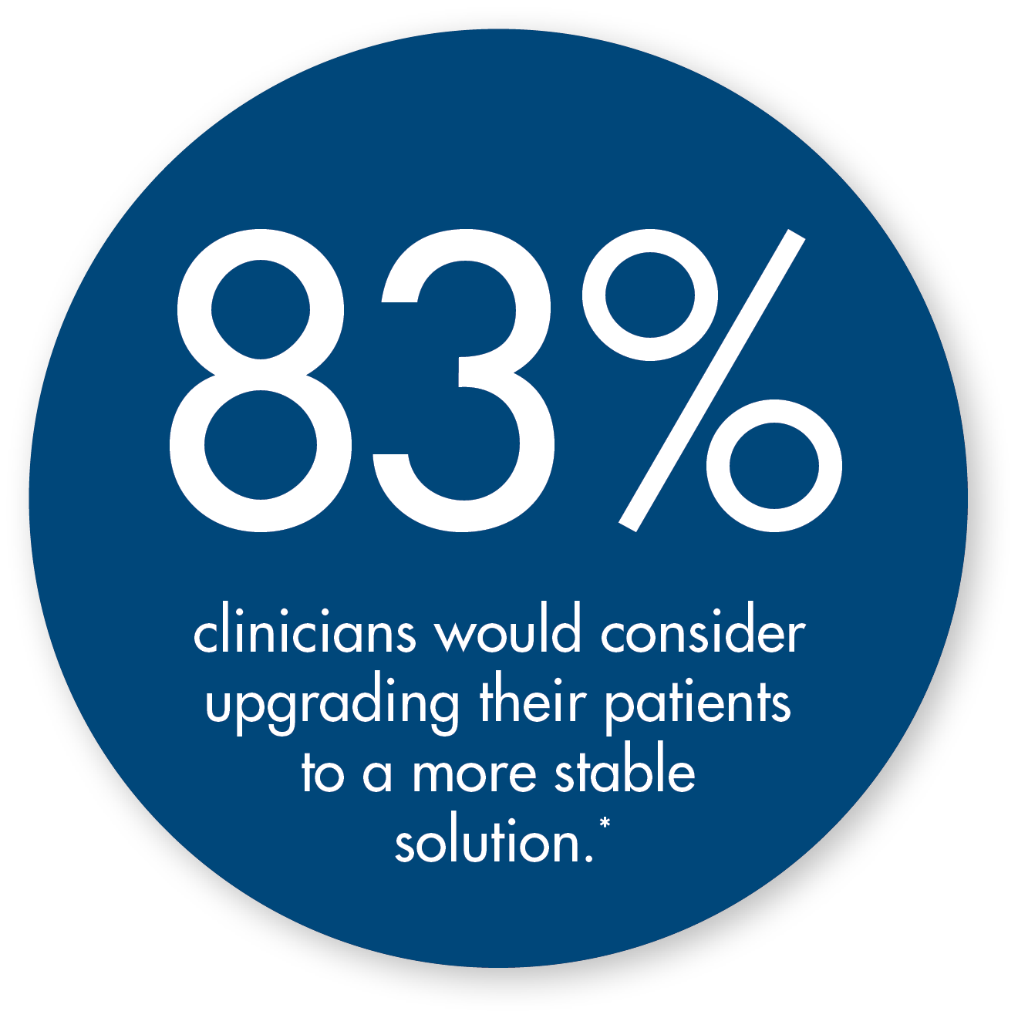
“By offering the Atlantis Conus concept to my patients,
I am able to provide a cost-effective solution that delivers
the benefits of a removable and the functional attributes
of a fixed prosthesis.”
Arnold Rosen, DDS, MBA
Private practice, Boston, Massachusetts, USA
* Results from a survey of clinicians in North America, Germany, Spain and France
Notes:
When we asked clinicians in Germany, USA, Spain and France, 83% of these clinicians said they would consider transitioning some or all of their patients to a more stable solution…
This is because many of their patients are dissatisfied with the stability of their current solution.
[NEXT SLIDE]

Slide 9
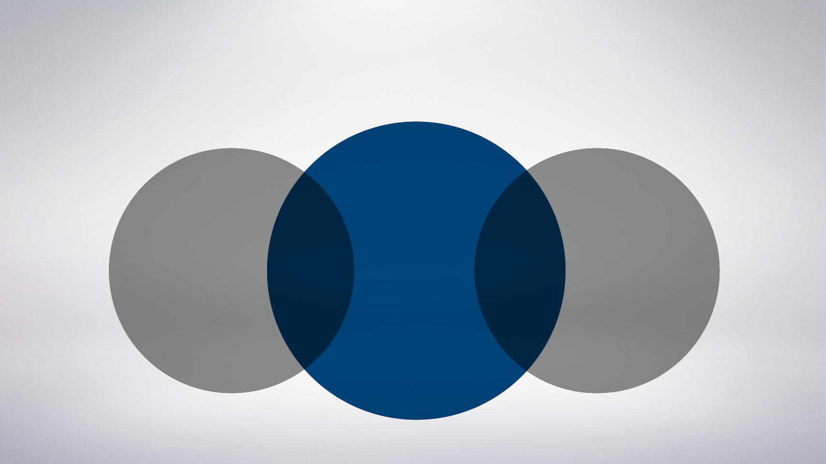
You can have both
Stability
Comfort
Esthetics
+
Easy maintenance
Cost effectiveness
Fixed
bridge
Removable
overdenture
Notes:
Atlantis Conus concept combines the benefits of a fixed bridge and a removable overdenture without the disadvantages of either…
Patients receive a stable, comfortable and esthetically pleasing solution that is easy to maintain and more cost effective in the long run.
[NEXT SLIDE]

Slide 10
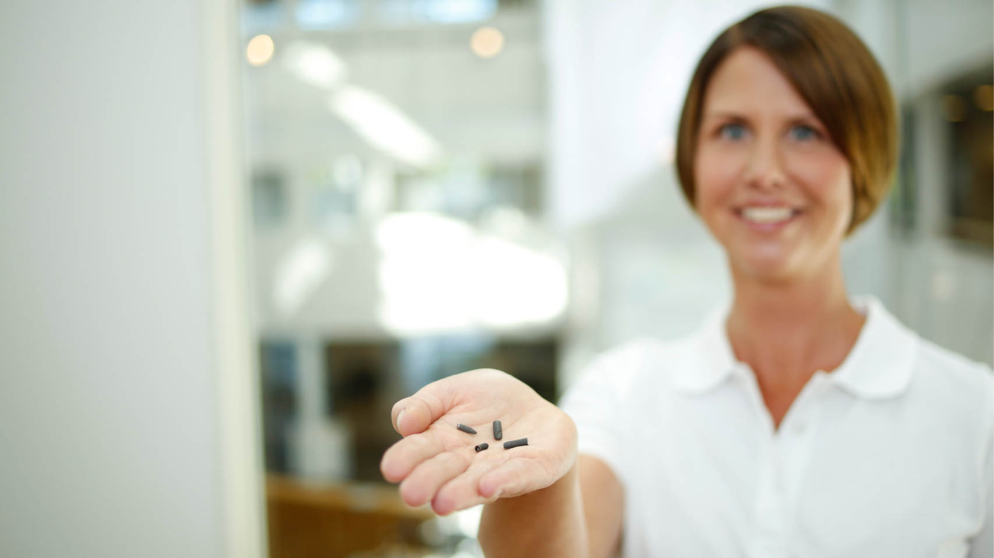
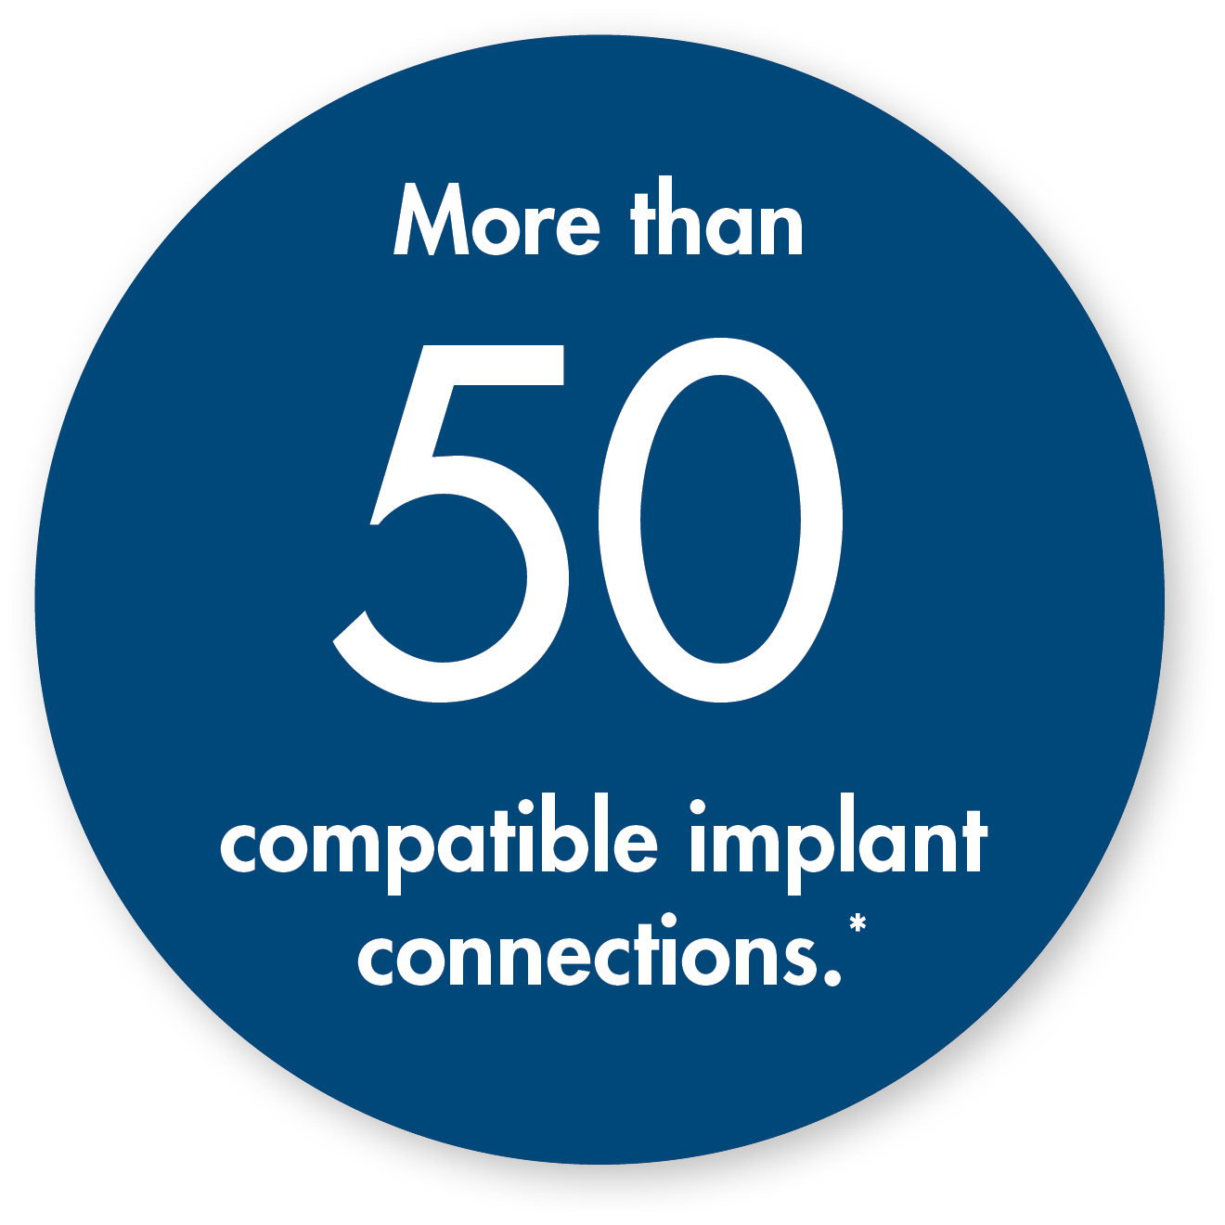
Freedom to choose your implant system
Why not continue working the way you’re used to?
* Refer to Atlantis abutments implant compatibility chart
Notes:
Compatibility with different implant systems is key…
Currently, Atlantis Conus concept is compatible with over 50 different implant interfaces…
If you’d like, I can send you the complete list of compatibility, also available on our website.
[NEXT SLIDE]

Slide 11
“Not only is the Atlantis Conus concept very affordable, it is also a great solution for those patients who need facial flange support and an open palate for taste and comfort.”
Lars Hansson CDT, FICOI
Bay View Dental Laboratory, Chesapeake, Virginia, USA
Notes:
Here is another dental professional sharing his experiences with Atlantis Conus concept, improving patient comfort and appearance.
[NEXT SLIDE]

Slide 12
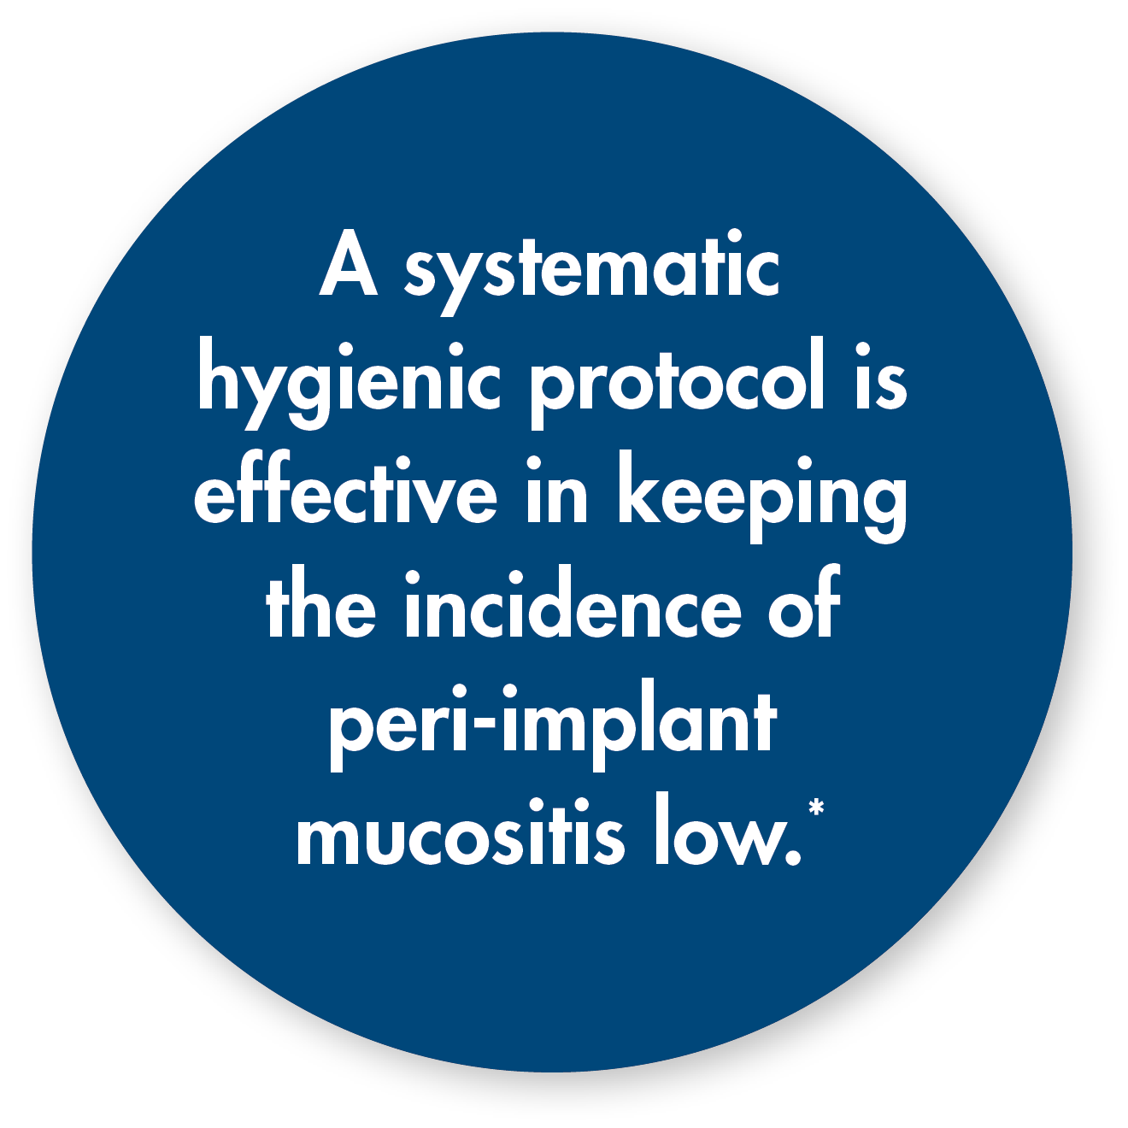
Easy maintenance, even as patients grow older
Will the solution you provide today meet your patients’ needs in the future?
* Corbella S, et al. Clinical evaluation of an implant maintenance protocol for the prevention of peri-implant diseases in patients treated with immediately loaded full-arch rehabilitations. Int J Dent Hygiene, 2011; 9(3): 216–222.
Notes:
The Atlantis Conus concept prosthesis is easy to remove so patients can keep up with hygiene, even as they age…
Good hygiene is important for avoiding complications in the long run…
This has been shown to be the case in many studies, including this one by Corbella S, et al; “Clinical evaluation of an implant maintenance protocol for the prevention of peri-implant diseases in patients treated with immediately loaded full-arch rehabilitations, which was published in the International Journal of Dental Hygiene in 2011.
[NEXT SLIDE]

Slide 13
“The digital technology behind the Atlantis Conus concept allows us to restore implants that are not perfectly parallel to each other in a semi-fixed fashion.”
Lars Bouma, DDS, MS, FACP
Private practice, Oklahoma City, Oklahoma, USA
Notes:
In another example, Dr. Lars Bouma from Oklahoma explains how the patented Atlantis VAD (Virtual Abutment Design) software can be used to compensate for misaligned, unparalleled implants in most cases.
[NEXT SLIDE]

Slide 14
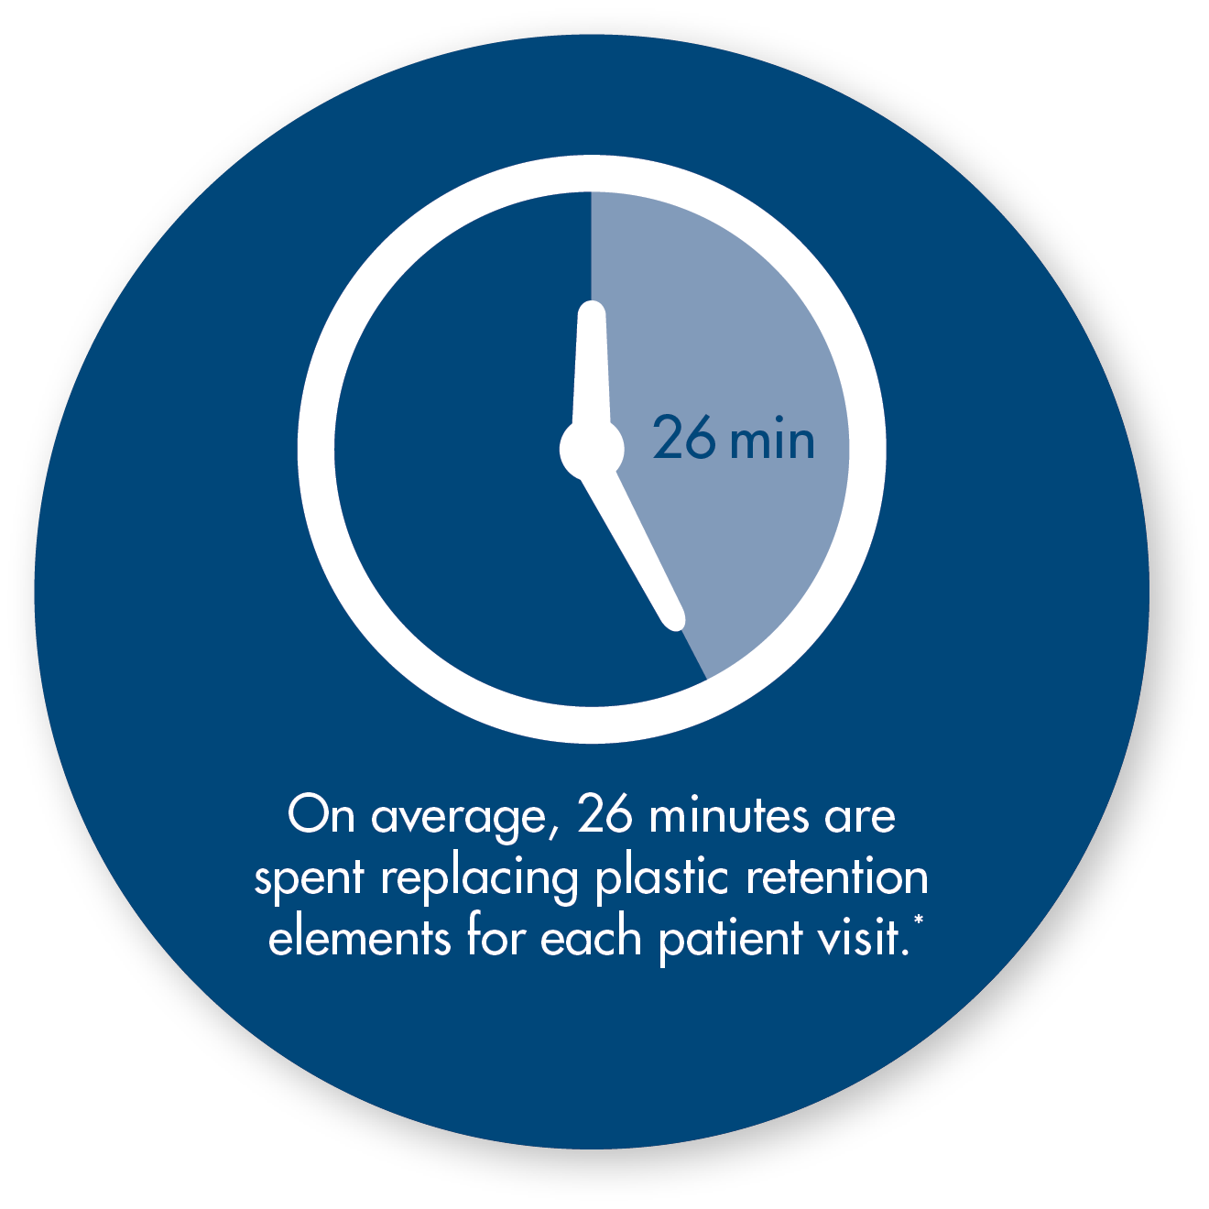
Regain lost time
Are maintenance visits for replacing worn-out retention elements becoming routine?
* Results from a survey of clinicians in North America, Germany, Spain and France
Notes:
From the survey that was mentioned previously…
We also discovered that clinicians are spending hundreds hours a year, replacing worn-out plastic retention elements used to retain other forms of removable prostheses…
Using the Atlantis Conus concept would allow this lost time to be re-cooped, allowing you to use the time for other important tasks.
[NEXT SLIDE]

Slide 15
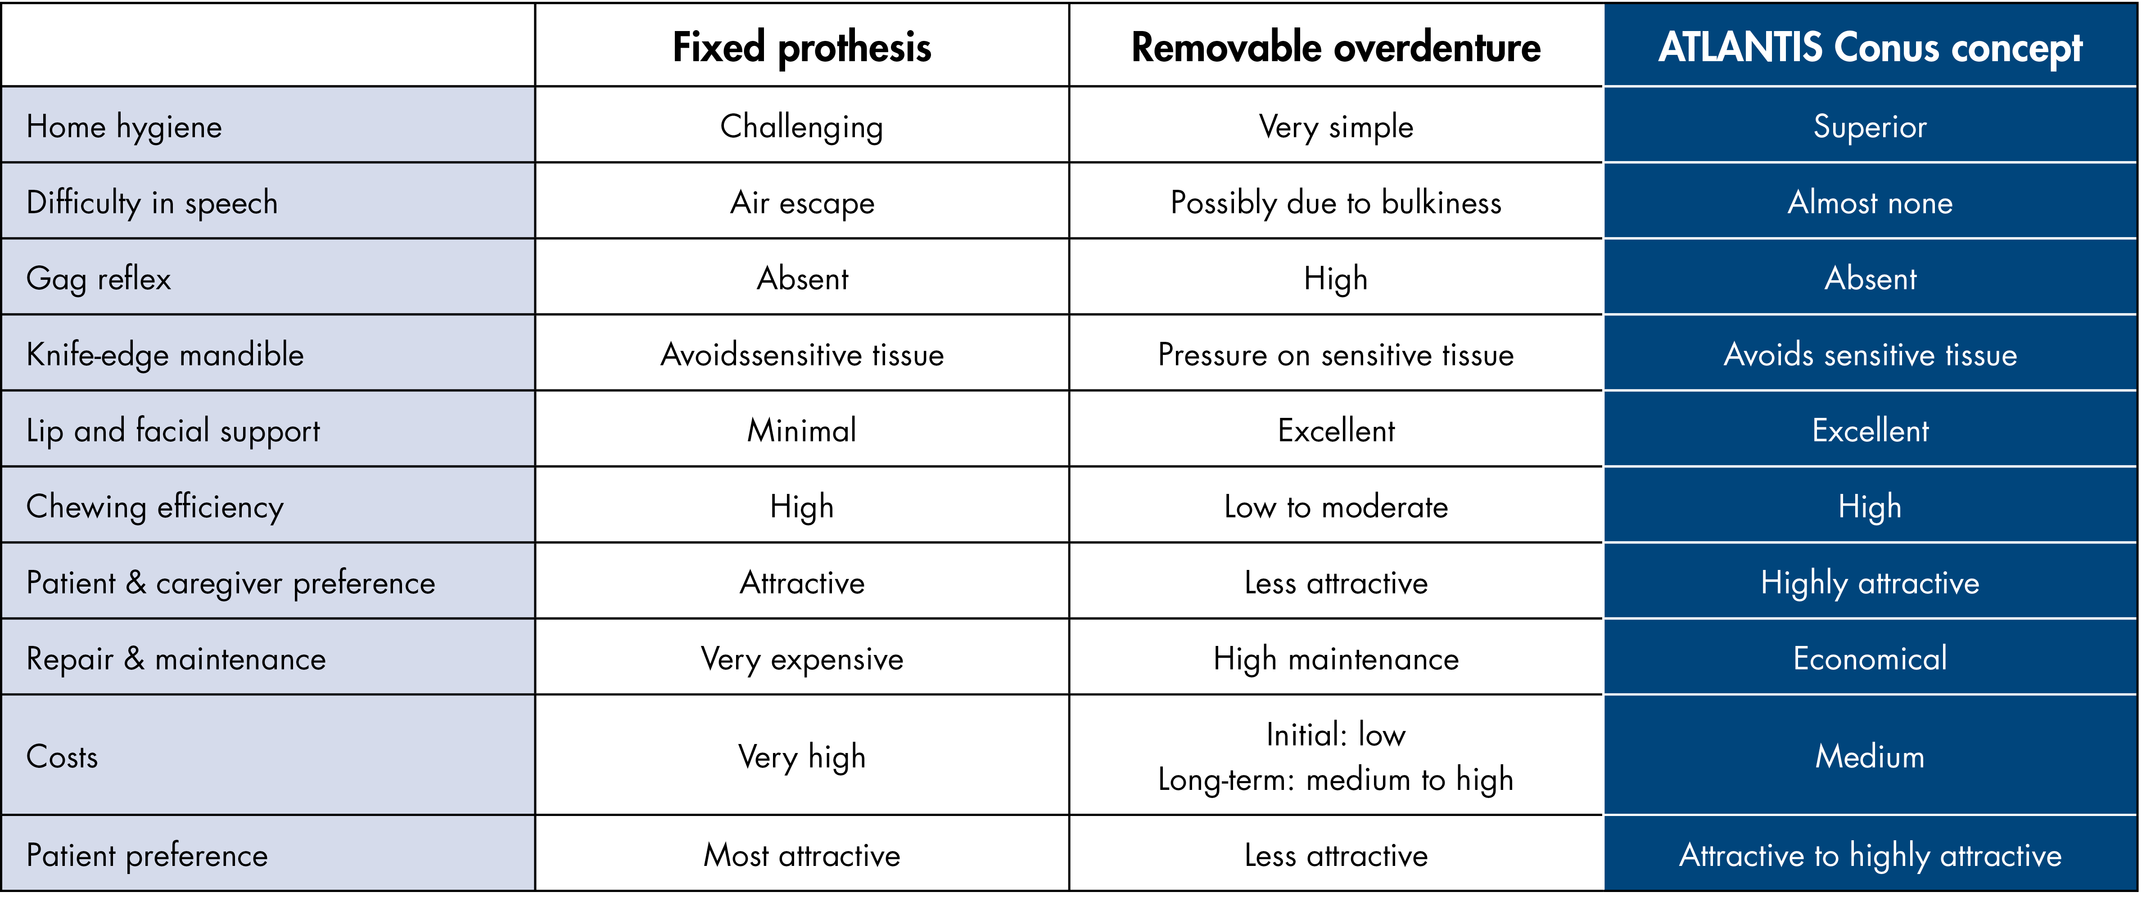
Comparison to other edentulous solutions
Courtesy of Ernest Cholakis, DMD, Cholakis Dental Group, Winnepeg, Manitoba, Canada
Notes:
In this chart, Dr. Cholakis – a clinician who has solid experience with edentulous restorations, compares the different solutions available for edentulous patients…
As you can see, the Atlantis Conus concept provides definitive benefits over alternative solutions.
[NEXT SLIDE]

Slide 16
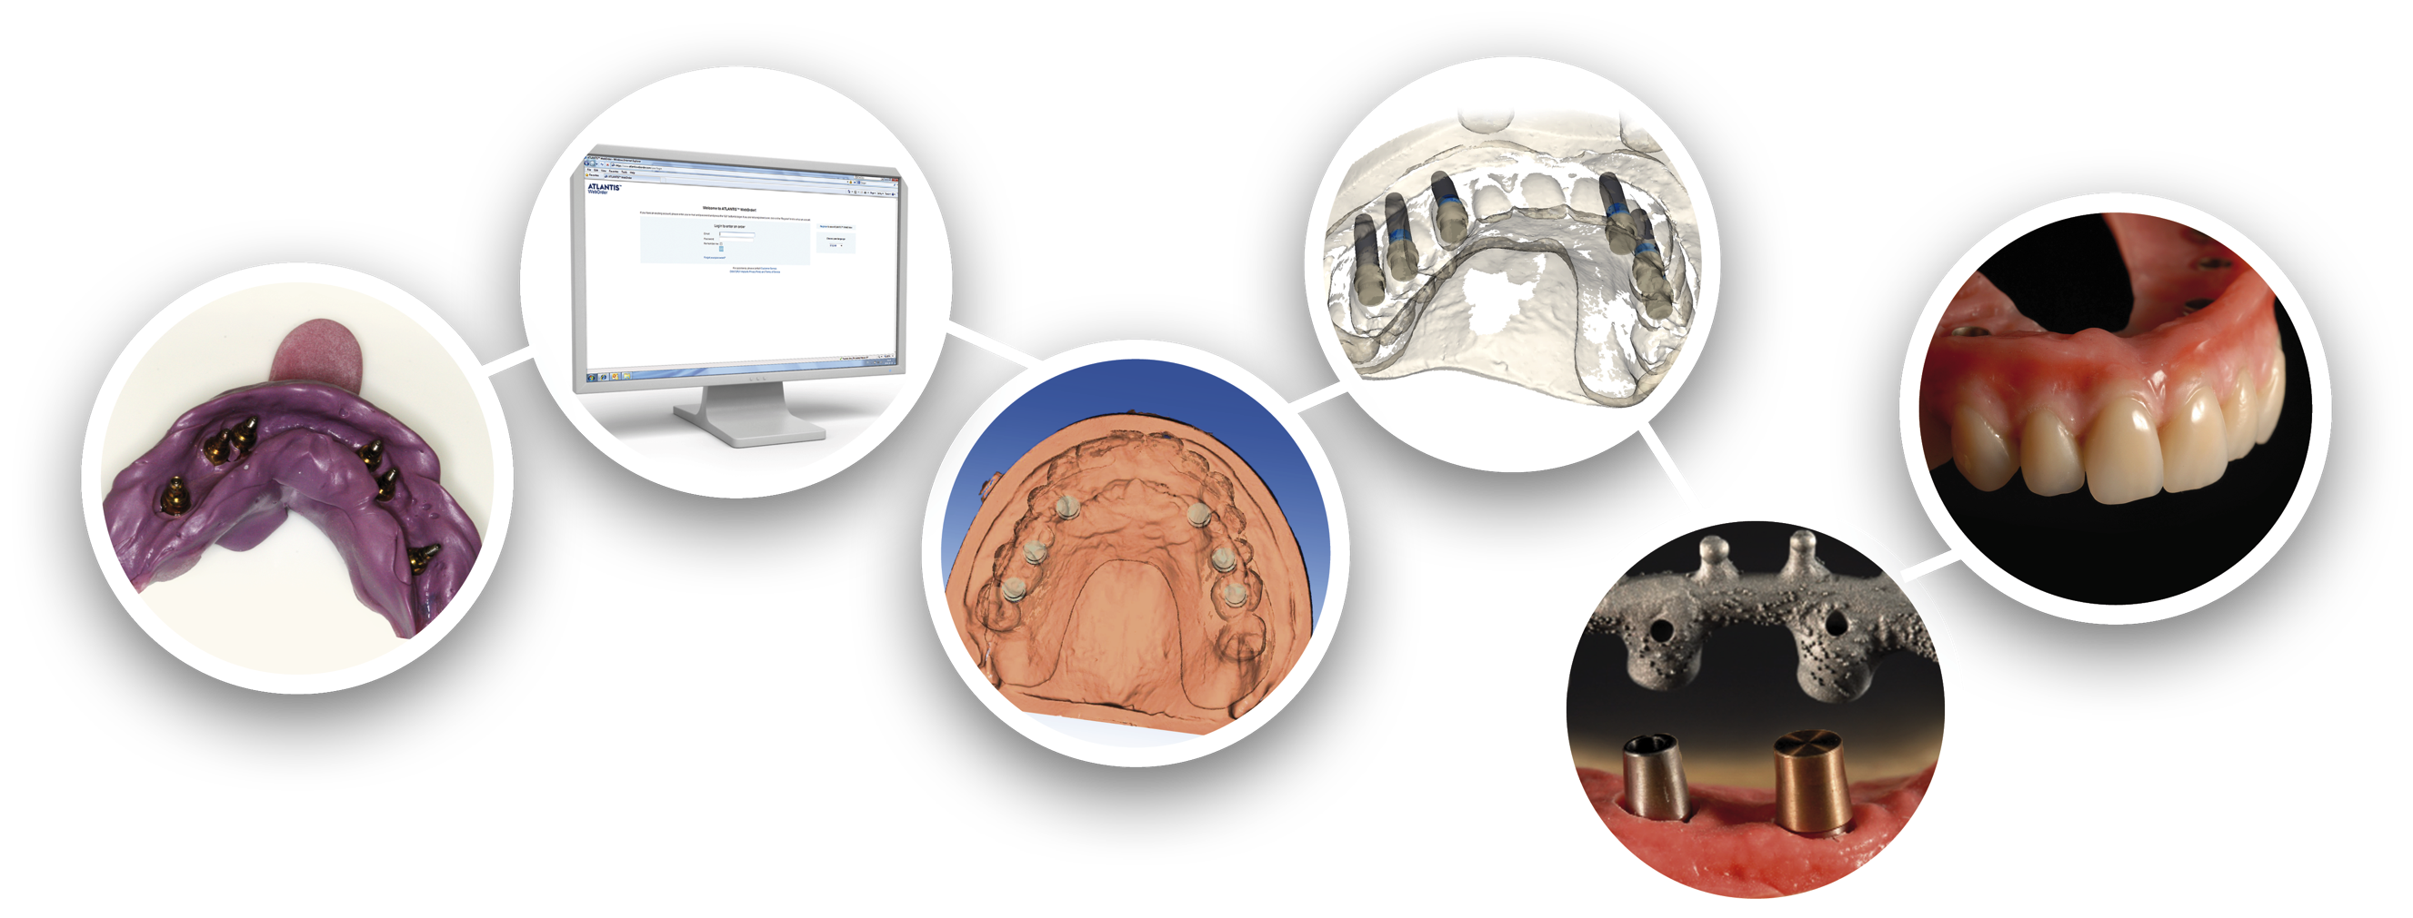
Easy ordering procedure
Treatment team review/approval
Final prosthesis
Online ordering*
Clinical impression
Sophisticated design software
Ready to use for final prosthetics
* To ensure proper placement and alignment, a diagnostic tooth set-up must always be provided.
Notes:
Like all Atlantis solutions, ordering Atlantis Conus concept is really simple…
The clinician just needs to send an implant-level impression - with pick-ups and replicas in place, to the dental laboratory, requesting Atlantis Conus concept…
A dental technician then enters the order for abutments and caps in Atlantis WebOrder…
We then receive the order and design the patient-specific abutments using Atlantis VAD (Virtual Abutment Design) software…
When the design is ready, the treatment team reviews and approves it…
Then it is produced, sent through quality control, and shipped back to the dental laboratory for production of the final prosthesis…
For more details on how the prosthesis is produced, I can also send you the complete procedural manual, also available on our website.
[NEXT SLIDE]

Slide 17
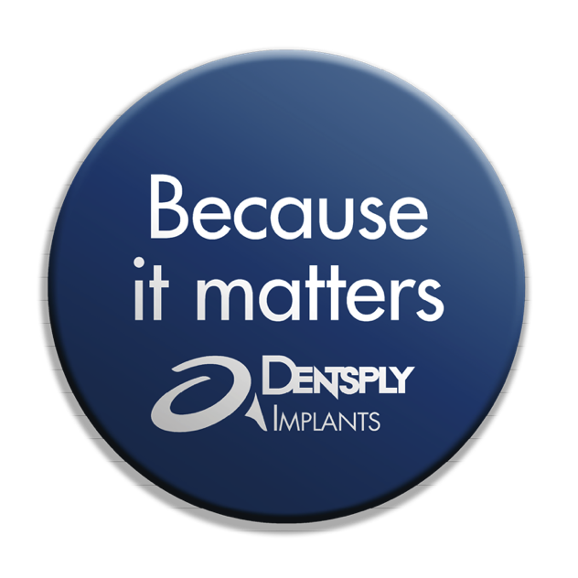
A little friction is a good thing
Notes:
Your patients depend on you for a solution that meets their needs today and supports their improved quality of life as they get older…
Atlantis Conus concept allows you to satisfy your patients’ needs and restore their ability to eat, speak and smile with confidence…
Not only does this innovative concept offer the security of a fixed restoration with the flexibility of a removable prosthesis, but your patients will be able to clean and maintain it just as easily as other removable solutions, but minimize the number of office visits that would normally be required to replace worn-out retention elements…
This is what we mean by "a little friction is a good thing."
[NEXT SLIDE]

Slide 18
Thank You

