Slide 1
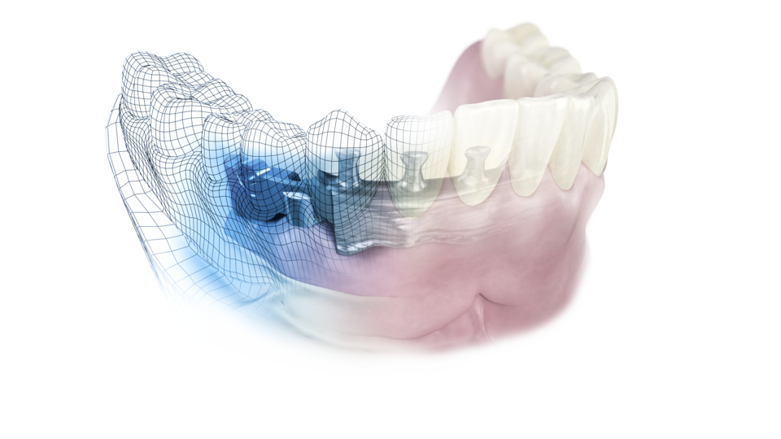
Atlantis
Suprastructures
– Beyond CAD/CAM

Slide 2
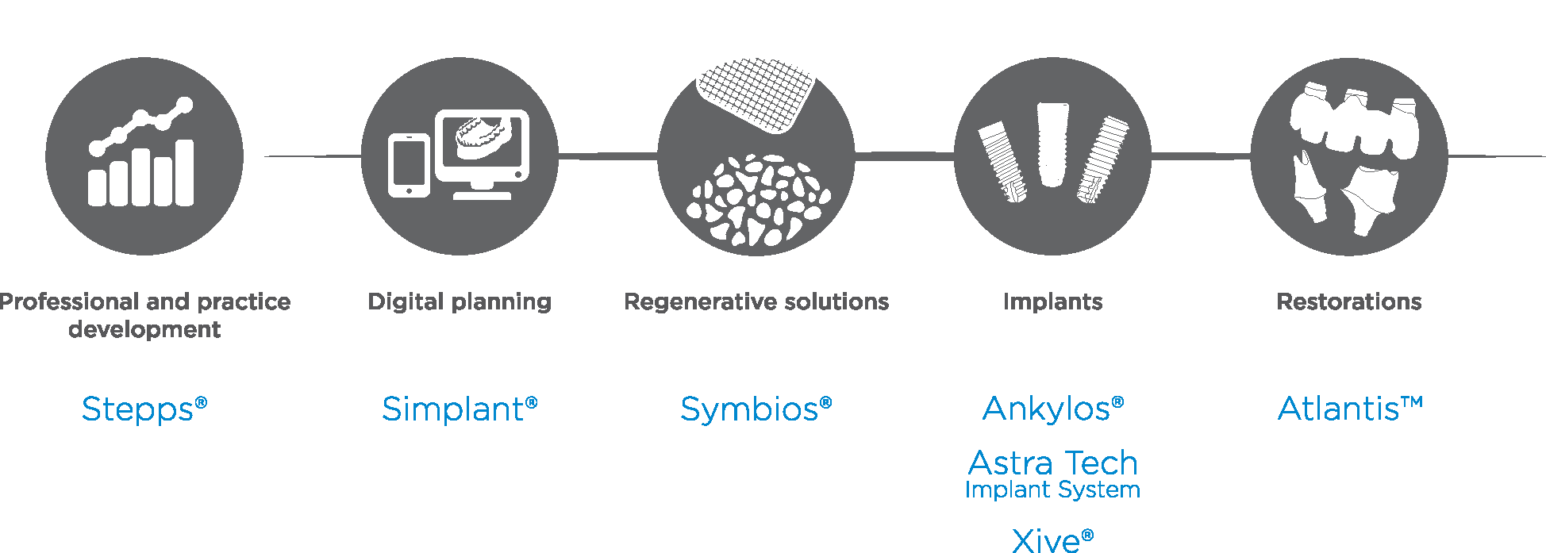
Comprehensive solutions for all phases of implant therapy

Slide 3
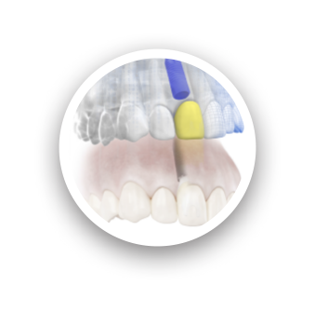
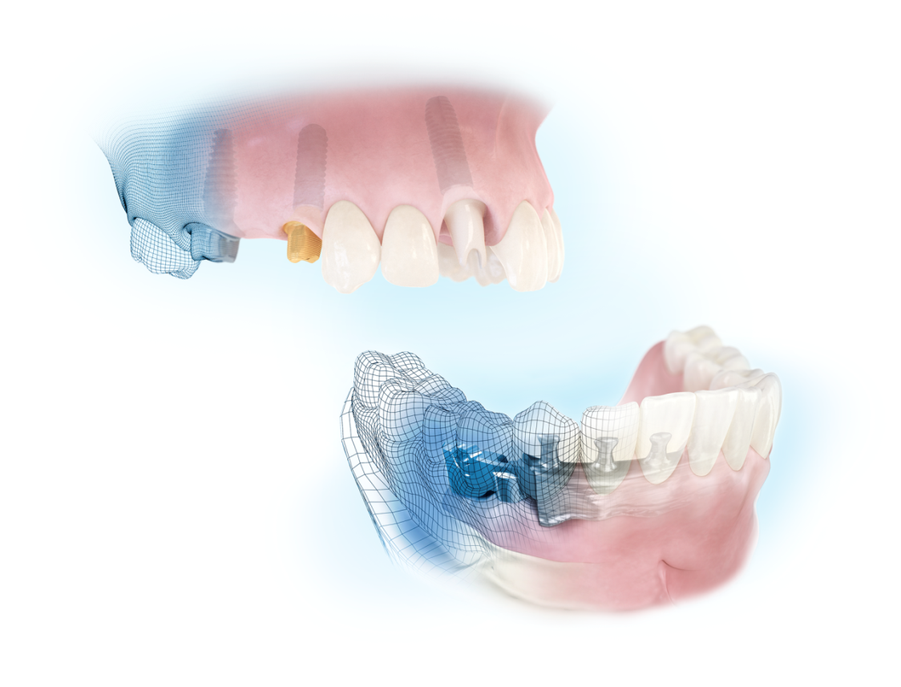
Digital solutions from Dentsply Sirona Implants
Simplant
Computer guided implant treatment
Atlantis
For all major implant systems
Patient-specific prosthetic solutions
- beyond CAD/CAM

Slide 4
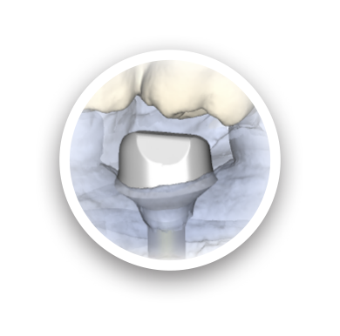
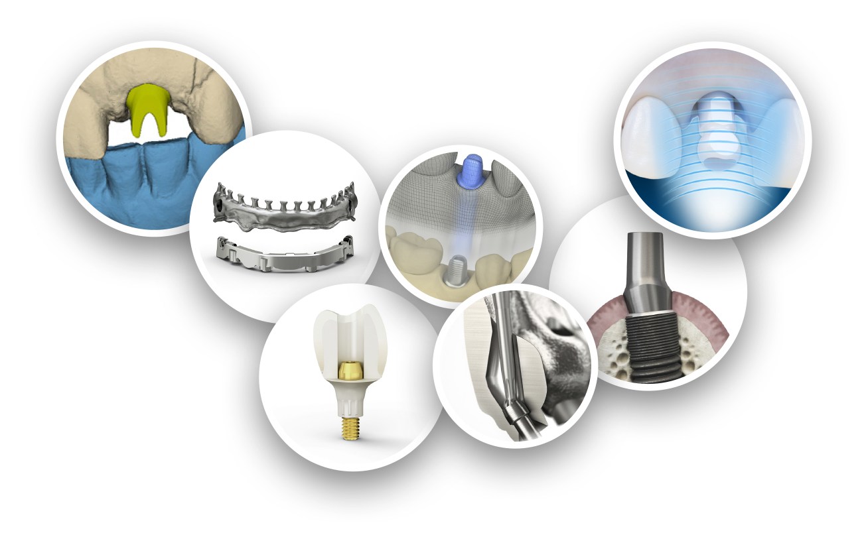
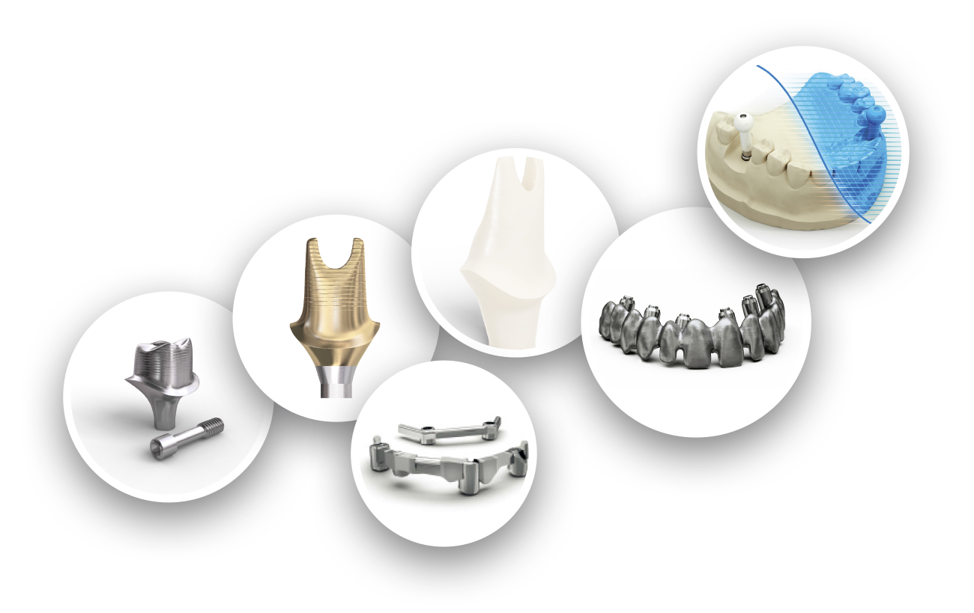

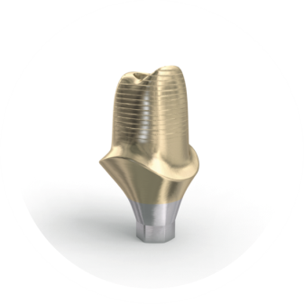
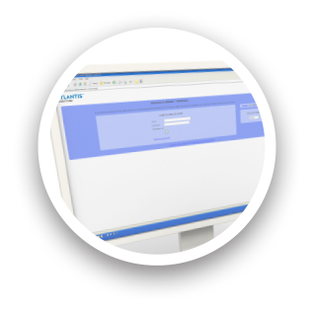
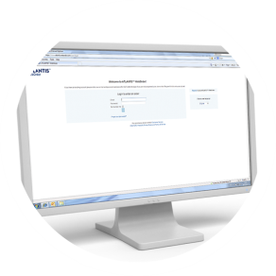
Ongoing innovation
2014
Intraoral scanning
for Atlantis Abutment
2009
Lab-based scanning
for Atlantis abutments
2011
2in1 suprastructure
2006
Abutments in zirconia
2012
Atlantis Core file
2004
Abutments in gold-shaded titanium
1999
First patient-specific abutment delivered –
in titanium
2010
Atlantis Editor for abutments
2008
Bridge and hybrid for
Screw-retained restorations
2015
Atlantis
Conus concept
2005
First bar
delivered –
In titanium
2007
Atlantis WebOrder
online ordering system
2011
Atlantis
Crown Abutment
2014
Angulated screw access
for Atlantis Bridge and Hybrid

Slide 5
Restorative freedom
Atlantis abutments
For cement-, (single tooth) screw-
and attachment-retained restorations.
Atlantis suprastructures
A full range of implant suprastructures
for fixed and removable prostheses.

Slide 6
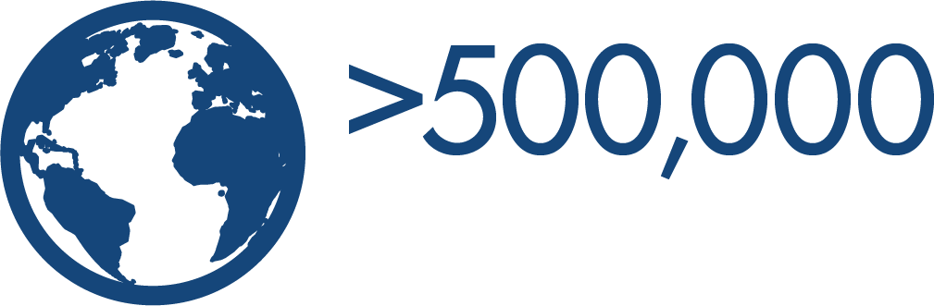
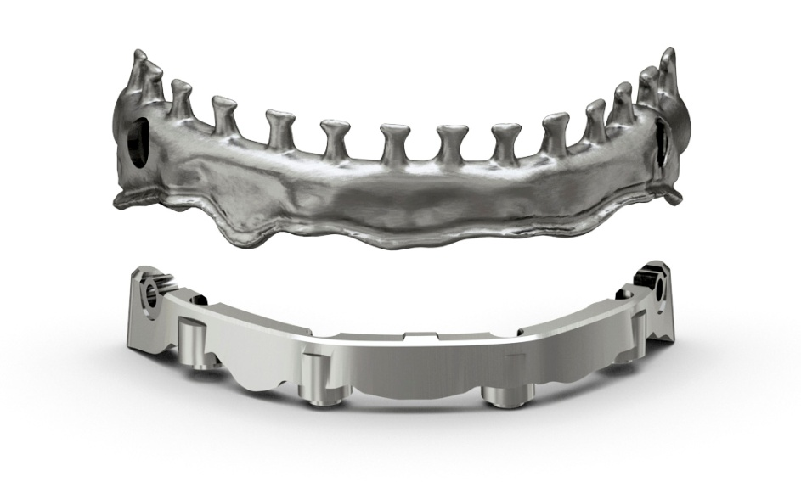



Confidence you can count on
2005

Slide 7
Restorative freedom
– patient-specific prosthetic solutions for all major implant systems
Atlantis® abutments
For cement-, (single tooth) screw-
and attachment-retained restorations.
Atlantis® suprastructures
A full range of implant suprastructures
for fixed and removable prostheses.

Slide 8
Surgical flexibility
Dentsply Sirona Implants
  Ankylos
  Astra Tech Implant System
  Xive
BioHorizons
Biomet 3i
Camlog
Keystone Dental
Nobel Biocare
Straumann
Zimmer Dental
All trademarks, company names and implant designs are the property of their respective owners.
Notes:
Atlantis is an open solution available for all major implant systems.

Slide 9
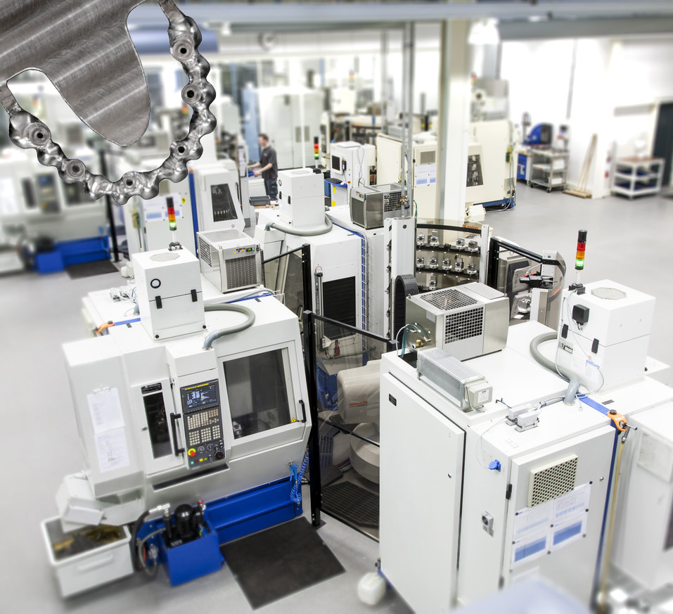

Engineered for high precision
State-of-the-art production
Produced using the latest developments in world-class production technologies, and supported by computer-based industrial and medical-device expertise.

Slide 10
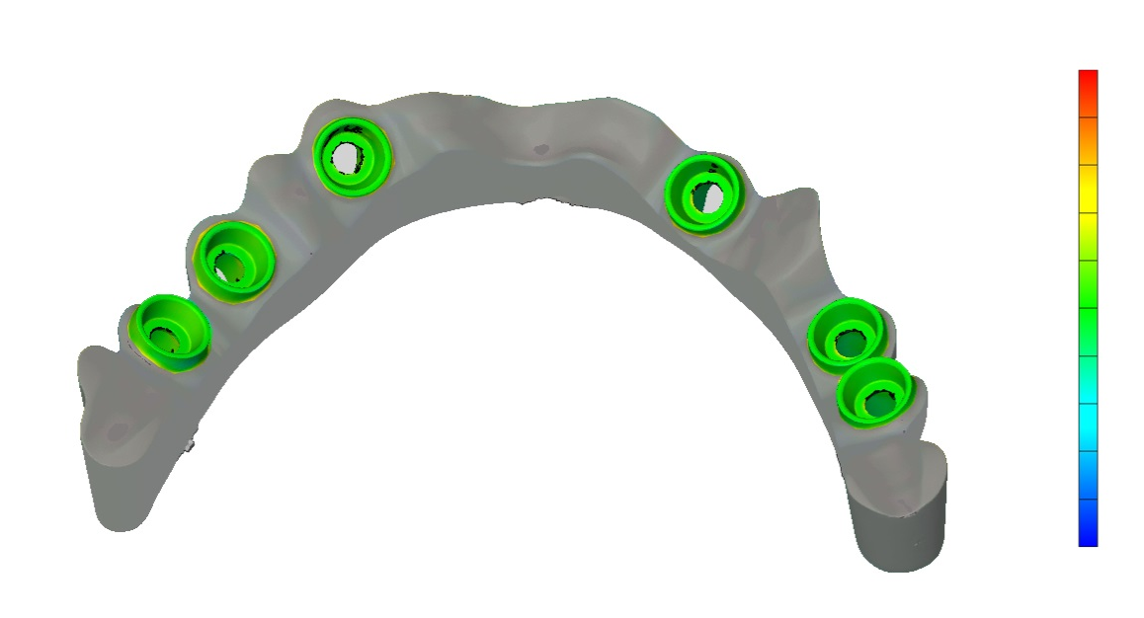
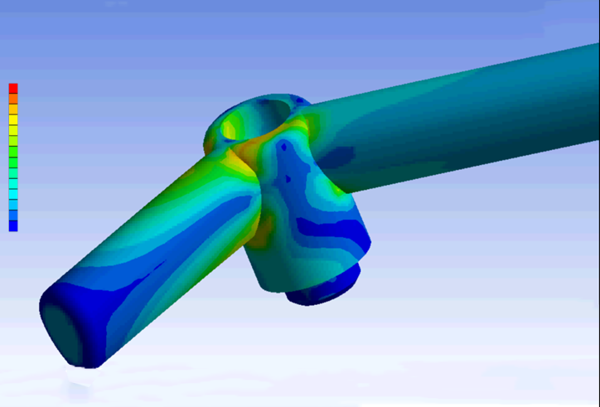
Engineered for high precision
Milling strategies for Atlantis suprastructures have been optimized to produce a precise and passive fit.

Slide 11
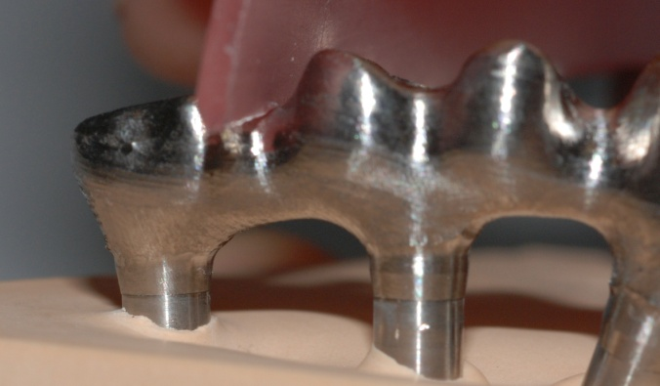
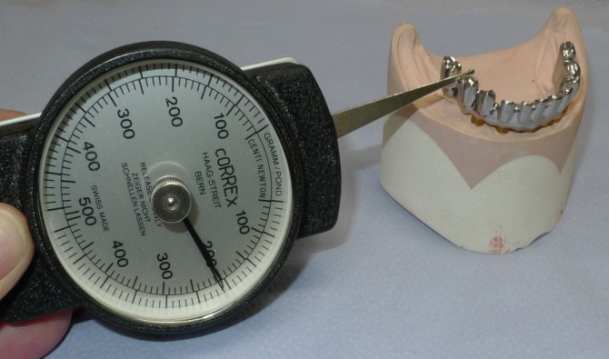
Precision providing tension-free fit
The precise and passive fit of Atlantis suprastructures are in accordance with the Sheffield Fit Test* by the University of Sheffield, UK
*White GE. The Sheffield fitting test. Osseointegrated Dental Technology 1993:61.
Quintessence Publishing Co Ltd, London.

Slide 12
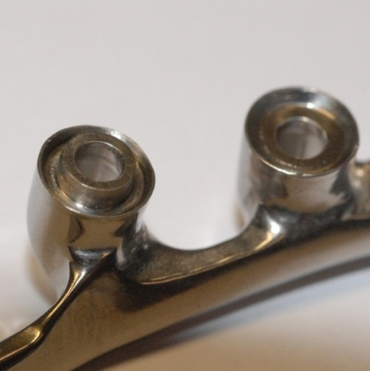
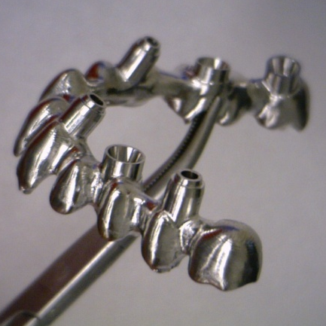
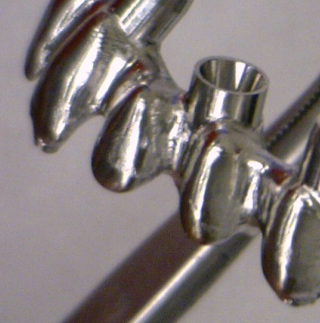
Restorative flexibility
Implant level –
internal and external connection
Combination of abutment
and implant level
Abutment level
Notes:
Will be updated with speakers notes.

Slide 13
Full range of implant suprastructures
Removable prostheses
Atlantis 2in1
Atlantis Bar
Fixed prostheses
Atlantis Bridge
Atlantis Hybrid
Notes:
All suprastructures are designed based on the final tooth set-up.

Slide 14
Atlantis 2in1
Removable prosthesis
Primary and secondary implant suprastructures with conical friction design
Secondary construction - hybrid or bridge
Design is based on the tooth set-up
Available in titanium
Notes:
Combines screw-retained stability with removable prosthetic convenience

Slide 15
Atlantis Bar
Removable prosthesis
Standard bar profiles for attached dentures
  Custom bar design with attachments
  provisions and/or conical friction design
  Design is based on the tooth set-up
  Available in titanium or cobalt-chrome
Notes:
Will be updated with speakers notes.

Slide 16
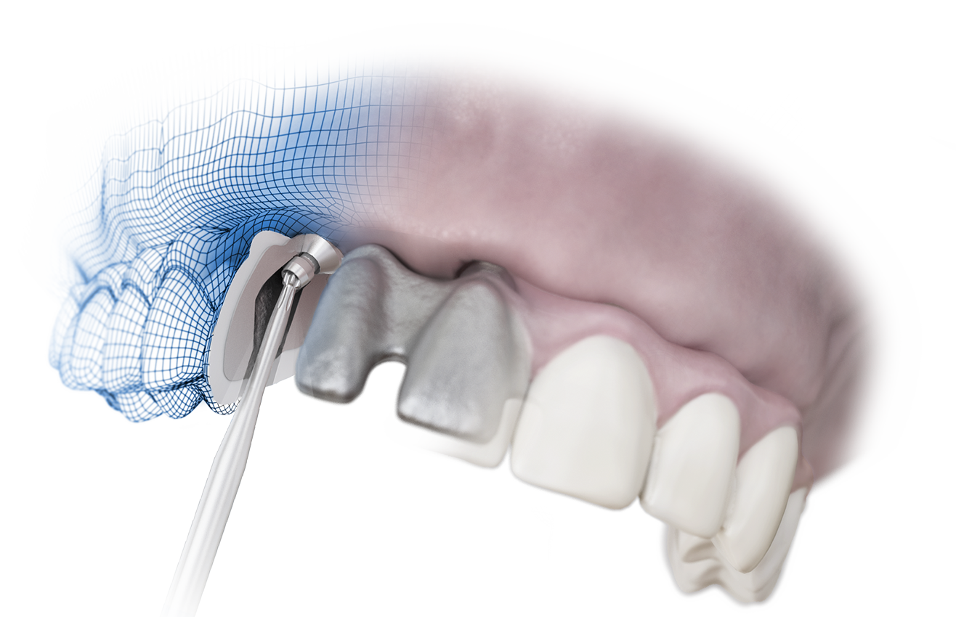
Atlantis Bridge
Fixed prosthesis
Ceramic or composite layering techniques
Design is based on the tooth set-up
High gloss surface option
Available in titanium or cobalt-chrome
Angulated Screw Access
for Atlantis Bridge and Hybrid
Notes:
Will be updated with speakers notes.

Slide 17
Atlantis Hybrid
Fixed prosthesis
Wrap-around technique with
full retention surface
Wrap-on technique with basal/ lingual
high gloss surface
Design is based on the tooth set-up
Available in titanium or cobalt-chrome
Angulated Screw Access
for Atlantis Bridge and Hybrid
Notes:
Will be updated with speakers notes.

Slide 18
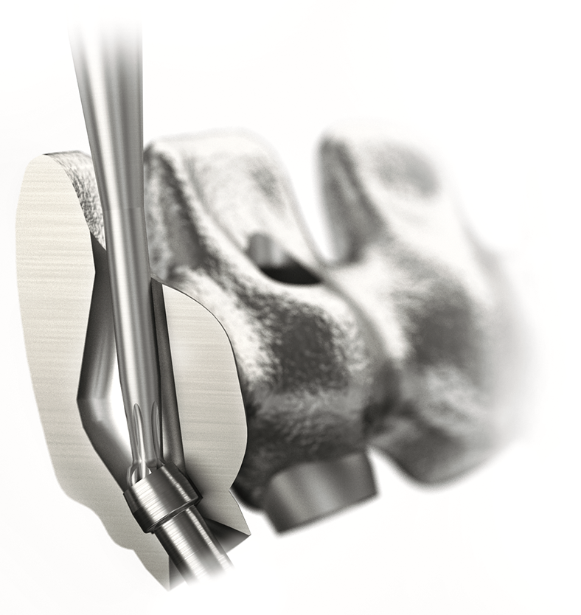
Angulated Screw Access
Optimally position the prosthetic screw access channel to be angled up to 30º off the implant/abutment axis, for optimal esthetics and function.
Available for Atlantis Bridge and Hybrid
  Simple restorative procedure with reduced chairtime

Slide 19
Angulated Screw Access
Product development
Screwdriver has a specific Hexalobular design

Slide 20
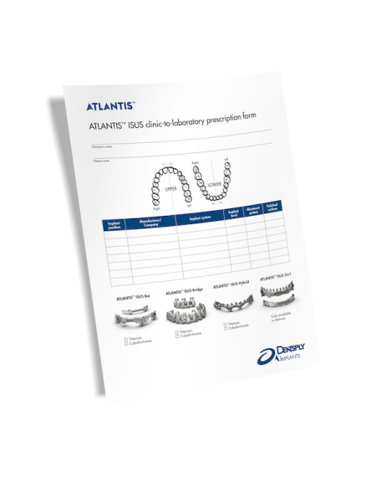
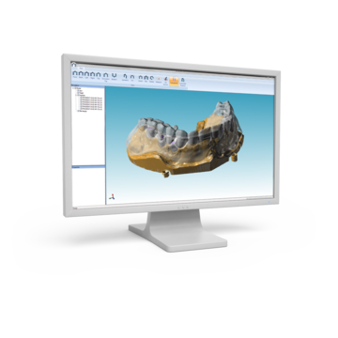
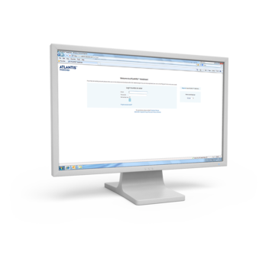
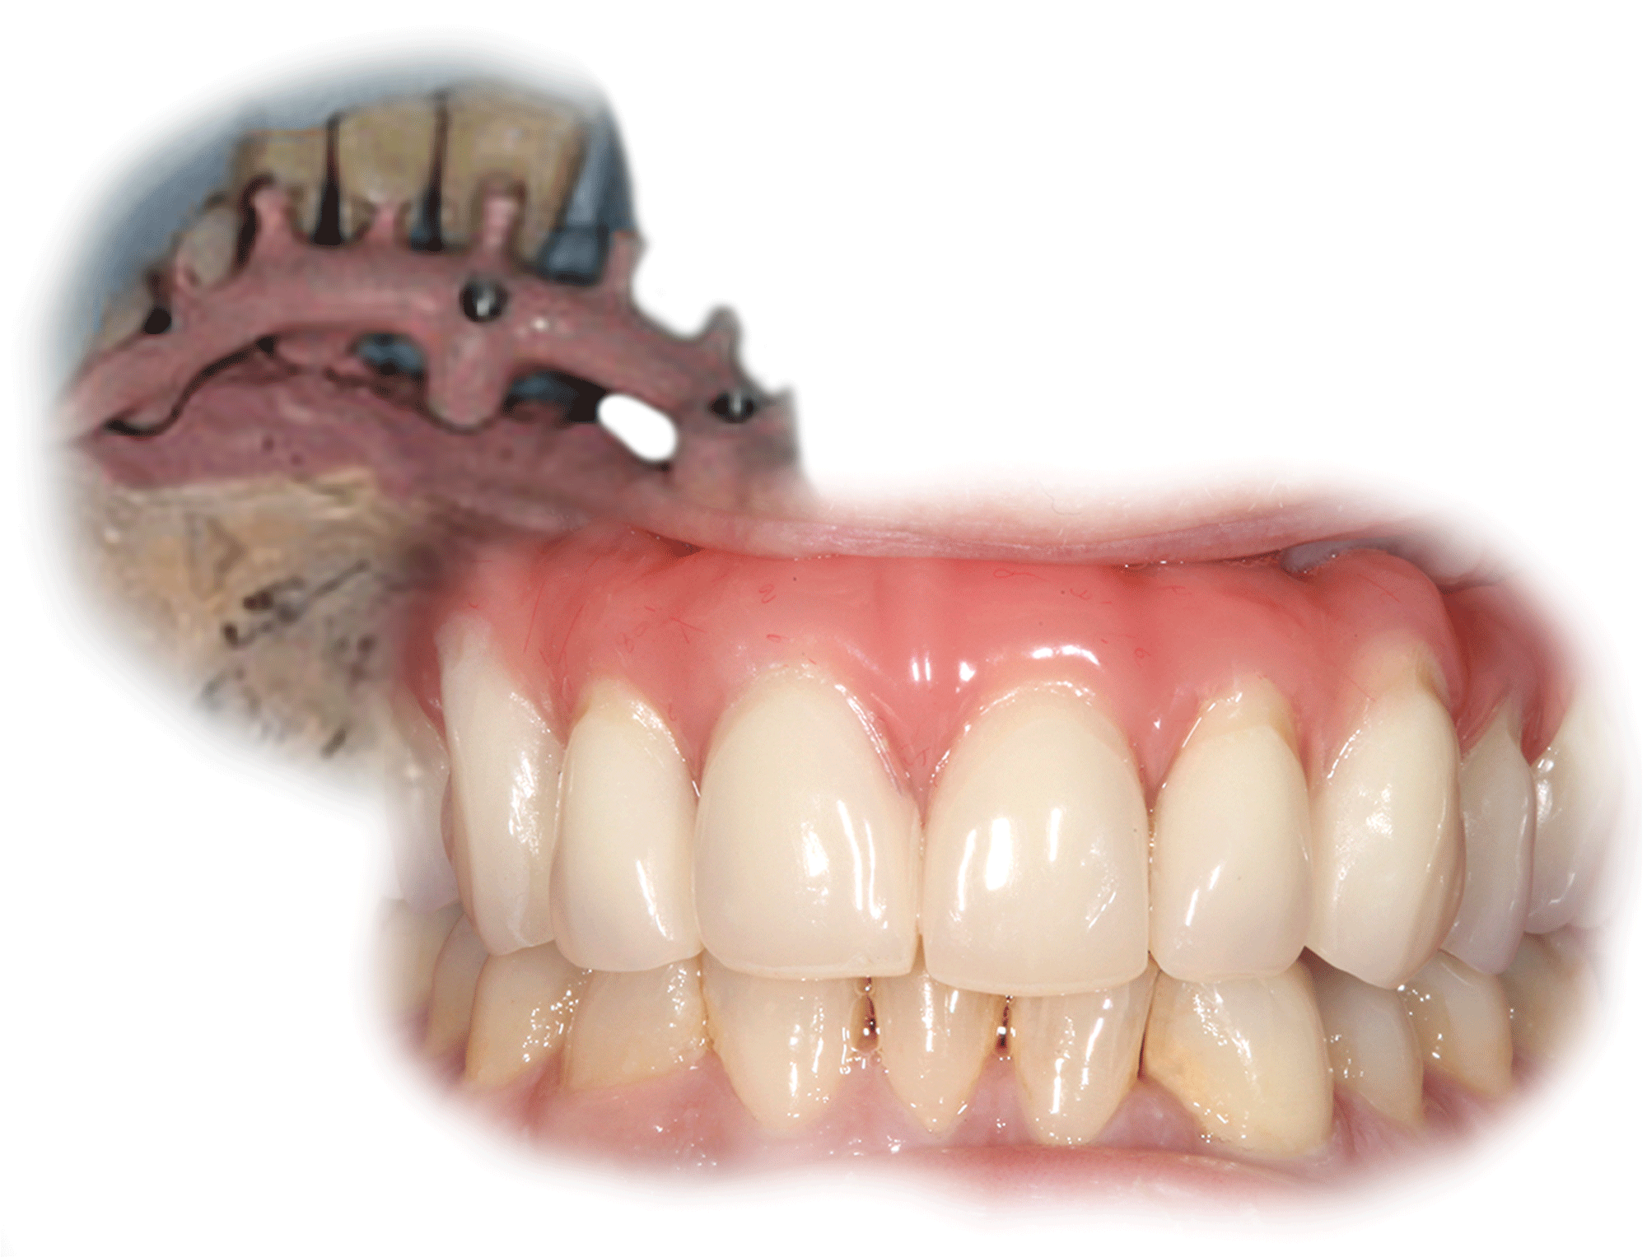
Atlantis is good business
– increased practice and laboratory efficiency
Fully integrated process
1
An implant- or abutment-level impression is taken by the clinician and sent to the dental laboratory with a request for an Atlantis suprastructure.
3
After review and final approval of the design in Atlantis Viewer, the suprastructure is milled.
2
The order is entered by
the dental technician using
Atlantis WebOrder. Case models and materials are shipped to Dentsply Sirona Implants.
4
The Atlantis suprastructure is shipped to the dental laboratory. Laboratory then produces the final prosthetic solution and sends the complete case back to the clinician.

Slide 21
1. Initiating the order
An implant/abutment level impression is taken by the clinician and sent to the dental technician with a request for Atlantis suprastructures.
Notes:
Will be updated with speakers notes.

Slide 22
2. Entering the order
The order is entered by
the dental technician in Atlantis WebOrder. Case models and materials can be shipped to
Dentsply Sirona Implants.

Slide 23
3. Designing the suprastructure
Atlantis suprastructures are milled only after review and final approval of the CAD design, in Atlantis Viewer.
Notes:
Will be updated with speakers notes.

Slide 24
4. Shipping the case
Once produced, the Atlantis suprastructure is shipped to the dental laboratory. The laboratory then produces the final prosthetic solution and sends the complete case back to the clinician.
Notes:
Will be updated with speakers notes.

Slide 25
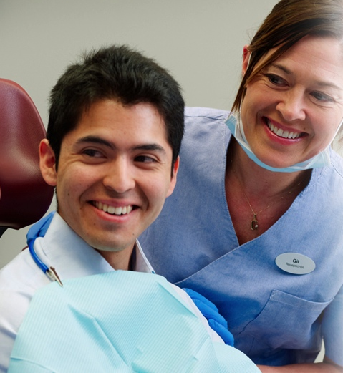
Designed for clinical practice success
Angulated screw access for optimal
function and esthetics
Simple restorative procedure with
reduced chairtime
Comprehensive warranty program*
*Subject to the terms and conditions of the ATLANTIS abutments warranty

Slide 26

Developed for dental laboratory efficiency
Eliminate the time needed for designing
and modifying frameworks—frees up skilled technicians´ time for other tasks
No need for investment in and maintenance of additional equipment and software
Simplified and efficient online ordering process

Slide 27
Save time for more advanced tasks
Conventional laboratory procedures
Master cast with analogs
Control index
Bite registration/ articulation
Teeth set-up/ wax-up
Silicone reference key
Bar wax-up/ pre-fabricated component
Shaping the suprastructure
Casting, finishing, fitting (soldering)
Polishing
Integration of retainer elements
Denture finishing
Atlantis suprastructure manufacturing
Master cast with analogs
Control index
Bite registration/ articulation
Teeth set-up/ wax-up
….
….
….
….
….
Integration of retainer elements
Denture finishing

Slide 28
Production workflow

Slide 29
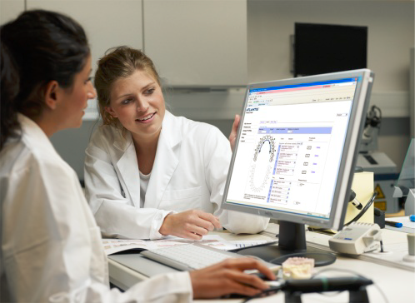
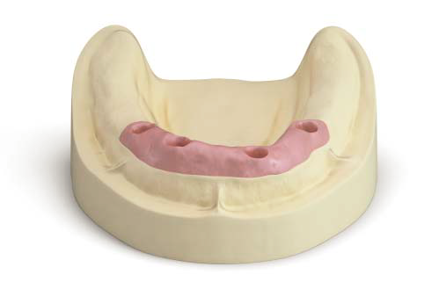
Dental laboratory order
Atlantis WebOrder
Stone model with soft tissue
Implant replicas

Slide 30
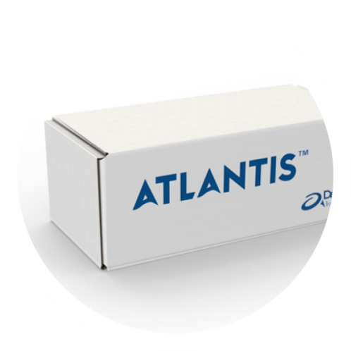
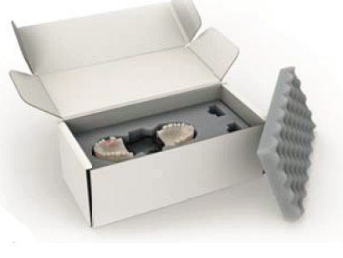
Order Intake
Stone model with soft tissue
New or undamaged analogues
Diagnostic wax-up or Design Guidance
Atlantis WebOrder ticket

Slide 31
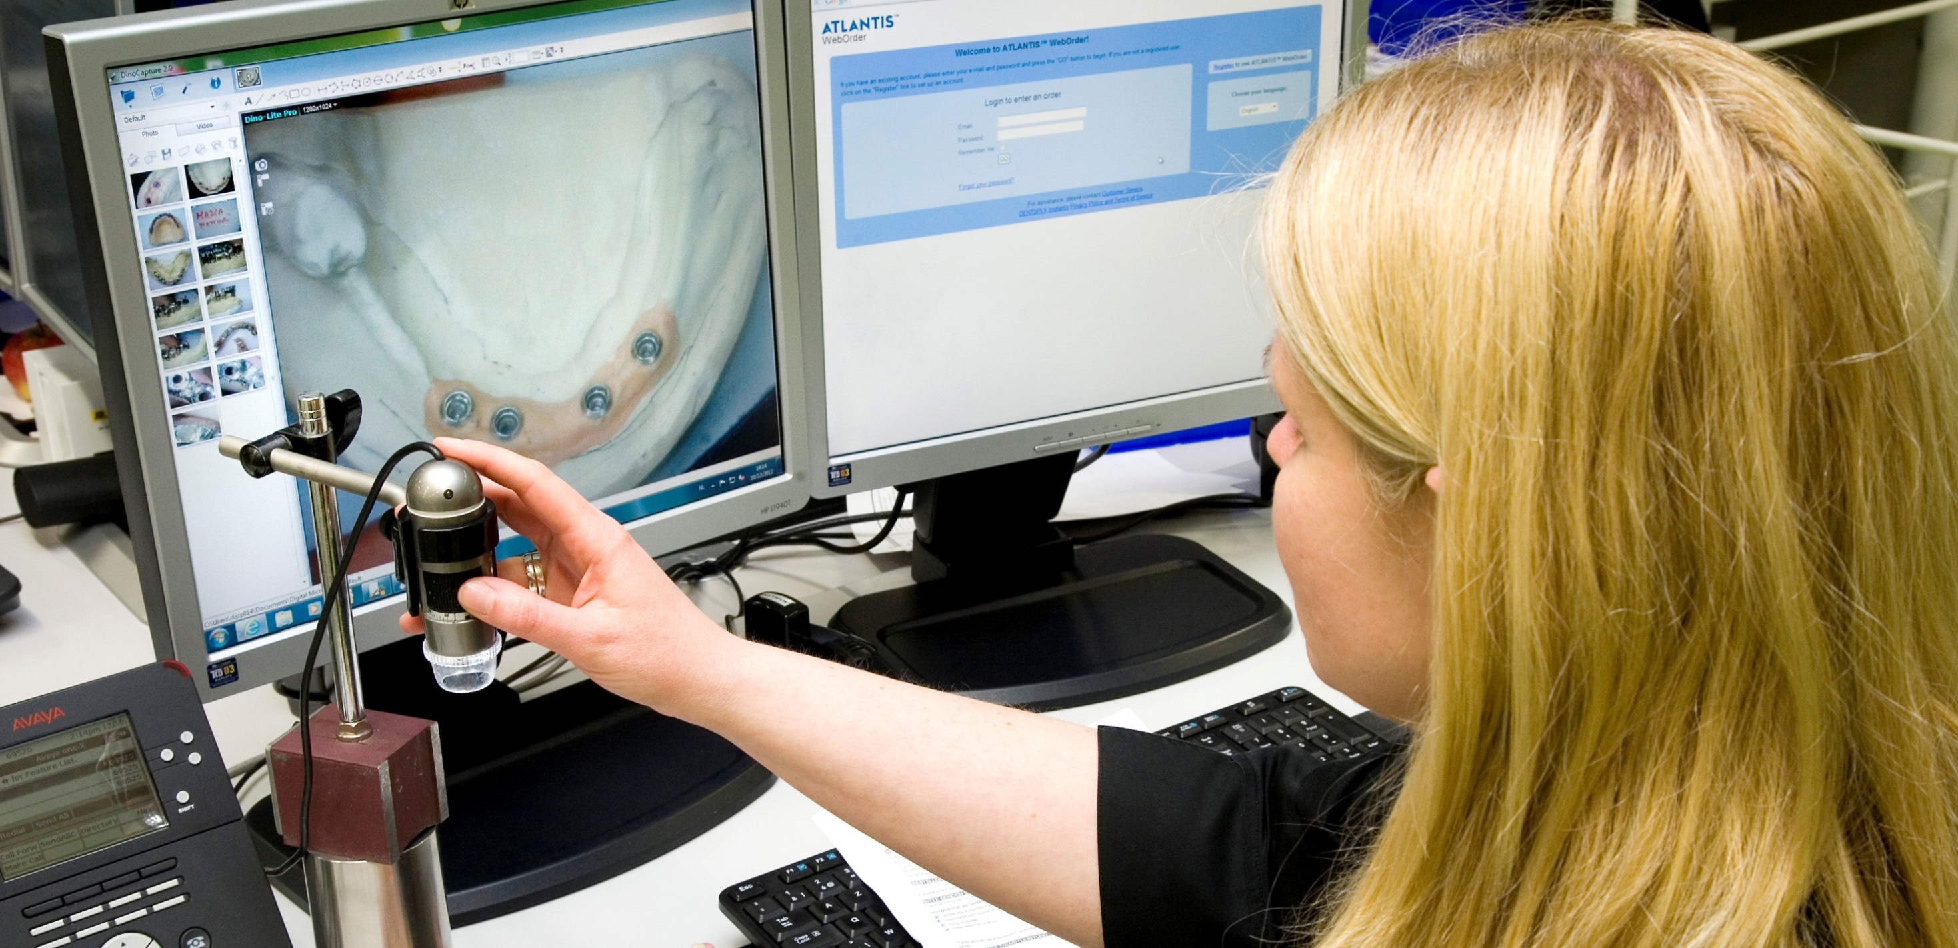
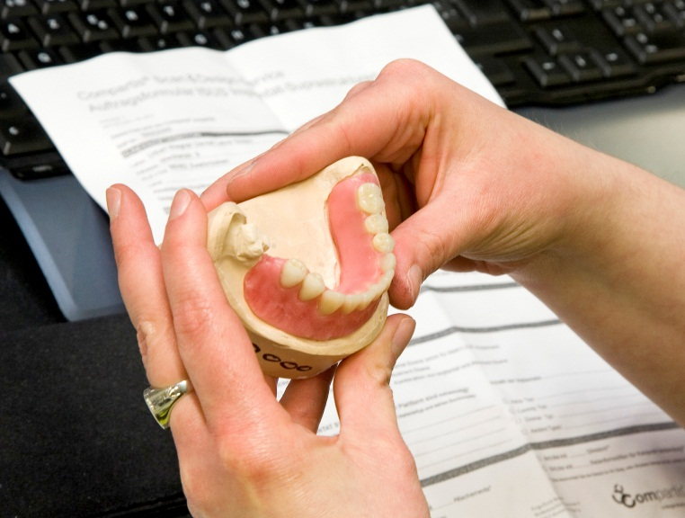

Slide 32
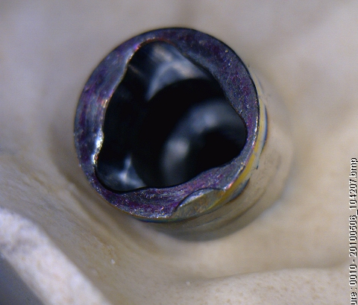
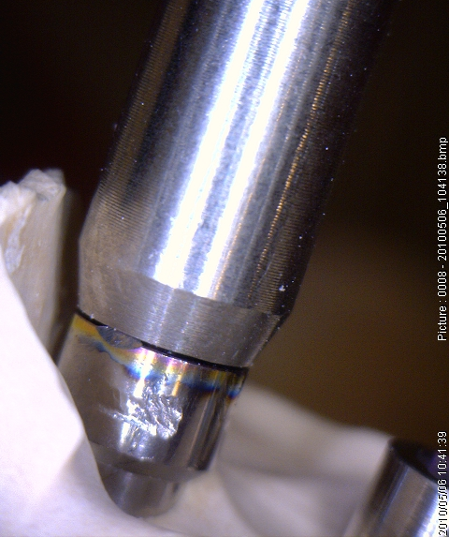
Incoming QC

Slide 33
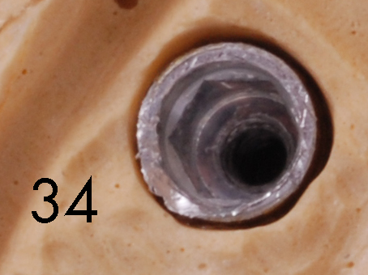
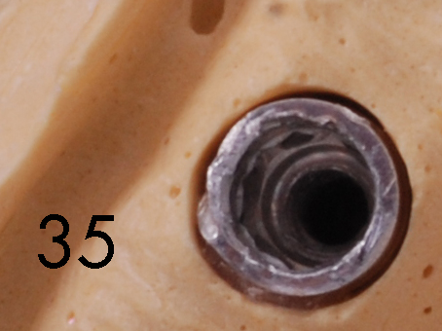
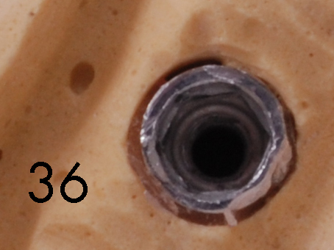
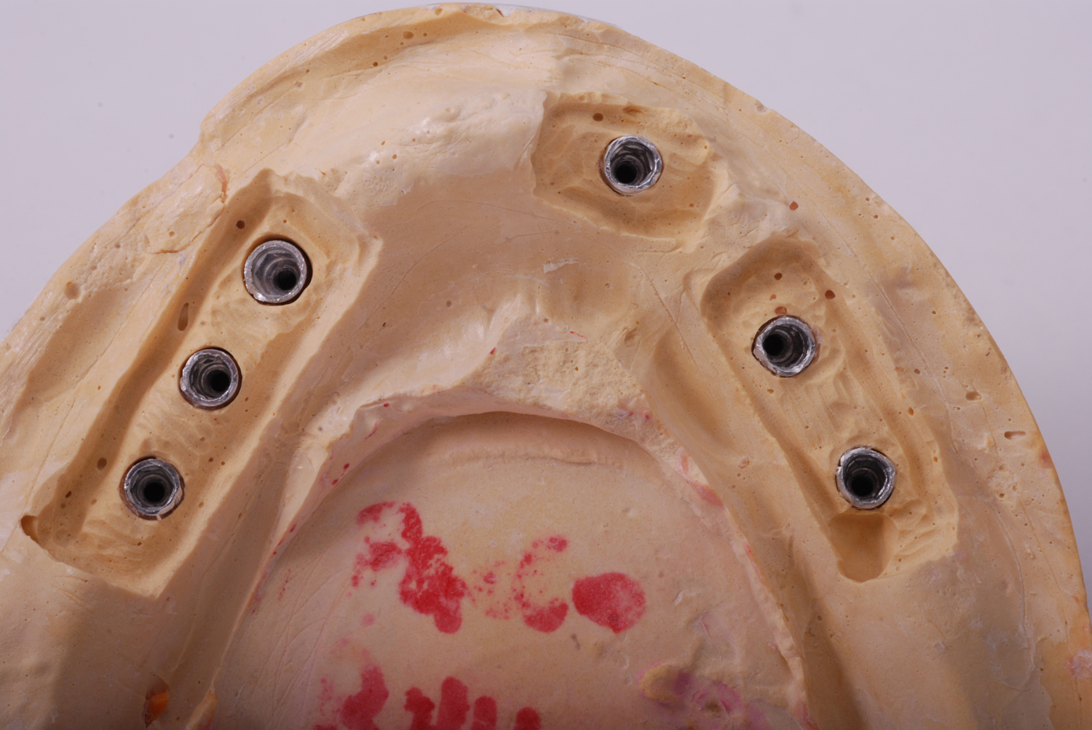
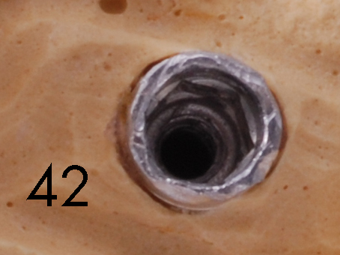
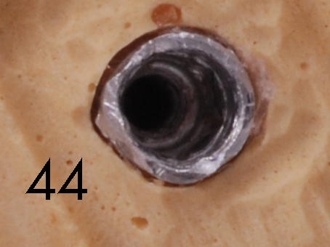
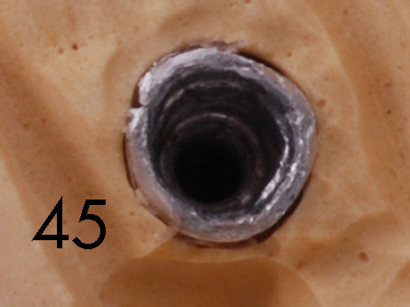

Slide 34
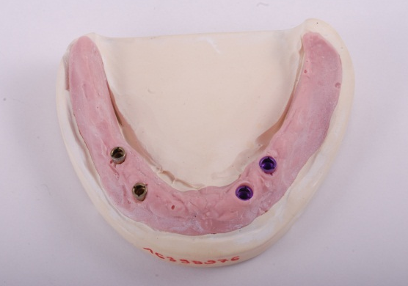
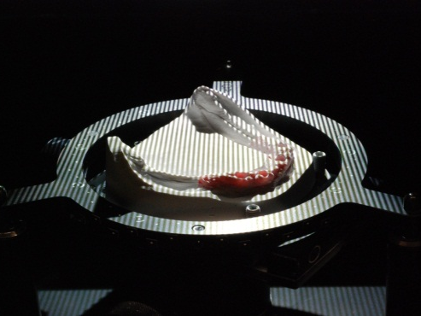
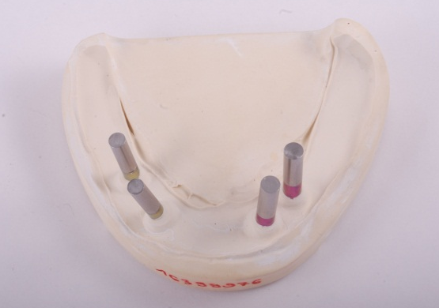
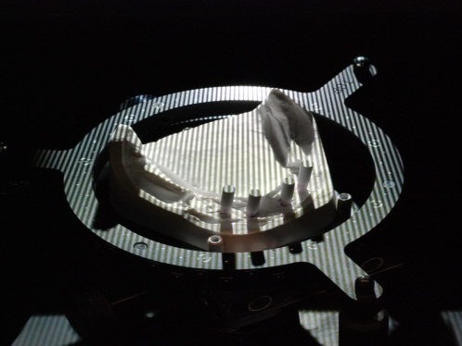
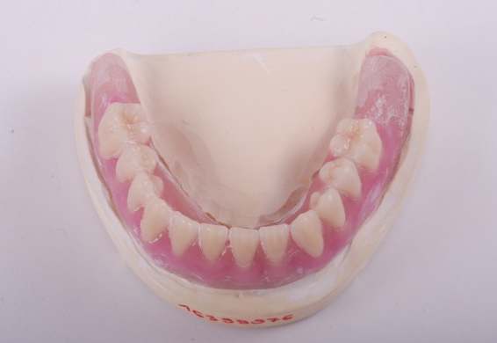
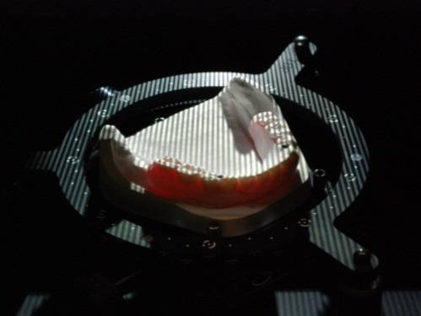
1st Scan = Mouth situation
2nd Scan = Implant position
3rd Scan = Prosthetic situation or “Design Guidance”

Slide 35
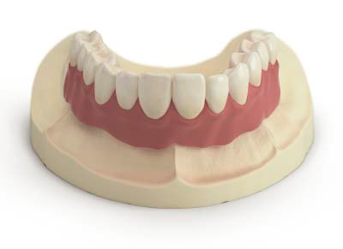
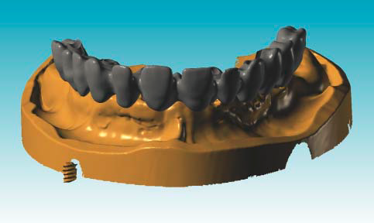



Diagnostic Teeth set-up
Design Guidance

Slide 36



Scanning
Scan master model with implant analogues
Scan cylinder with reference points

Slide 37



Slide 38





Slide 39


Slide 40

Creation of an individual milling strategy
Material specific control
Material specific corrections
CNC operators
In-process Quality Control

Slide 41



Slide 42


In-process quality control

Slide 43




Slide 44


Slide 45



Slide 46




Let’s get connected
Dentsply Sirona Implants’ digital solutions provides technologies that make it easier for everyone to connect
– streamlining the workflow for all of your restorations.

Slide 47

Atlantis CaseSafe
Atlantis Case Safe ensures
efficient order processing and
safe transport of your case materials.

Slide 48


Atlantis WebOrder
– the communication platform
Atlantis orders can be conveniently
placed by the dental technician
24/7 online for quick and easy order entry.
No need to install or upgrade software
Case data remains easily accessible
Consistent workflow
No investment costs

Slide 49


Atlantis suprastructure design
Implant suprastructures
are designed using
the latest digital technologies
and “Atlantis ISUSsoft.”

Slide 50

Atlantis Viewer
Atlantis suprastructures are milled only after review and final approval of the design.

Slide 51


Going beyond CAD/CAM
Atlantis suprastructures provide:
Precision providing tension-free fit
Available for all major implant systems
Wide flexibility in therapy and design options for partially- and fully-edentulous patients
Simplified and efficient on-line ordering

Slide 52


We have you covered
Naturally, the implant suprastructures solution that offers the greatest freedom is also backed by a comprehensive warranty. If an implant supplier does not honor its warranty due to your use of Atlantis suprastructures, Dentsply Sirona Implants will cover both the suprastructure and the implants.*
Titanium
COBOLT-CHROME
10 YEARS
10 YEARS
*Subject to the terms and conditions of the Atlantis suprastructures warranty.

Slide 53

We have you covered
For added assurance that you are receiving genuine Atlantis suprastructures, warranty cards are provided with an order identification number for every case delivered.

