Slide 1
Ankylos SynCone Concept A new paradigm for implant-supported dentures

Slide 2
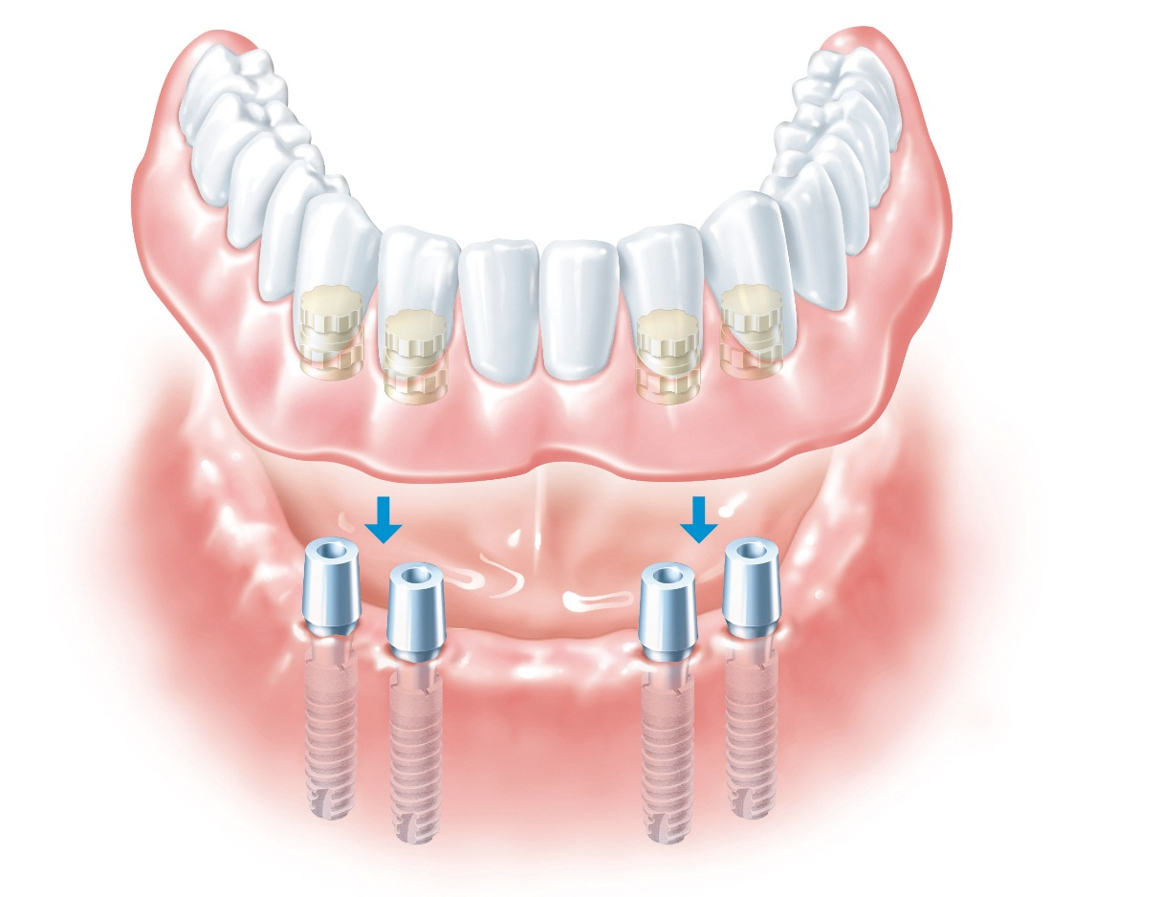
SynCone
Helping your denture patients regain an active lifestyle
Notes:
SynCone abutments provide a fast and economical restoration of the edentulous mandible with an immediately-loaded prosthesis on four pre-fabricated interforaminal-tapered abutments.
Simplified, predictable dental care using prefabricated components.
Patient and dental team cost benefits:
As an intermediate solution, the patient’s existing denture can be utilized.
For the long-term, a new denture containing reinforcing framework should be created.

Slide 3
Preoperative diagnostic exam
Patient health
Anatomical requirements for placing implants 11 mm - preferably 14 mm in length
Fit of existing denture
Notes:
Dimension considerations when treatment planning:
Recommended minimum clearance between SynCone Cap and occlusal plane of denture = 5 mm
SynCone Cap height = 5 mm
Patient sulcus height & available abutment heights (soft tissue recommended equal to or below base of SynCone Cap)
Implant depth / length: subcrestal implant placement recommended 0.5 mm to 1.5 mm – 11 mm length implants preferably 14 mm

Slide 4
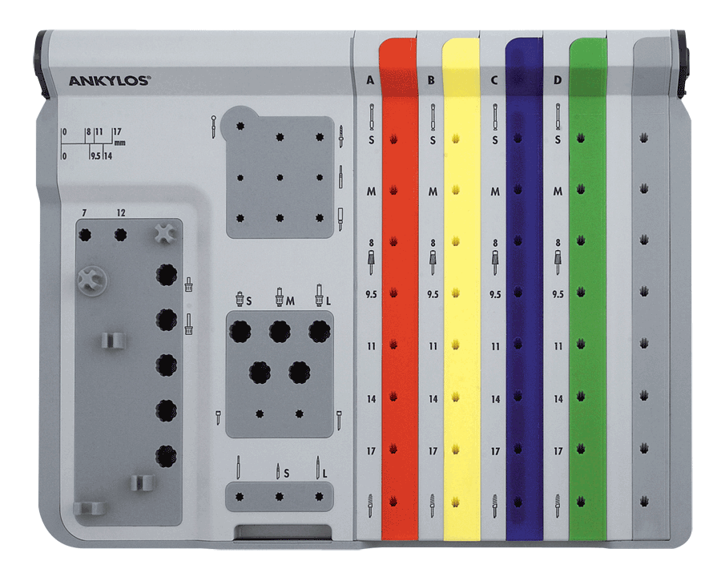
ANKYLOS® Surgical kits
Notes:
The modular components of the surgical trays with the minimum required number of instruments can be supplemented with additional modules for implant-specific diameters.
Storage of the implant drills in diameter-specific snap on modules provide utmost flexibility.
Surgical ratchet, implant drivers and screw drivers are clearly arranged in a separate module.

Slide 5
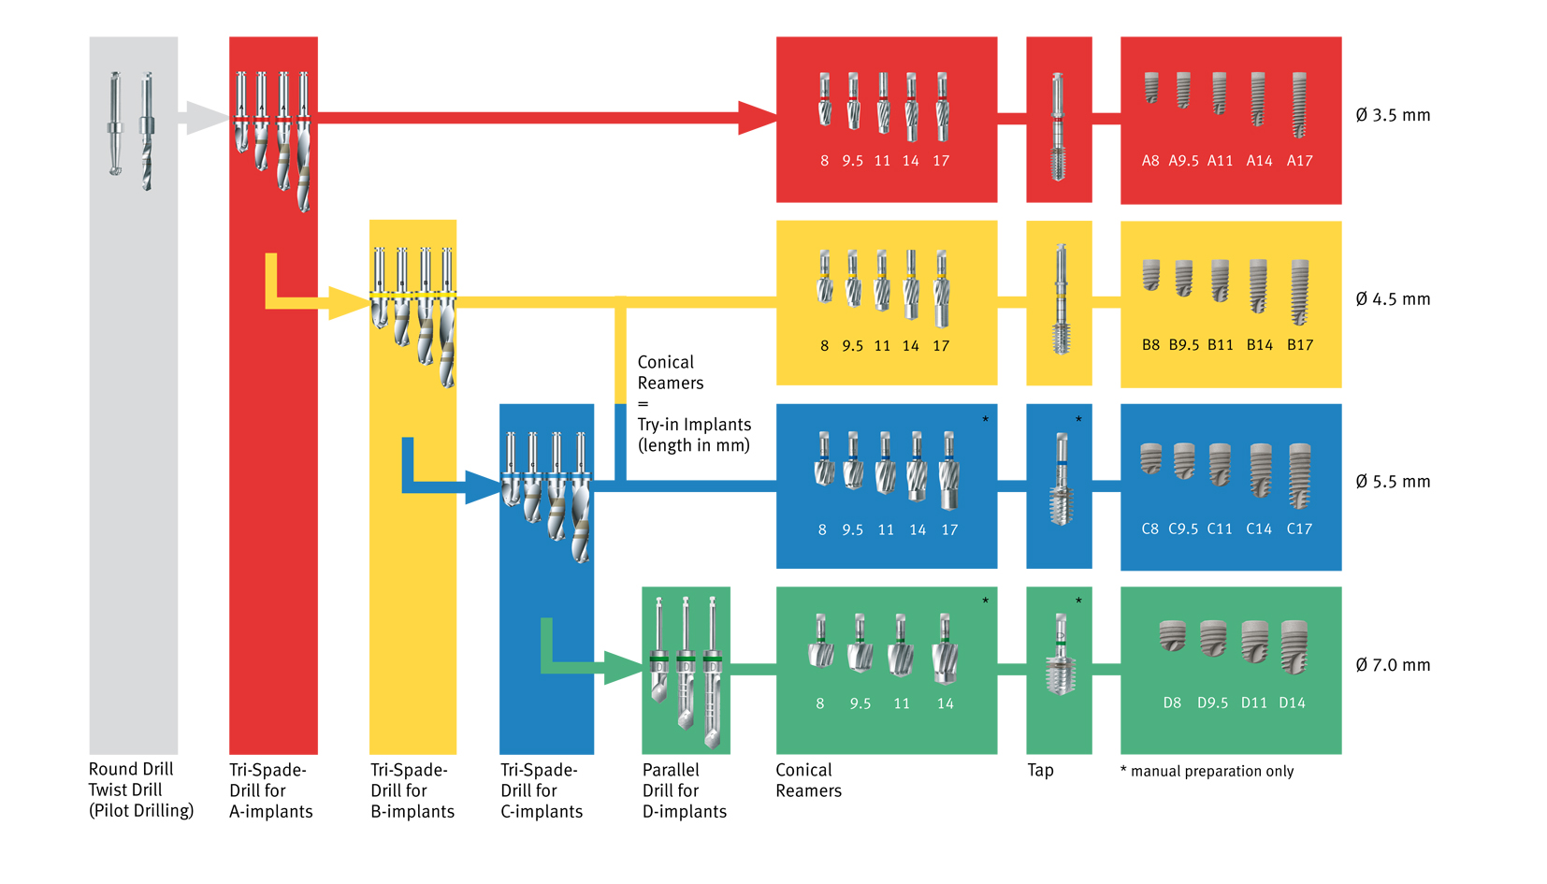
Surgical instruments
Notes:
An essential component of a successful implant placement is accurate and atraumatic preparation of the bone at the implant site.
The instrument set for the ANKYLOS® implant system allows for simple and precise preparation of the bone.

Slide 6
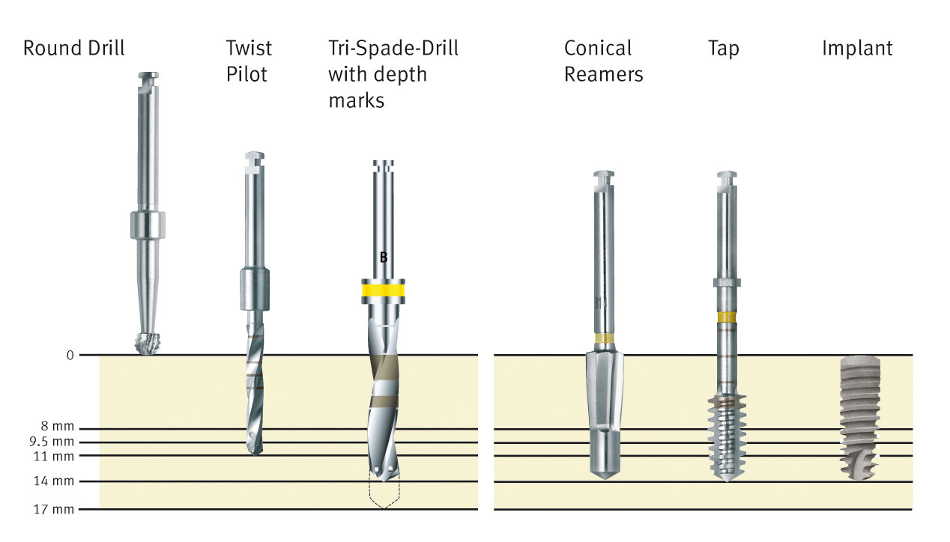
Surgical steps
motorized
motorized or manual
Notes:
Here we see a standard drilling protocol.
Implant site preparation can be accomplished in two steps:
- With a motorized preparation to accommodate specified implant diameter followed by either a motorized or manual final preparation of the implant site.
- The osteotomy is prepared with internally-irrigated, handpiece driven drills. The drills are marked with rings to indicate depth.
A maximum speed of 800 rpm is recommended.
Following the drilling sequence, final implant osteotomy preparation is accomplished with the Conical Reamer and Tap.
Note: with A- and B-sized implants, the Conical Reamer and Tap are available for surgical use with a handpiece.
Only manual Conical Reamers and Taps are available for C- and D-sized implants due to the potential to exceed torque levels.
A maximum speed for the conical reamer, tap and handpiuece is 15 rpm with maximum torque of 60 Ncm.
Note: Cutting instruments should generally be replaced after 20 uses. Blunt or damaged instruments should be replaced immediately.

Slide 7
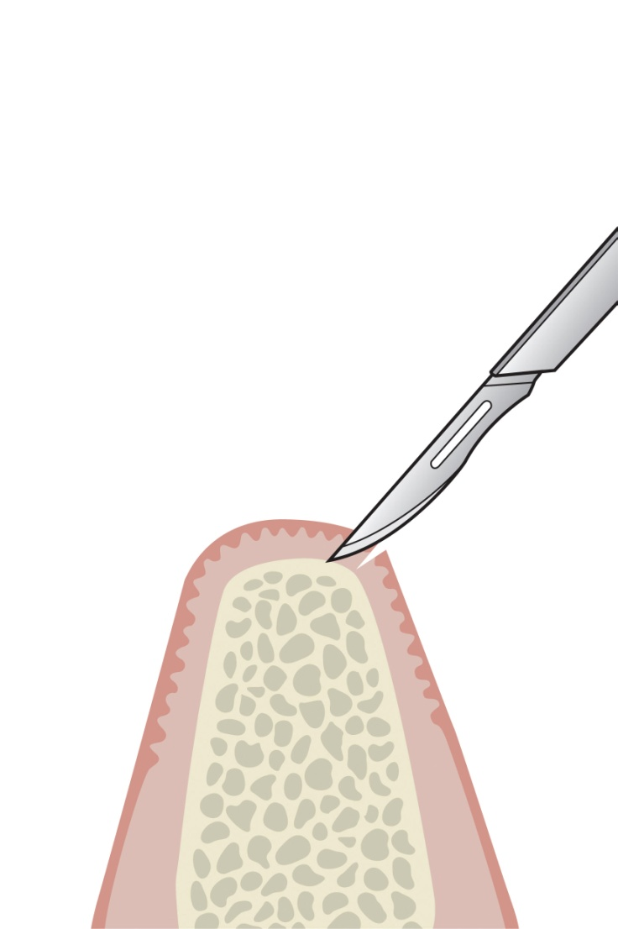
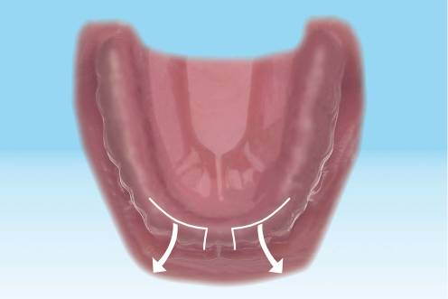
Flap preparation
Insert clinical image here
Insert clinical image here
Courtesy of…
Notes:
A crestal incision with a vertical release flap preparation is shown.

Slide 8
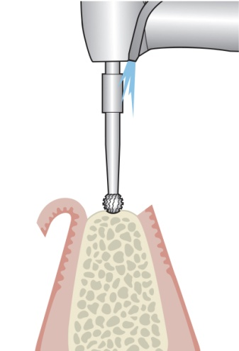
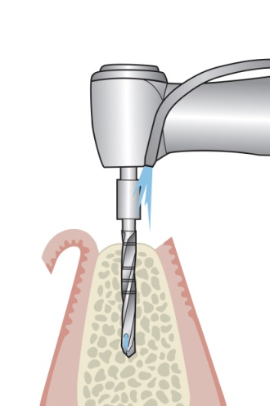
Bone smoothing and pilot drilling
Notes:
3mm Round Burr
The 3 mm Burr can be used to smooth the bone to give an equal datum point for implant placement.
If a template is not being used, the 3 mm burr can be used to create a witness mark to guide the Pilot Drill.
2mm Twist Drill
The 2 mm Twist Drill can be used with a surgical template (the length of the twist drill is 17 mm).

Slide 9
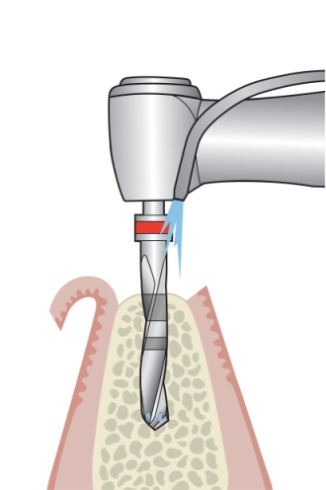
Depth drilling and axial alignment
Insert clinical image here
Courtesy of…
Notes:
The osteotomy axial alignment can be checked during pilot drilling and depth drilling using the Parallel Gauges. A radiograph can also be taken at this stage to check axial alignment and depth. Alternatively a drill guide system can be used to assist in parallelism.
Tri-Spade Drill A should always be used first. When placing B, C or D implants, the osteotomy should be widened sequentially in ascending drill diameter (up to B, C or D).
Subcrestal placement is dependent on available ridge height. Increase drill depth from 0.5 mm to 1.5 mm for subcrestal implant placement.

Slide 10
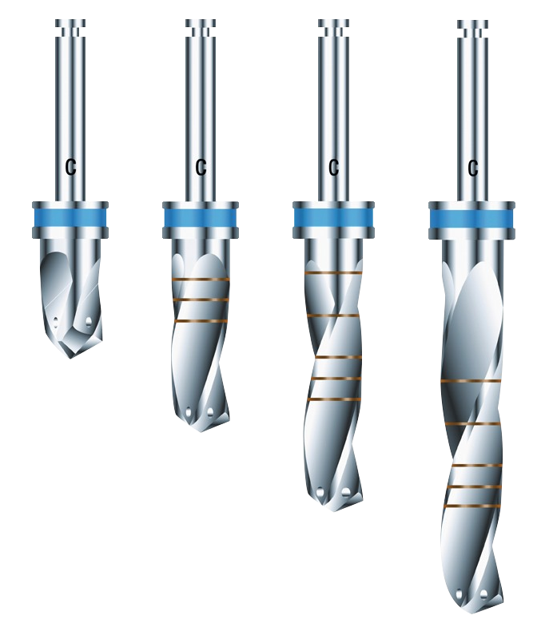
Tri-Spade Drills
17 mm
XS
14 mm
11 mm
S
9.5 mm
8 mm
M
L
Notes:
The Tri-Spade Drill design concept is to reduce drill chatter by the drill being better balanced due to the three cutting surfaces.
Tri-Spade drills are available in:
Extra Small (XS) – 8 mm cutting depth
Small (S) - 14 mm cutting depth
Medium (M) - 20 mm cutting depth
Long (L) - 27 mm cutting depth

Slide 11
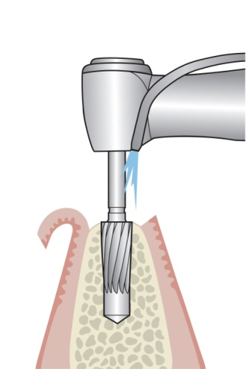
Conical Reamer
Insert clinical image here
Courtesy of…
Notes:
The Conical Reamer is used to form the osteotomy to accept the implants tapered body. Each Conical Reamer corresponds to the implant size and can be used manually (A,B,C implants) or in a handpiece (A,B implants).
Drilling in a clockwise direction will remove bone which can be used for grafting.
Drilling in a counter-clockwise direction will condense bone.
The Conical Reamer is the exact length of the corresponding implant and therefore can be used as an implant depth gauge.

Slide 12
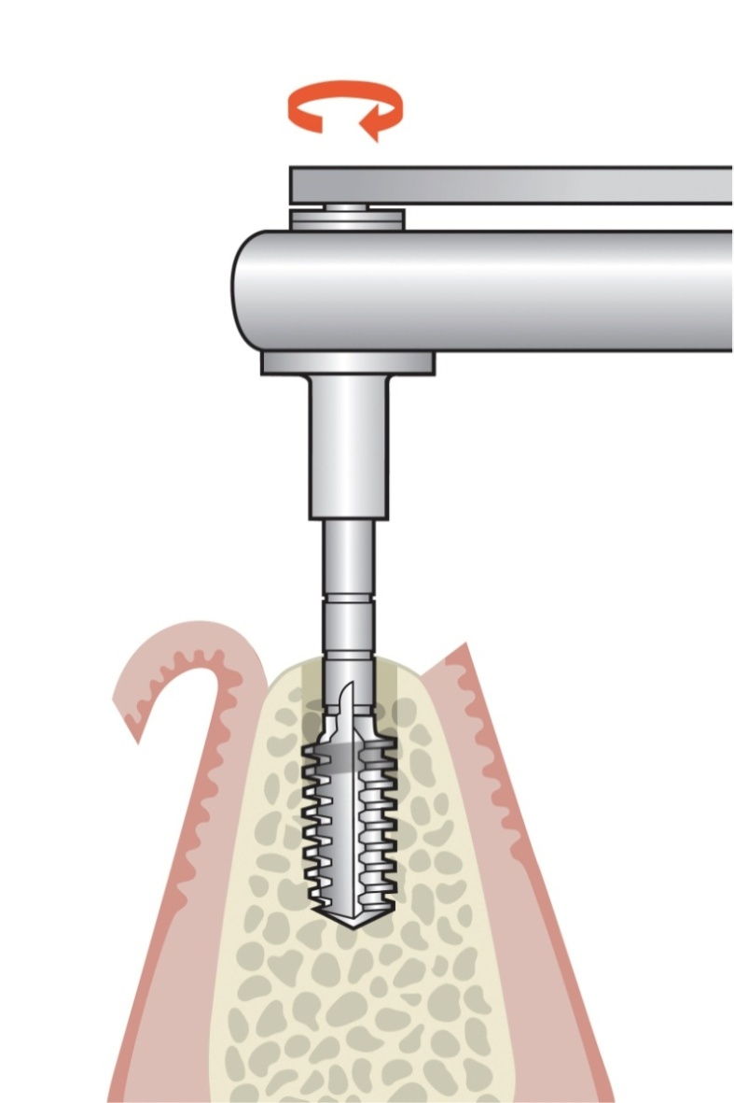
Thread cutting (tapping)
Insert clinical image here
Courtesy of…
Notes:
The tap used in a clockwise direction cuts the threads in the osteotomy. Drilling in a counter-clockwise direction is required to remove the tap instrument.
It is extremely important not to tap further than the prepared osteotomy as this may strip the osteotomy’s threads.

Slide 13
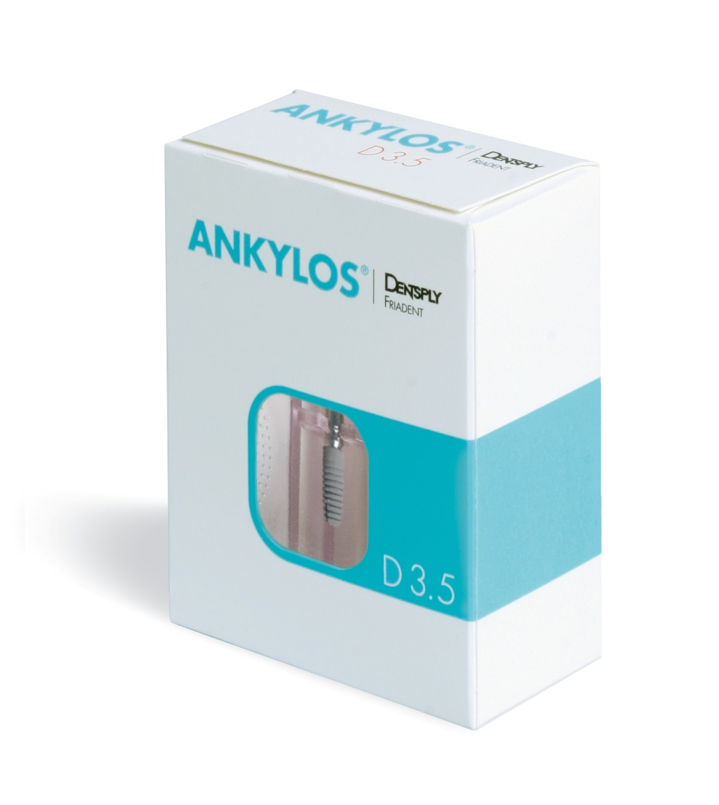
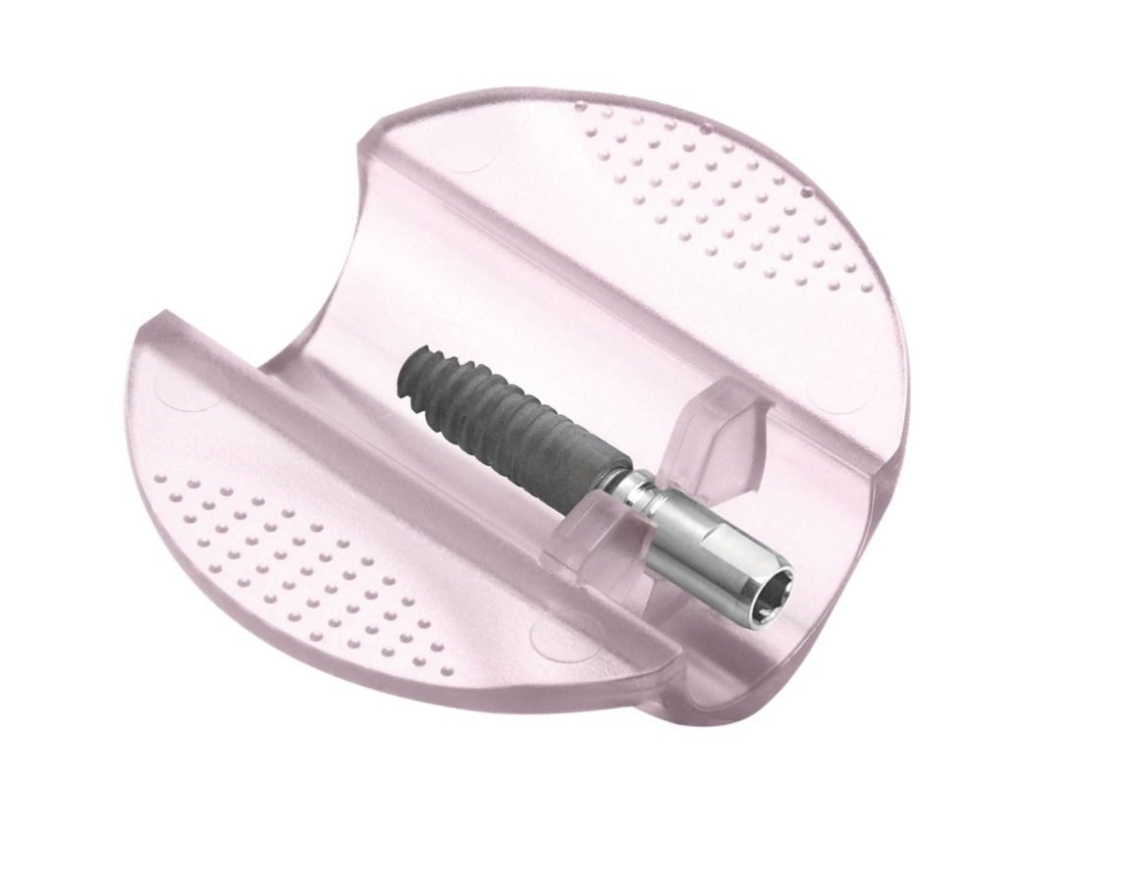
Implant packaging
Notes:
Packaging
All ANKYLOS® implants are supplied in double-sterile blister packaging inside a protective carton.
Implant holder
The implant holder “shuttle” holds the implant with the ANKYLOS® C/X implant with the placement head.
The implant holder can be safely transferred utilizing the three wings for holding it.

Slide 14
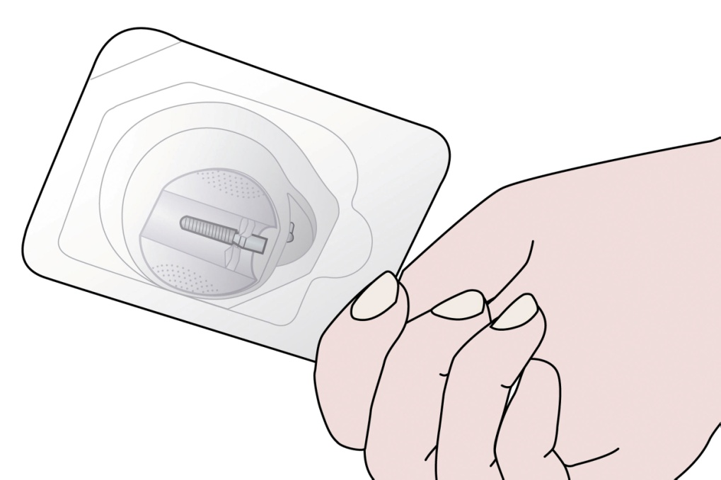
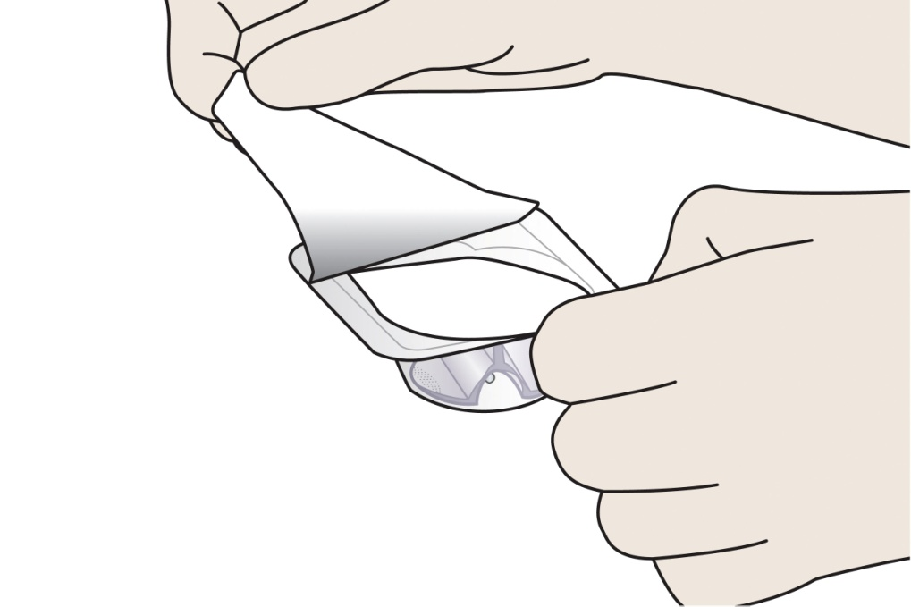
Implant removal from package
Outer sterile barrier
Inner sterile barrier
Notes:
Note: After preparation of the implant site, the implant packaging is opened outside of the sterile area and the sealing foil of the outer blister is removed.

Slide 15
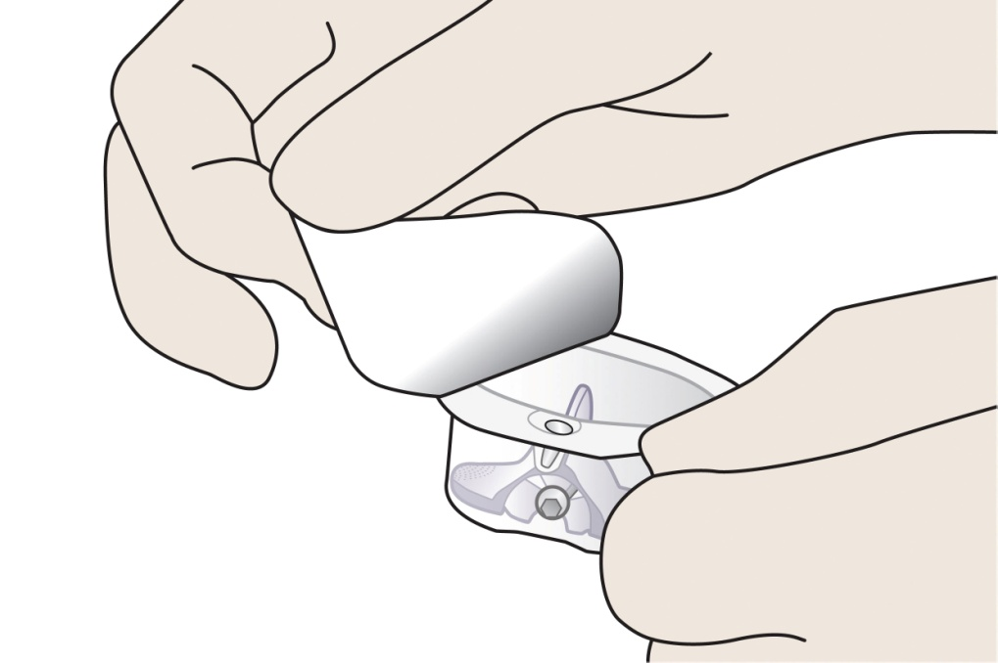
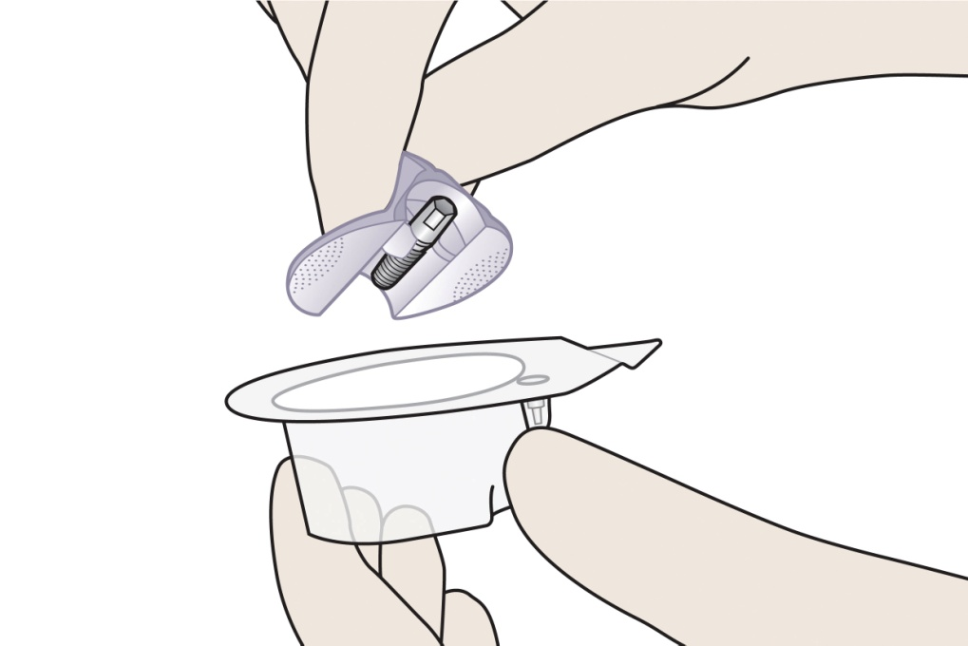
Implant removal from package
Transparent inner blister
Implant shuttle with the secured implant
Note: Keep the inner blister horizontal with the sealing foil upwards when opening and removing the implant shuttle to prevent the cover screw from falling out of the packaging.
Notes:
Transparent inner blister
This is the inner sterile packaging and contains the implant shuttle and cover screw. This area of the packaging also contains the peel-off label with batch number for accurate documentation in the patients records.
The inner blister should be removed under sterile conditions. Peel-off adhesive labels with the batch number are on the sealing foil of the inner blister for subsequent documentation in the patients file.
Implant shuttle with the secured implant
Protects the implant from damage.
Three wings with roughened surfaces for non-slip holding allows for an easy, no-contact transfer of the implant during surgical procedures.

Slide 16
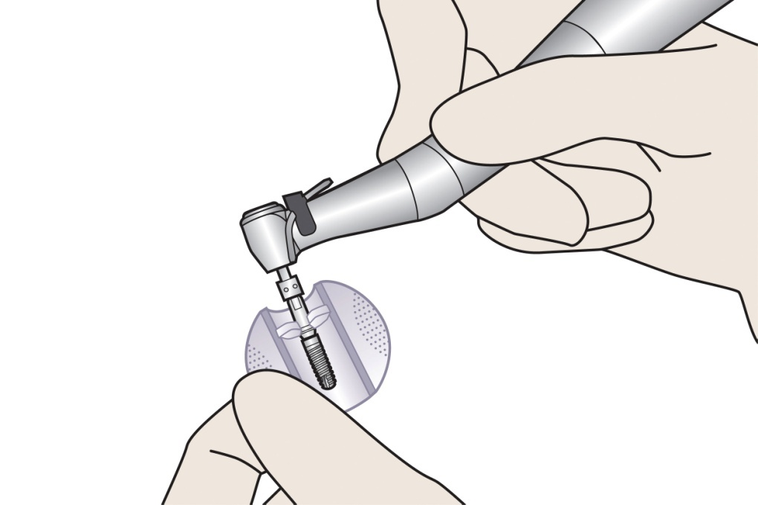
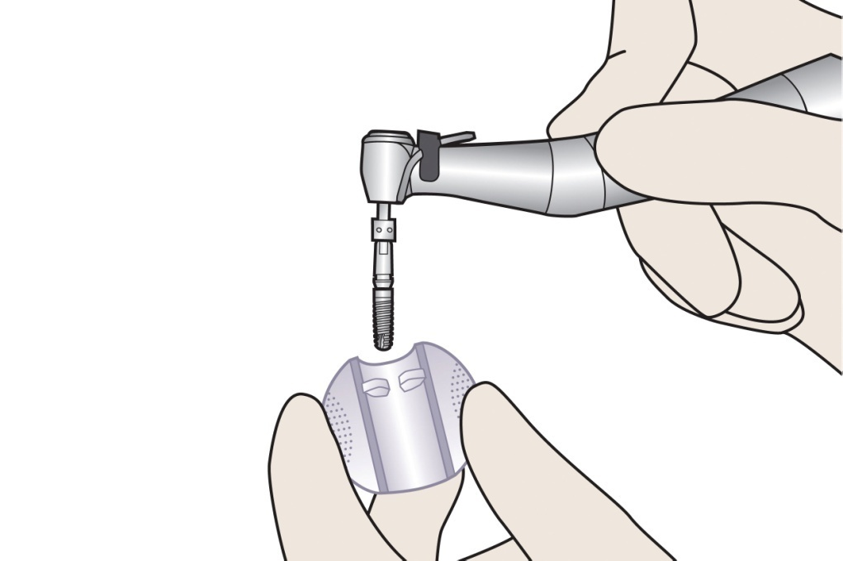
Implant removal from package
Implant insertion driver
Secure implant in the insertion driver and lift out of shuttle
Notes:
Attach the implant insertion driver to the placement head on the implant.
To remove the implant, push the implant driver into the placement head on the implant.
Secure the implant into the implant insertion driver to remove from the implant shuttle.
Slightly bend the parallel wings to release the implant from the shuttle.

Slide 17
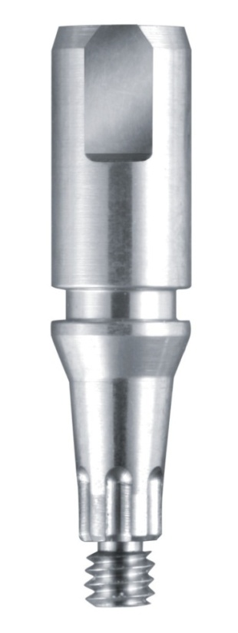
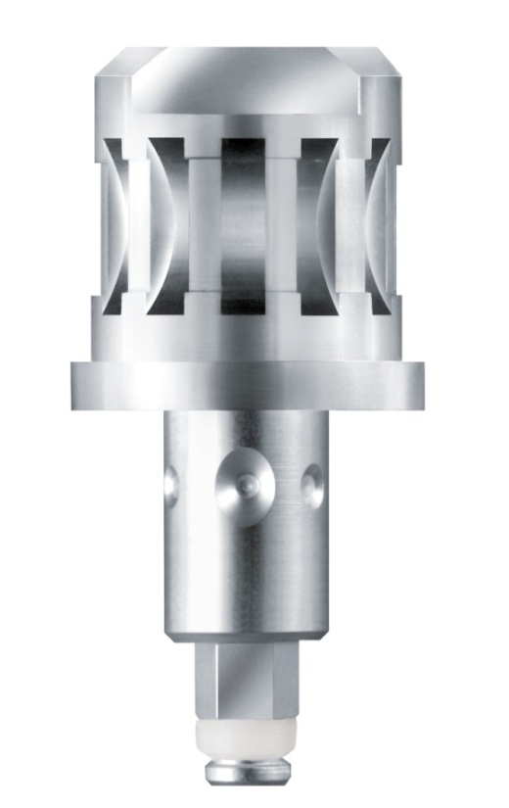
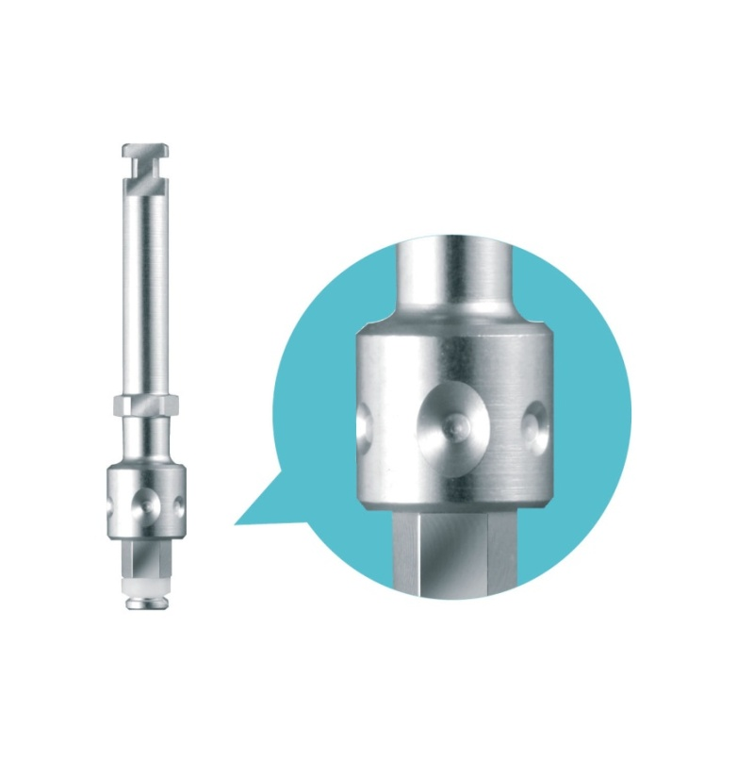
Implant insertion tools
Placement Head
Manual Driver
Motorized Driver
Notes:
Please note:
Circular indentations are milled on the implant driver. To use the indexed abutment components in the prosthetic restoration, note that one of the markings on the implant driver indicates the vestibular direction. If this is not taken into account, problems in the alignment of angled abutments may be encountered when using the positioning aid (index).
If the positioning aid will not be used, the implant depth alone must be monitored.
Please note:
The placement head for ANKYLOS® C/X implants does not fit in ANKYLOS® Plus implants. The placement head should be removed using a 1 mm hex driver.

Slide 18
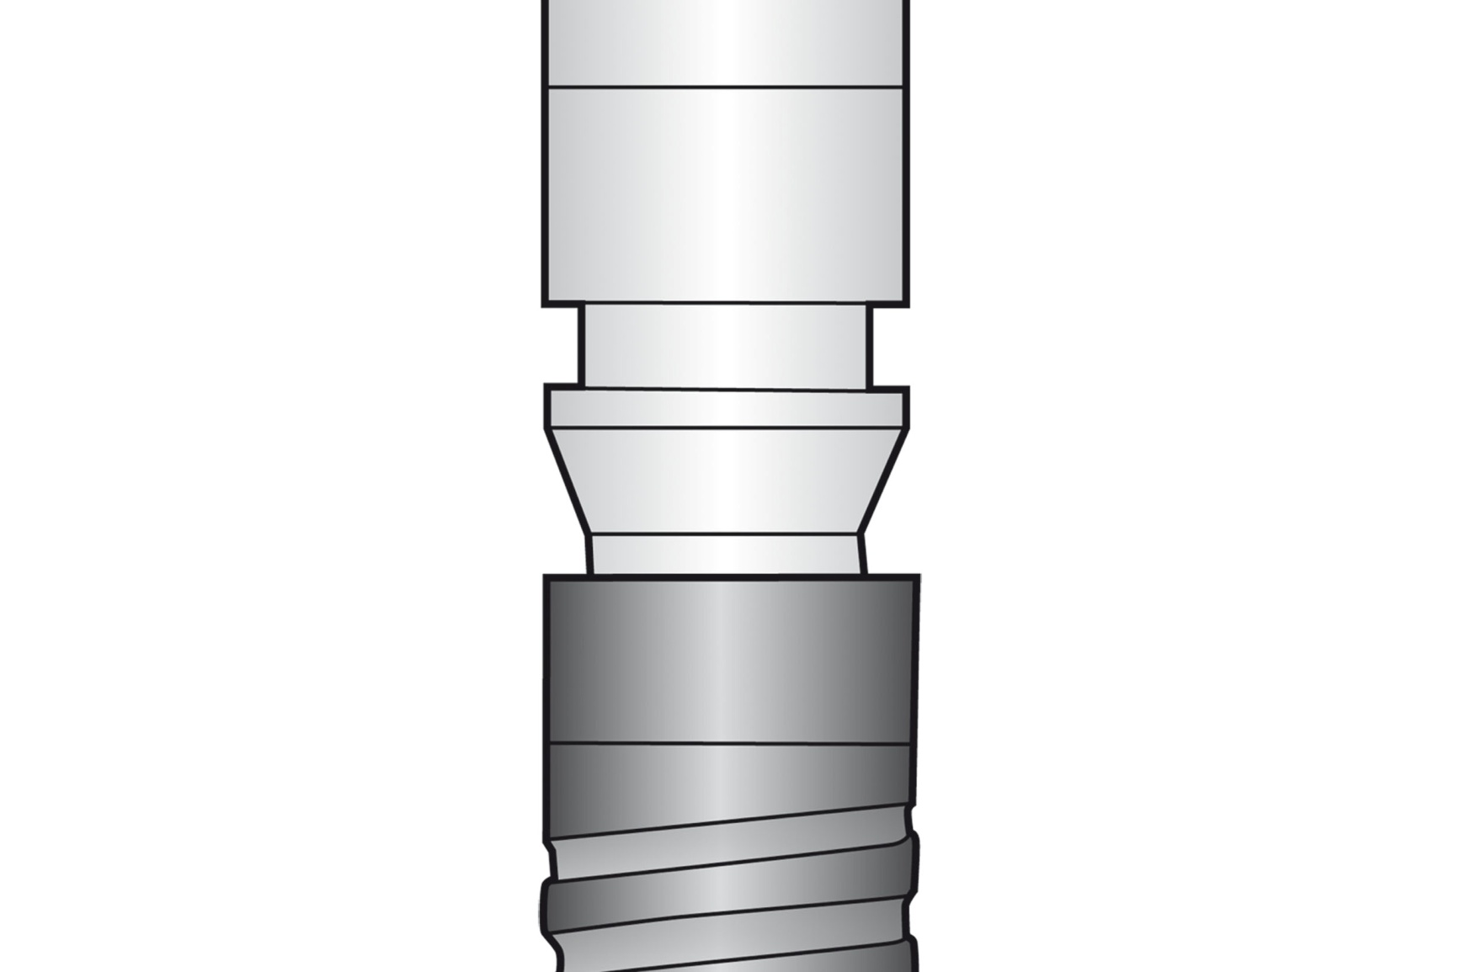
Implant placement head
3mm
Placement Head
1mm
Implant
Notes:
A step is located between the implant and the placement head to indicate the position of the implant shoulder.
The placement head is 3.4mm in diameter for all sizes of implants.

Slide 19
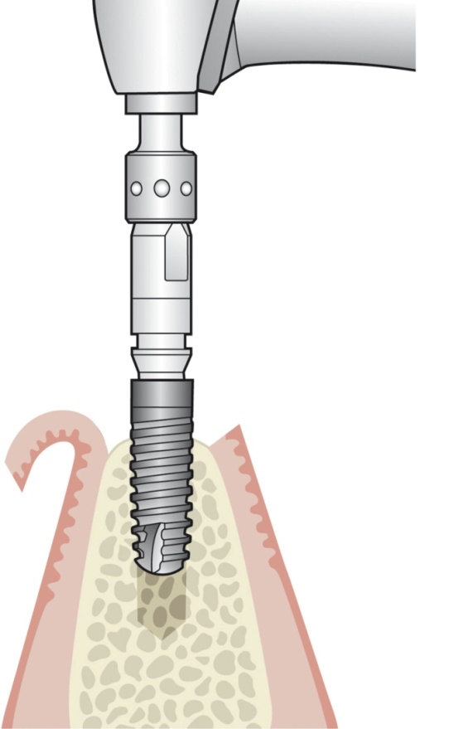
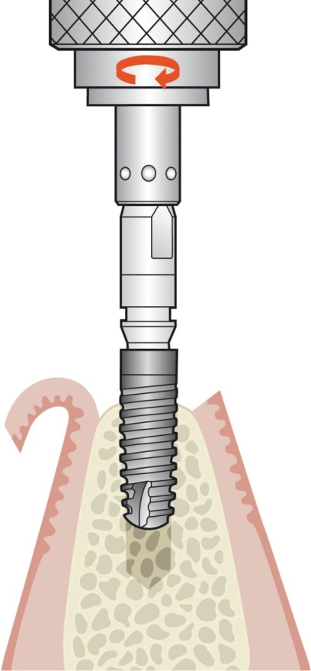
Implant insertion
Note: For both placement options, if the implant becomes difficult to screw before it reaches the final position, unscrew it and rinse or tap the implant site again.
Motorized
Manual
Notes:
An implant can be placed manually or using a motorized driver.
Placing the implant with the motorized driver
After the implant has been removed from the implant holder/shuttle with the motorized implant driver fixed in the contra-angle handpiece, it is screwed into the jaw bone.
The maximum speed is 15 rpm, the maximum torque is 50Ncm.
Placing the implant manually
The handle for the ratchet insert is attached to the implant driver of the desired length to remove the implant from the implant holder/shuttle.
The implant is screwed into the jawbone for about two-thirds of its length.

Slide 20
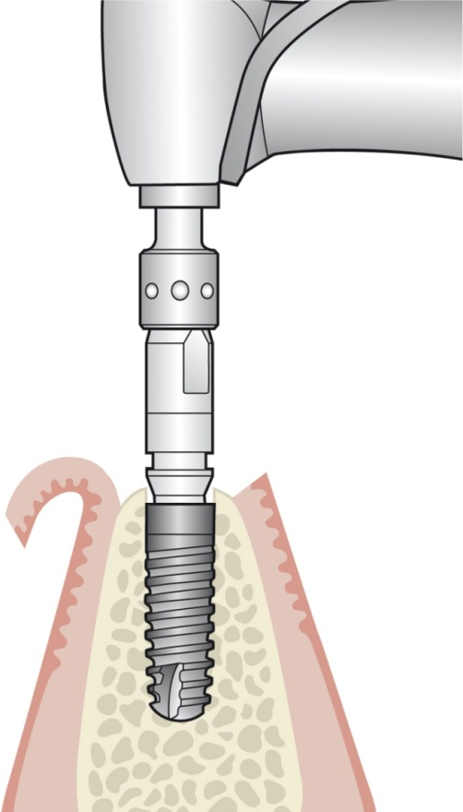
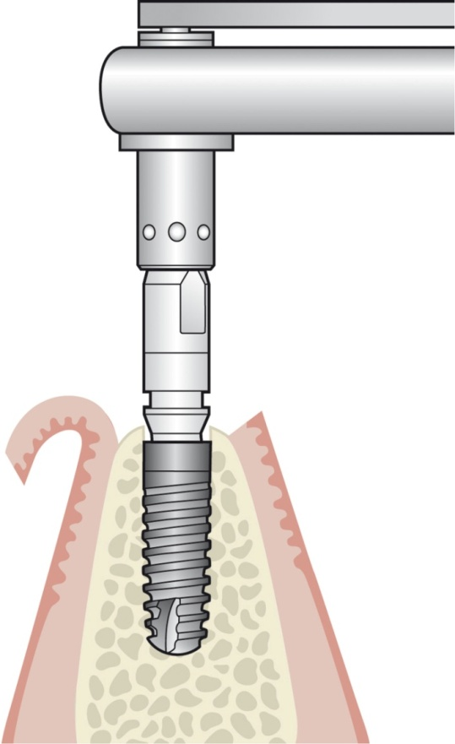
Final positioning - implant
Motorized
Manual
Notes:
For both manual and motorized drivers, the process of finalizing the implant position is the same. To use the indexed abutment in the prosthetic restoration, note that one of the markings on the implant driver indicates the vestibular direction. If the positioning aid will not be used, the implant depth alone must be monitored.

Slide 21
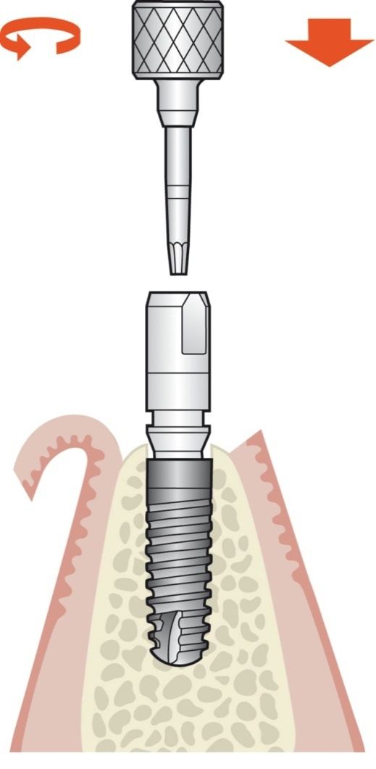
Placement head removal
Note: In soft bone, the placement head must be stabilized with the open-end wrench to prevent rotation of the implant during removal.
Notes:
When the implant has reached its final position, check that it is tightly seated, then remove the implant driver from the placement head.
After the implant driver has been removed, insert a 1 mm hex driver into the placement head and remove the placement head.
The retaining screw will loosen with the first turn of the 1 mm hex driver. With the second turn of the 1 mm hex driver, the retaining screw will push the placement head out of the implant.

Slide 22
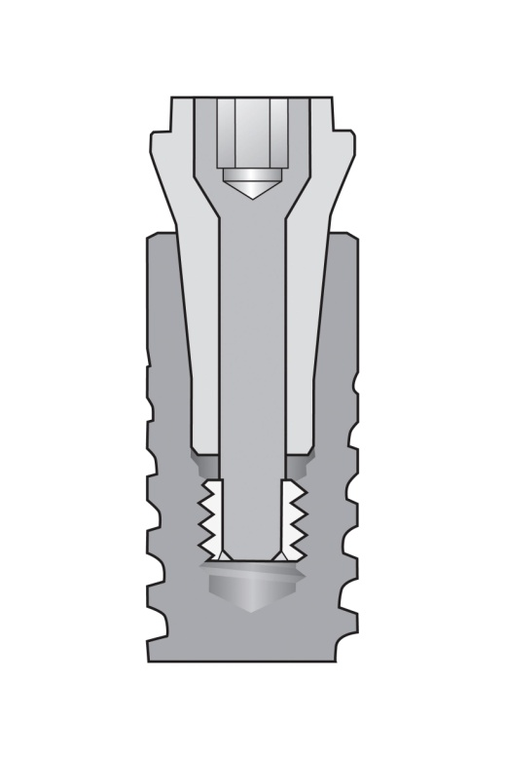
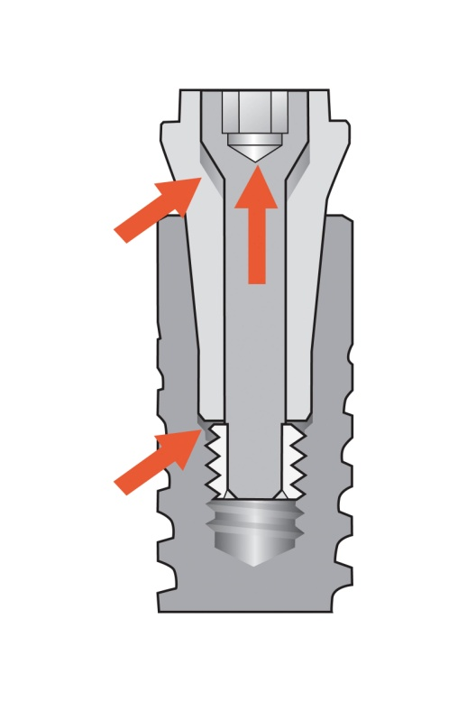
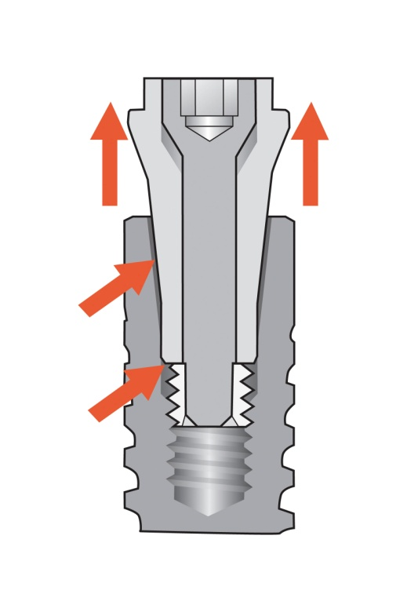
Disassembly of implant adapter
Placement head pre-mounted in the implant, retaining screw tightened.
Retaining screw pushes the placement head out of the implant.
Retaining screw loosened from implant using 1mm hex (approx. one full turn of hex driver)
Notes:
(third image)
You may feel that the screw has re-tightened at this point, this is due to the torque required to push the placement head out of the implant.

Slide 23
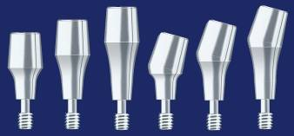
Abutment placement
Available in 4°, 5° or 6° retention values
Option of straight abutments or a variety of different angulations
Various sulcus heights
Notes:
Place SynCone® Abutments into implants.
SynCone® Abutments are available in 4°, 5° or 6° retention values, straight or 15 ° angulations (for the 5° abutment—angulations include 7.5°, 15°, 22.5°, and 30°) and various sulcus heights 1.5 mm, 3.0 mm, 4.5 mm
In the mandible, the recommended abutment selection:
High retention = four 6° Abutments
Higher retention = two 6° (Posterior) & two 4° (Anterior) Abutments
Highest = four 4° Abutments

Slide 24
Paralleling abutments
Insert clinical image here
Courtesy of…
Notes:
In cases where the implants are not aligned in a parallel axis, the 15º pre-angled SynCone® Abutments can be used to correct this non-parallelism (delayed loading ONLY).
The abutment parallelism can be checked and adjusted at this stage using the Paralleling Pins. As ANKYLOS® does not have any internal indexing, the abutments are able to rotate about the axis of the implant to produce a line of draw for the denture.

Slide 25
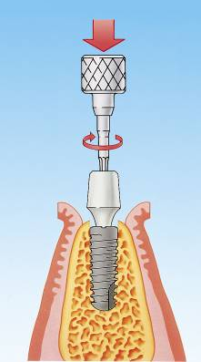
Abutment placement
Insert clinical image here
Courtesy of…
Notes:
Once the desired position of the abutments are confirmed, use the Prosthetic Ratchet Insert 1 mm hex to secure the abutments. The Prosthetic Ratchet Insert 1mm hex has a torque set at 15Ncm. The drive of this instrument will slip once 15Ncm has been achieved.
Note: All SynCone® Abutments and caps should be properly disinfected and sterilized prior to use.

Slide 26
Suturing
Insert clinical image here
Courtesy of…
Notes:
Carefully suture the edges of the wound to prevent saliva and microbial infiltration.

Slide 27
Preparation for polymerization
Insert clinical image here
Insert clinical image here
Courtesy of…
Notes:
Place the Polymerization Sleeves over the abutments. The Polymerization Sleeves are used to protect the wound and sutures during the polymerization phase and to protect against any polymerization material from getting into the abutments undercut creating a “lock-on” effect.

Slide 28
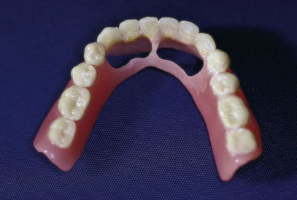
Preparation for polymerization
Notes:
In preparation of the denture for the polymerization phase, a window can be hollowed out in the denture to create a clearance between the denture and the SynCone® abutments/caps.

Slide 29
Polymerization
Insert clinical image here
Courtesy of…
Notes:
Conformation is required to ensure denture fit.

Slide 30
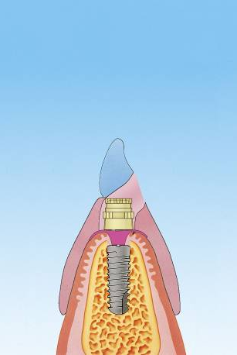
ANKYLOS® SynCone® Polymerization
The use of DENTSPLY Trubyte TRIAD DuaLine is recommended during polymerization.
Insert clinical image here
Insert clinical image here
Courtesy of…
Notes:
TRIAD DuaLine is a dual paste catalyst / base reline system dispensed from a cartridge. This is a self-cure and visible light-cure product which is available in different shades.
For specific product directions, consult DENTSPLY Trubyte and or the products directions for use.
To minimize the potential of denture fracture the denture lingual flange can be thickened for additional reinforcement.
After curing, the denture can be removed, excess material can be trimmed and the denture can now be polished.

Slide 31
Post surgical examination
Insert clinical image here
Insert clinical image here
Insert clinical image here
Courtesy of…
Notes:
After the polymerization, the trimmed and polished denture should be placed in the patient’s mouth, where it should remain for one week.
After one week, the doctor should conduct a postoperative examination with the patient to include a cleaning of the denture.
Two weeks after surgery (case-specific), a final postoperative examination should be conducted.
Regular examinations are required thereafter.
After surgery, advise the patient to:
Eat only soft foods for first 14 days after surgery – longer case specific
Continuously wear the denture for two weeks
Use anti-microbial mouthwash after meals
Use antibiotic prophylaxis for a week

Slide 32
Thank You

