Slide 1
DS PrimeTaper Images
See notes for each of the slides in the NOTES VIEW.
This material is divided into sections. Use only what is appropriate for the location of your presentation.
You should TRANSLATE from English to your local language.
You should ADD YOUR OWN CASES where appropriate.
Where official directions are offered, you must follow the manufacturer instructions (ON LABEL USAGE ONLY).
All materials are property of Dentsply Sirona or their original copyright holders.
DO NOT PUBLISH or transfer any slides, images or videos to any other person, institution or company.
Notes:
This presentation material is the property of Dentsply Sirona Implants.
The entire contents are copyright protected either by Dentspy Sirona or the original authors. This material is furnished only to pre-approved and pre-qualified trainers in order to prepare their own lectures and presentations. You, as an approved, individual presenter, can utilize any of the materials (pictures, animations, videos, logos etc… ) herein for your live presentations. These materials must not be copied, transferred, given or shared in any way given to any other parties or publishers.
Do not change any sequence or mode of use of any of the systems described herein.
The drilling protocol and surgical procedures are clinically tested and validated and part of the IFU, therefore any sequences must be demonstrated according to current manufacturer recommendations.
This presentation has been built in 16x9 aspect ratio. When re-formatting to your personal presentation look be careful not to distort any images if moving to a 4x3 screen size.
All video embedded is platform-independent. That means than any MP4 format material should play on both Windows (version 7 and later) and Mac systems.
Author: Dentsply Sirona Implants Clinical Affairs
Johanna Nilsson: Johanna.nilsson@dentsplysirona.com
Review date: August 2021

Slide 2
DS PrimeTaper 3D images Table of Contents
Implants Slide 2
Prosthetics Slide 7
Instruments Slide 15

Slide 3
3D images Implants
The DS PrimeTaper Implant line is available in different diameters and lengths. The color coding makes it easy to identify the correct connection and to select the right prosthetic components
 | 6.5 mm | 8 mm | 9 mm | 11 mm | 13 mm | 15 mm | 17 mm
Ø3.6
Ø4.2
Ø4.8
Ø5.4
Notes:
Images from DS PrimeTaperTM Surgical manual and product catalog (32671962-USX-2105)

Slide 4
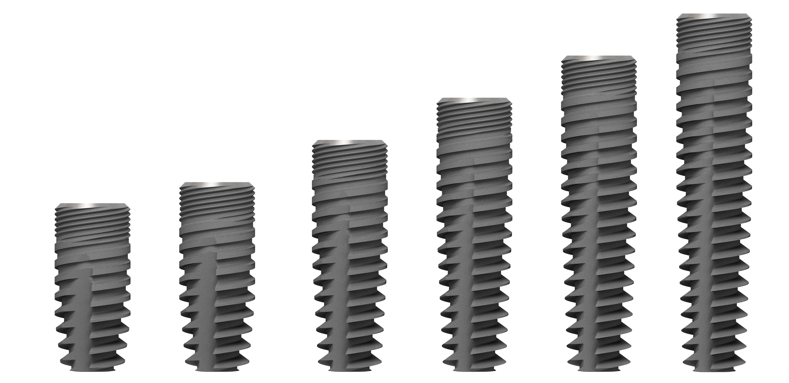
3D images Implants
Implant diameter 3,6 mm, all available lengths
32671962-USX-2105 DS PrimeTaperTM Surgical manual and product catalog
Notes:
Images from DS PrimeTaperTM Surgical manual and product catalog (32671962-USX-2105)

Slide 5
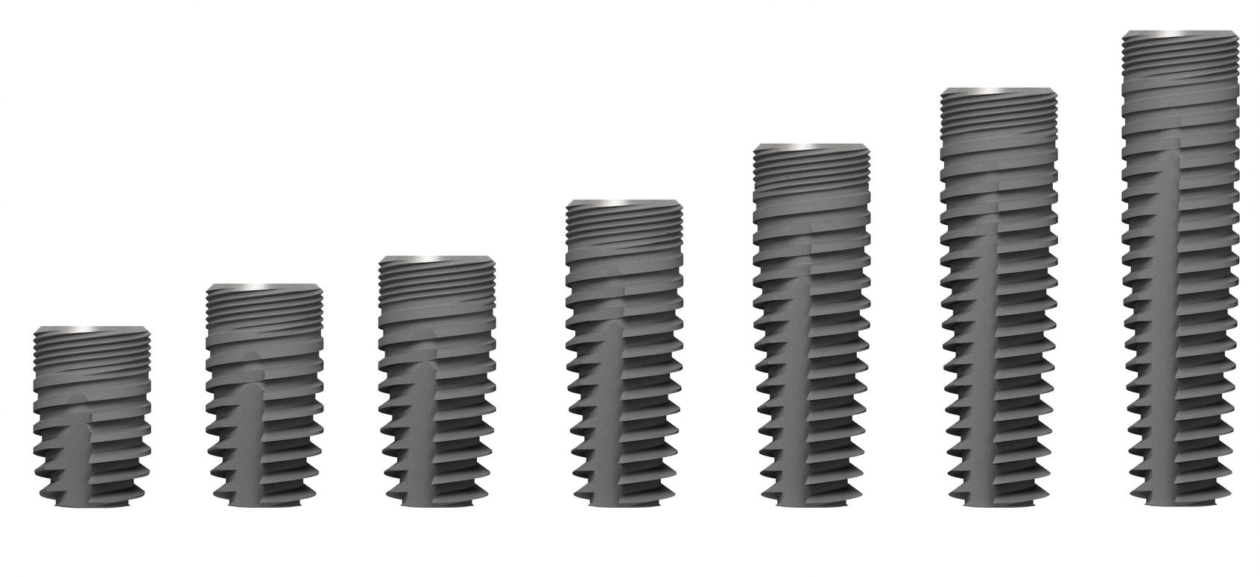
3D images Implants
Implant diameter 4,2 mm, all available lengths
32671962-USX-2105 DS PrimeTaperTM Surgical manual and product catalog
Notes:
Images from DS PrimeTaperTM Surgical manual and product catalog (32671962-USX-2105)

Slide 6
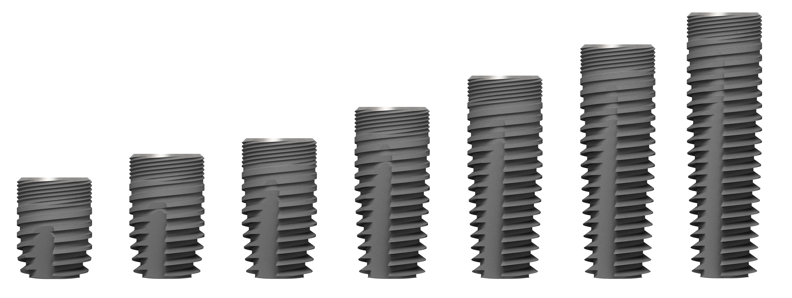
3D images Implants
Implant diameter 4,8 mm, all available lengths
32671962-USX-2105 DS PrimeTaperTM Surgical manual and product catalog
Notes:
Images from DS PrimeTaperTM Surgical manual and product catalog (32671962-USX-2105)

Slide 7
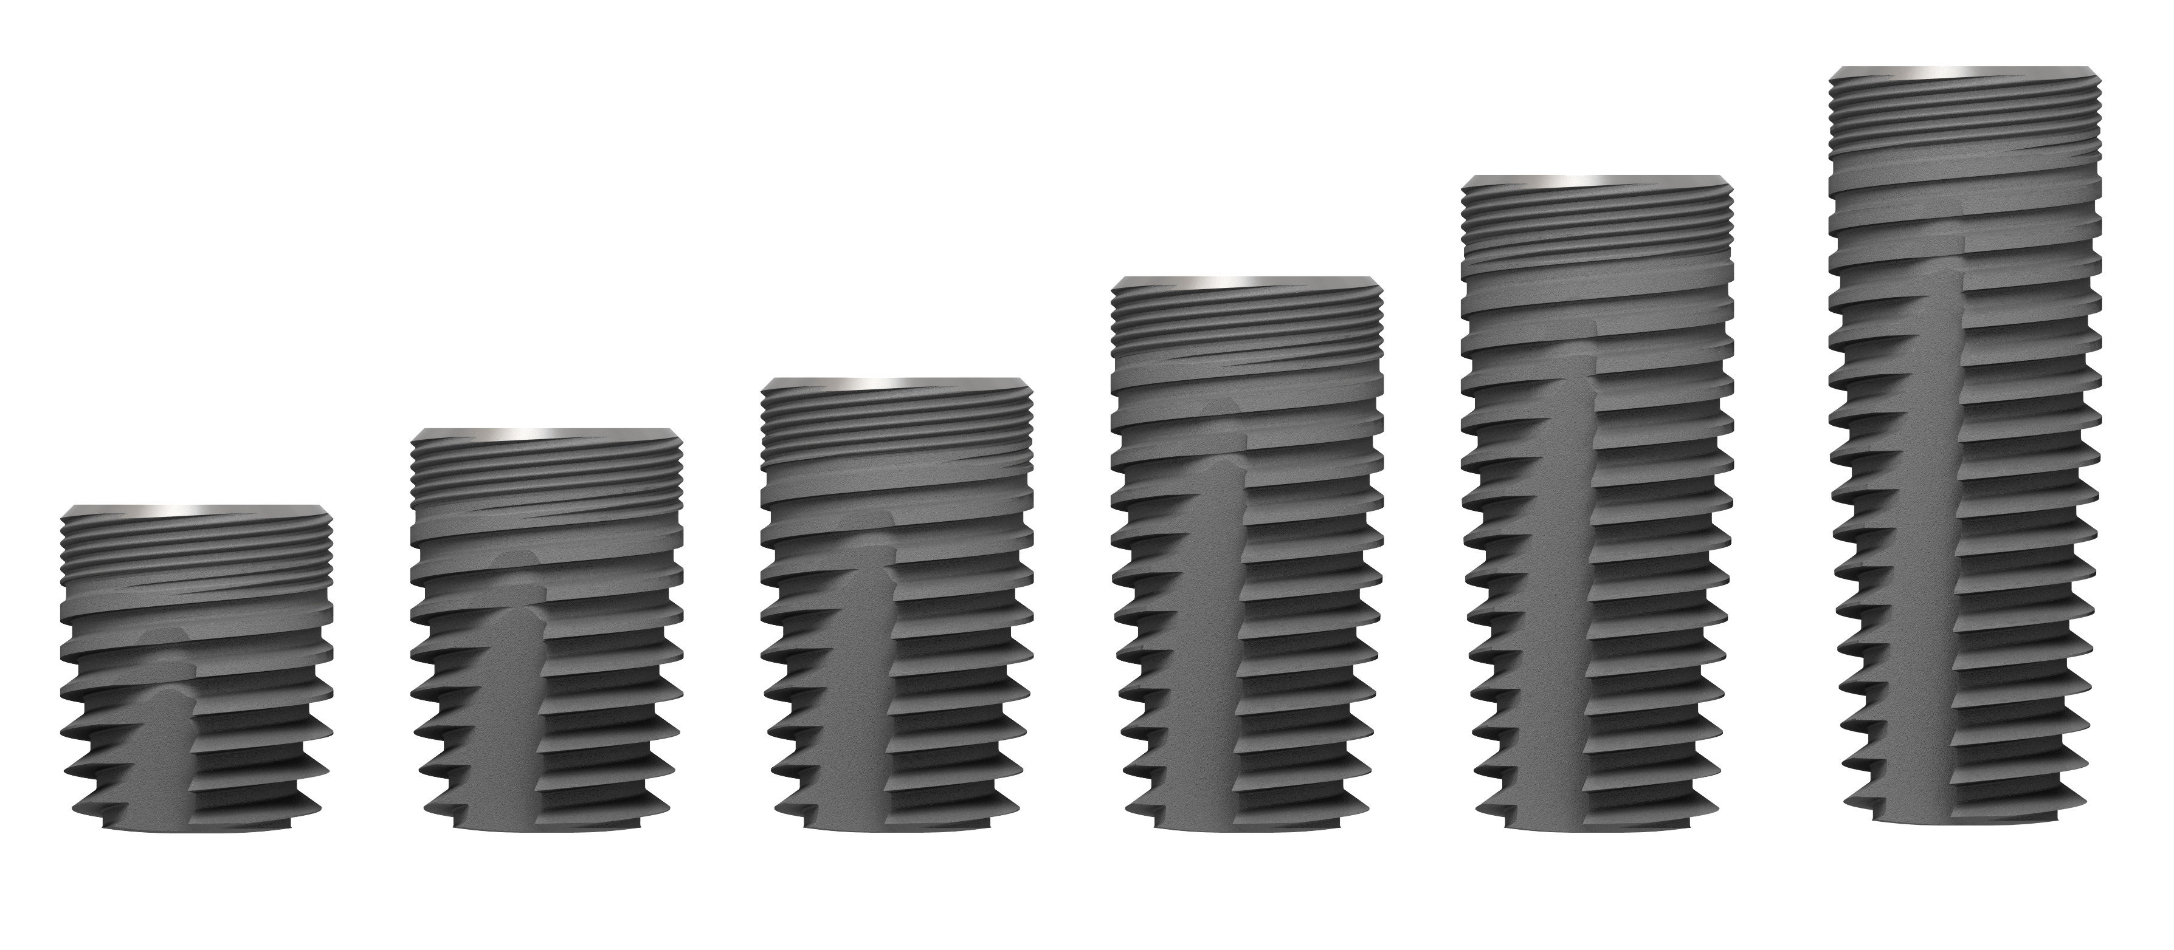
3D images Implants
Implant diameter 5,4 mm, all available lengths
32671962-USX-2105 DS PrimeTaperTM Surgical manual and product catalog

Slide 8
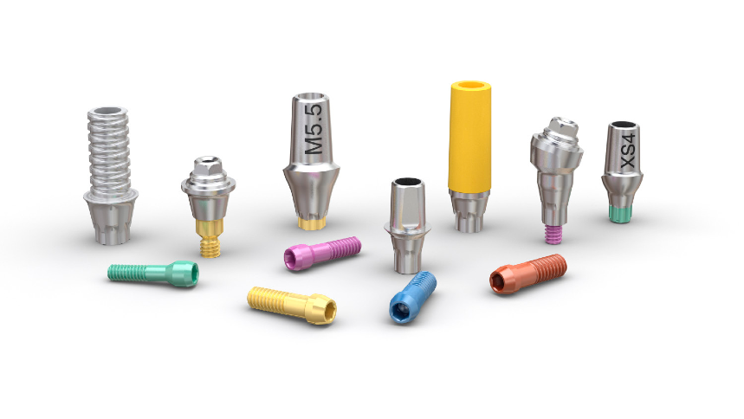
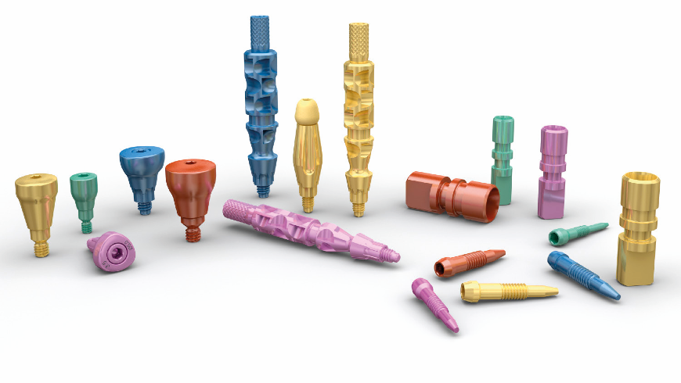
3D images Prosthetics
LAUNCH Q4 2021 ???
Color coding
Throughout the prosthetic assortment, markings, color coding and geometrical designs simplify the correct identification of the corresponding components.
Each implant-abutment connection size is identified by a specific color. The color is applied directly to components and instruments, as well as on packaging and information materials.
Stock components and their respective packagings are color coded:
Notes:
Images from Prosthetic manual_DS PrimeTaper presentation (32672079-USX-2107)

Slide 9
3D images Prosthetics
Implant Pick-Up EV Design
Titanium
Self-guiding impression component; only engages into the implant when correctly seated
One-hand procedure
Supports all indexing options; one-position-only, six position and non-indexed
Integrated pin for safe handling
Designed for splinting possibilities
Color coded
Implant Transfer EV
Titanium
Self-guiding impression component; only engages into the implant when correctly seated
One-hand procedure
Supports all indexing options; one-position-only, six positions and non-indexed
Color coded
Notes:
Images from Prosthetic manual_DS PrimeTaper presentation (32672079-USX-2107)

Slide 10
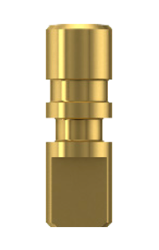
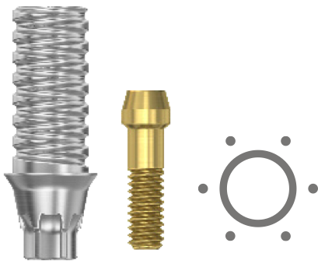
3D images Prosthetics
Implant Analog EV
Titanium
Color coded
Lab Abutment Screw EV
Titanium
Primarily used at the laboratory by the dental technician
Fits only into the implant analog
Guide tip supports efficient handling
Color coded
TempAbutment EV
Titanium
Designed for build-up technique
Designed for long-term temporary restorations
Color-coded abutment screw
Notes:
Images from Prosthetic manual_DS PrimeTaper presentation (32672079-USX-2107)

Slide 11
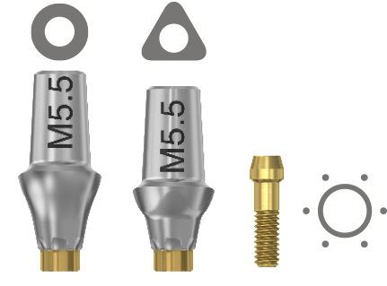
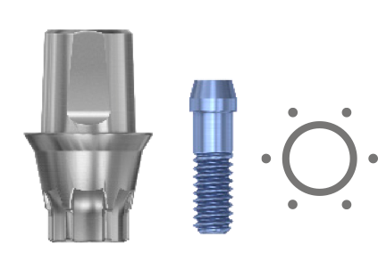
3D images Prosthetics
TiDesign EV
Titanium
Round – designed for the majority of tooth shapes
Triangular – primarily for incisors and canines with distinct triangular shape
Angled – for offset situations both in the anterior and posterior regions, compensating for implants with a restorative unfavorable angulation
Color-coded abutment and abutment screw
TitaniumBase EV
Titanium
TitaniumBase is provided with two flattened sides forming an anti-rotational feature
Color-coded abutment screw
Notes:
Images from Prosthetic manual_DS PrimeTaper presentation (32672079-USX-2107)

Slide 12
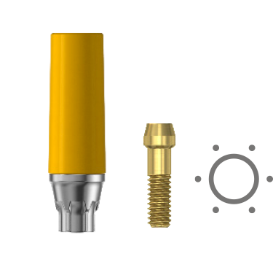
3D images Prosthetics
CastDesign EV
Gold-platinum alloy with POM plastic
Color-coded plastic sleeve and abutment screw
Notes:
Images from Prosthetic manual_DS PrimeTaper presentation (32672079-USX-2107)

Slide 13
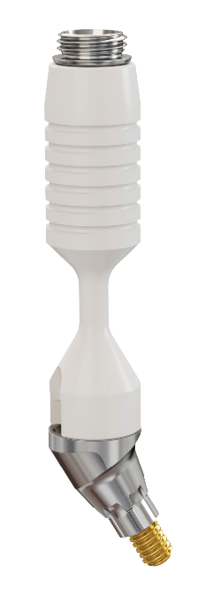
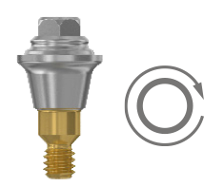
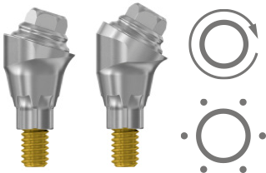
3D images Prosthetics
MultiBase Abutment EV, straight
Titanium with a PEEK plastic holder
One-piece abutment
Non-indexed abutments can be seated in any rotational position
PEEK holder has eight identification grooves
MultiBase Abutment EV, 17°/30°
Titanium with a PEEK plastic holder
Consists of three parts; abutment body, delivered with a pre-assembled abutment screw and a separate head part
Indexed abutments can be seated in six different positions
Non-indexed abutments can be seated in any rotational position
PEEK holder on 17° abutment has four identification grooves
PEEK holder on 30° abutment has six identification grooves
Abutment head
Holder
Abutment body
Abutment screw
Notes:
Images from Prosthetic manual_DS PrimeTaper presentation (32672079-USX-2107)

Slide 14
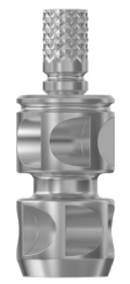
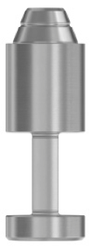
3D images Prosthetics
MultiBase Temporary Cylinder
Titanium
Designed to support both occlusal and lateral forces
MultiBase Lab Bridge Screw
Titanium
MultiBase Lab Abutment Pin
Stainless steel
MultiBase Pick-Up
Stainless Steel
Two-piece pick-up, with a pronounced groove for splinting possibility
MultiBase Analog
Stainless steel
Single-use
Notes:
Images from Prosthetic manual_DS PrimeTaper presentation (32672079-USX-2107)

Slide 15
3D images Instruments
Guide Drill
Used to mark a starting point
Precision Drill
Used to mark a starting point
Note: The Precision Drill is an extremely sharp drill for single use only. Once out of its package it should never be handled manually or placed on the tray.
Notes:
Images from PrimeTaper Surgical manual presentation (32672050-USX-2106)

Slide 16
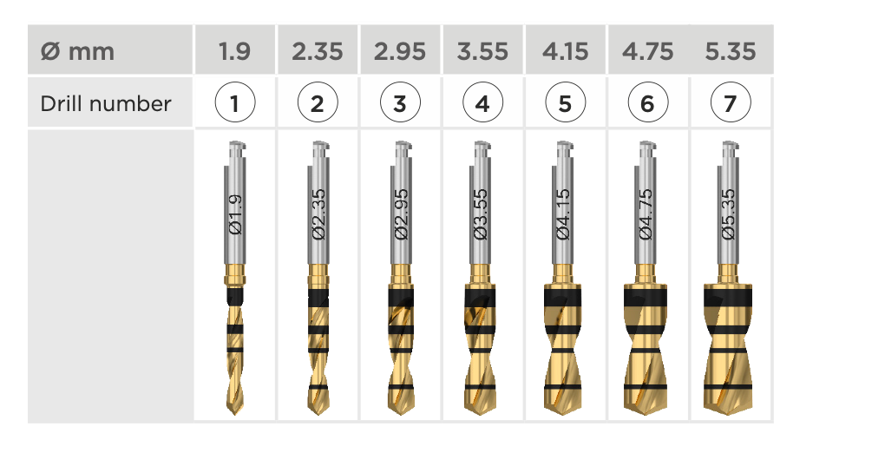
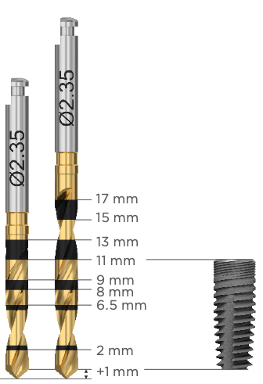
3D images Instruments
PrimeTaper Drills
For implant site preparation up to the planned implant diameter
Depth marked
Multiple use with option for single use
Marked with the respective diameters and numbers (1-7)
Available in two lengths:
Drill long
6.5-17 mm
Drill short
6.5-13 mm
PrimeTaper EV Ø4.2 x 11 mm
Notes:
Images from PrimeTaper Surgical manual presentation (32672050-USX-2106)

Slide 17
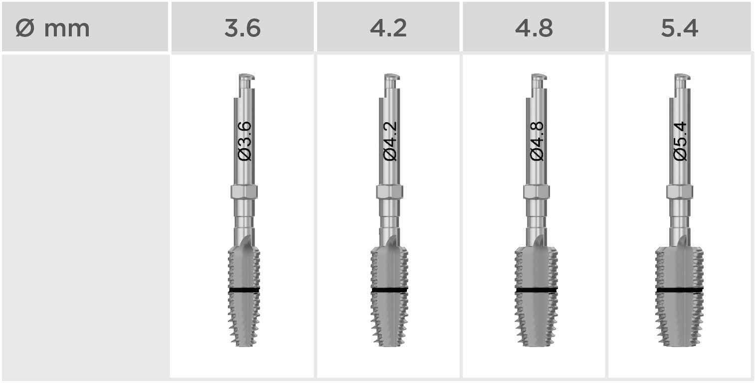
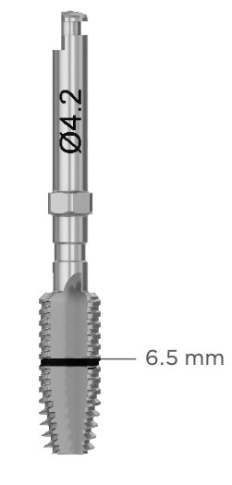
3D images Instruments
PrimeTaper Taps
For very dense bone preparation
Depth marked 6.5 mm
Multiple use with option for single use
Notes:
Images from PrimeTaper Surgical manual presentation (32672050-USX-2106)

Slide 18
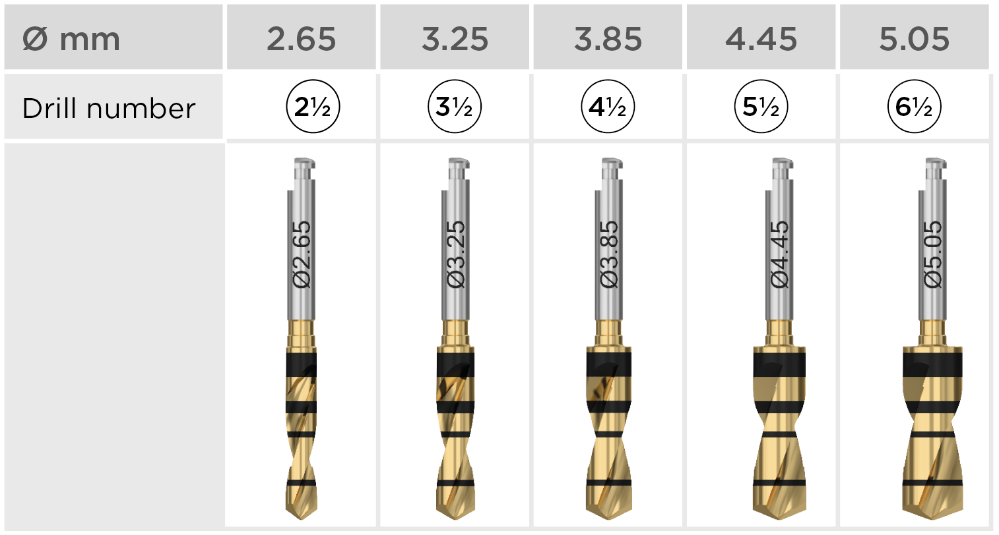
3D images Instruments
Intermediate drills
Intermediate twist drills for fine-tuning the diameter of the osteotomy
Depth marked
Multiple use with option for single use
Marked with the respective diameters
Available in two lengths
Notes:
Images from PrimeTaper Surgical manual presentation (32672050-USX-2106)

Slide 19
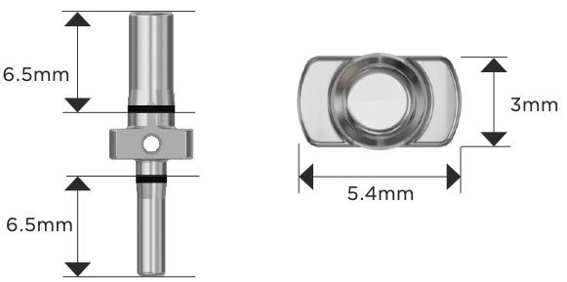
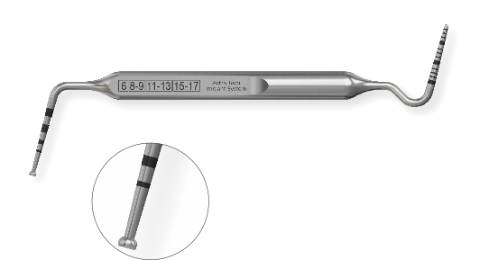
3D images Instruments
PrimeTaper Direction indicator
Used after drill 1 and drill 3
Used for visualizing the position and direction of the prepared osteotomy and for measuring the space between osteotomies.
Implant Depth Gauge
Used for measuring the depth of the implant site
Markings correspond to the implant lengths
The other end of the gauge can be used as a
measuring probe.
Note: The 6.5 mm marking is not indicated on the shaft.
Instrument Extender
Used for extending the length of a drill or implant driver
Ensure sufficient irrigation when using the extender
Notes:
Images from PrimeTaper Surgical manual presentation (32672050-USX-2106)

Slide 20
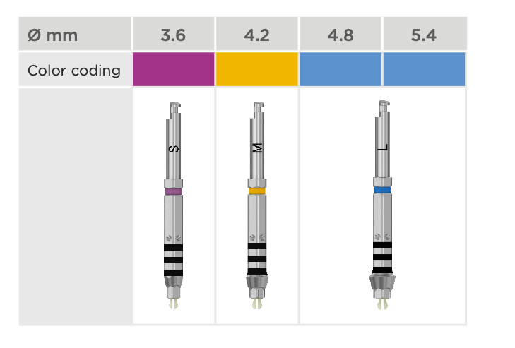
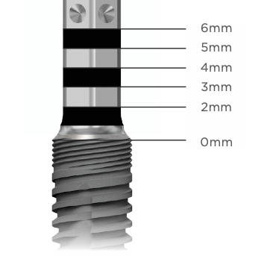
3D images Instruments
Implant drivers
The implant drivers can be used with a contra angle or with a surgical driver handle and a torque wrench.
Implant Driver EV
For implant installation
Color-coded and depth marked
Available in short and long
The reference point (“0”) of the depth markings is the intended bone level, i.e., the lowest point of the bone level.
To facilitate optimal placement of pre-designed abutments, align one of the dots buccally.
Notes:
Images from PrimeTaper Surgical manual presentation (32672050-USX-2106)

Slide 21
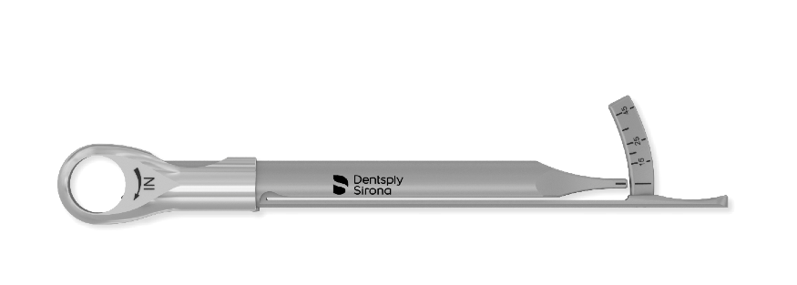
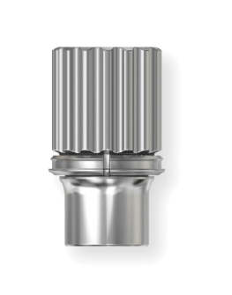
3D images Instruments
Torque wrench
Torque Wrench EV
For implant installation and adjustment of the implant position
Used together with the surgical driver handle
Torque Wrench EV Surgical Driver Handle
Used together with the torque wrench
Notes:
Images from PrimeTaper Surgical manual presentation (32672050-USX-2106)

Slide 22
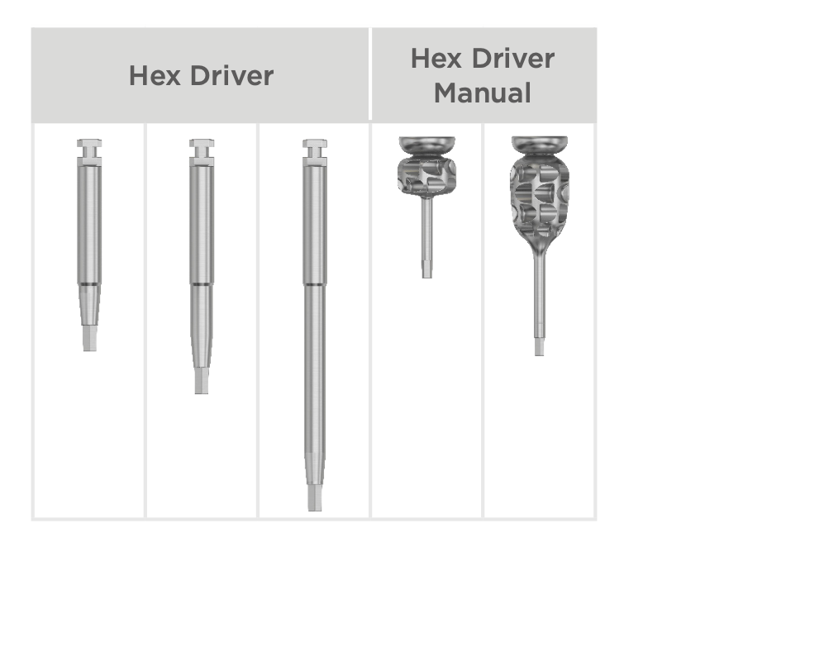
3D images Instruments
Hex drivers
Used for tightening screws, surgical and restorative components
Notes:
Images from PrimeTaper Surgical manual presentation (32672050-USX-2106)

Slide 23
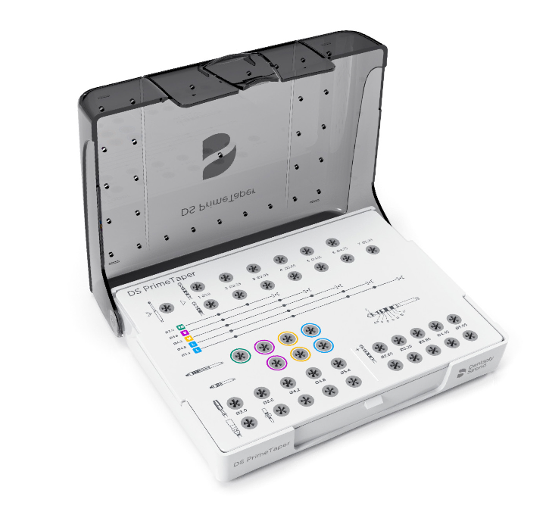
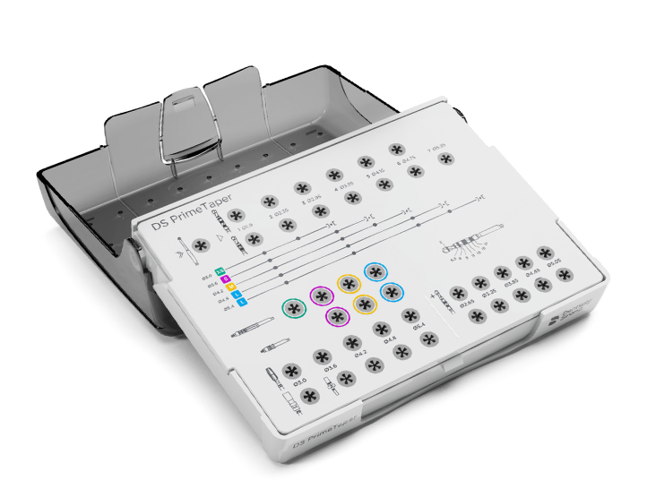
3D images Instruments
Surgical tray
All instruments for surgical use are stored in the PrimeTaper Surgical Tray, which is designed to make all instruments easily accessible.
Notes:
Images from PrimeTaper Surgical manual presentation (32672050-USX-2106)

Slide 24
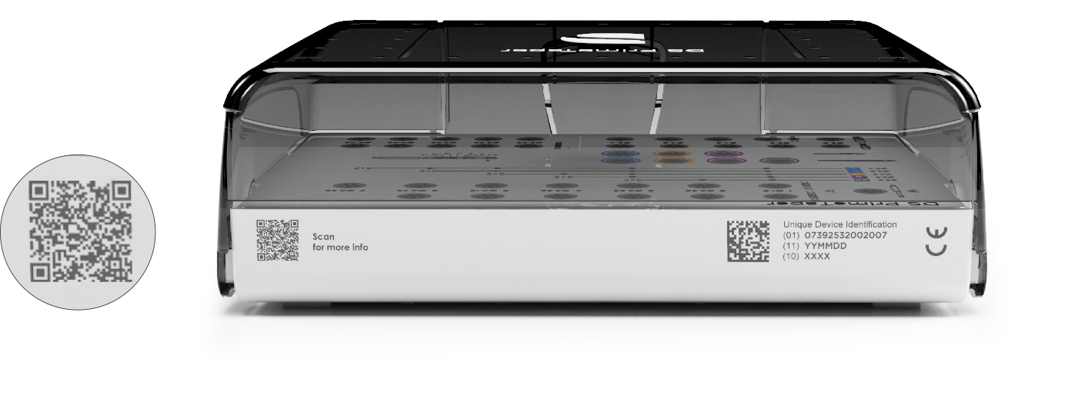
3D images Instruments
QR code for additional information about the surgical tray.
Notes:
Images from PrimeTaper Surgical manual presentation (32672050-USX-2106)

Slide 25
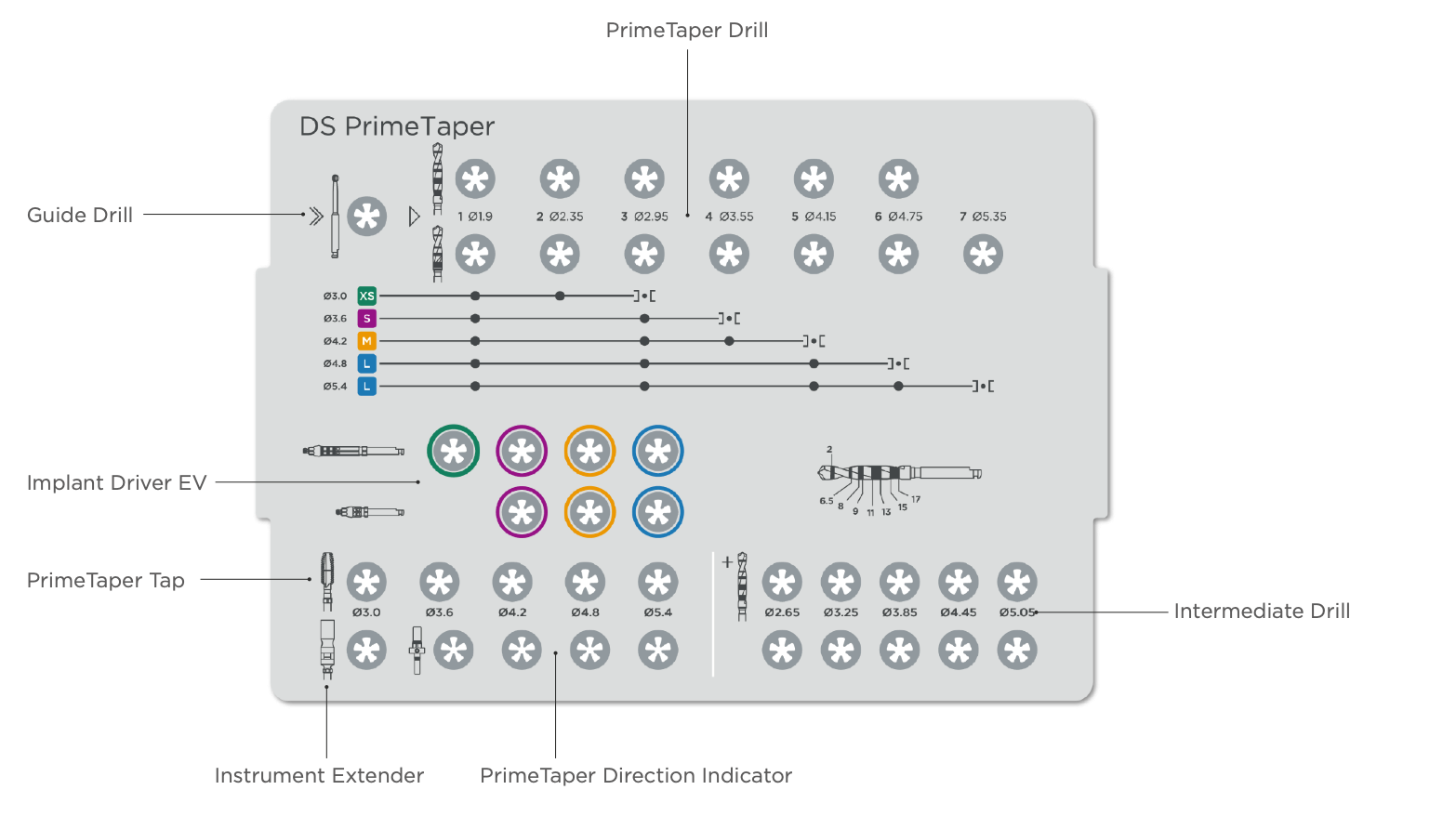
3D images Instruments
Notes:
Images from PrimeTaper Surgical manual presentation (32672050-USX-2106)

Slide 26
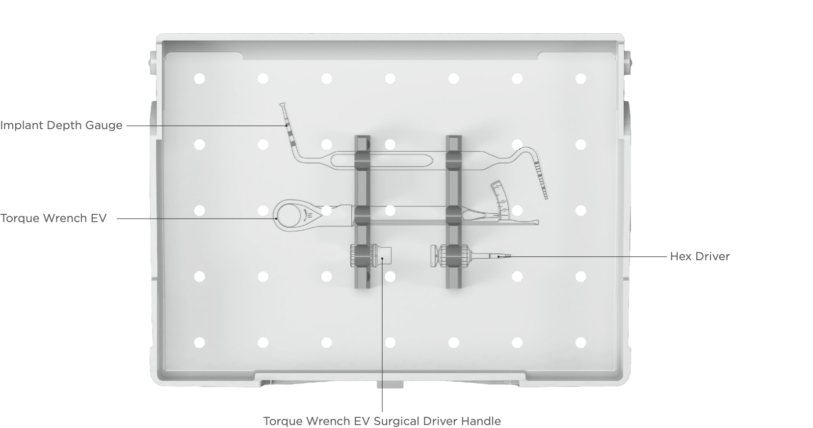
3D images Instruments
Notes:
Images from PrimeTaper Surgical manual presentation (32672050-USX-2106)

